Slide 1
ELECTRIC FIELDS DUE TO CONTINUOUS CHARGE DISTRIBUTIONS –
SURFACE CHARGE

Slide 2
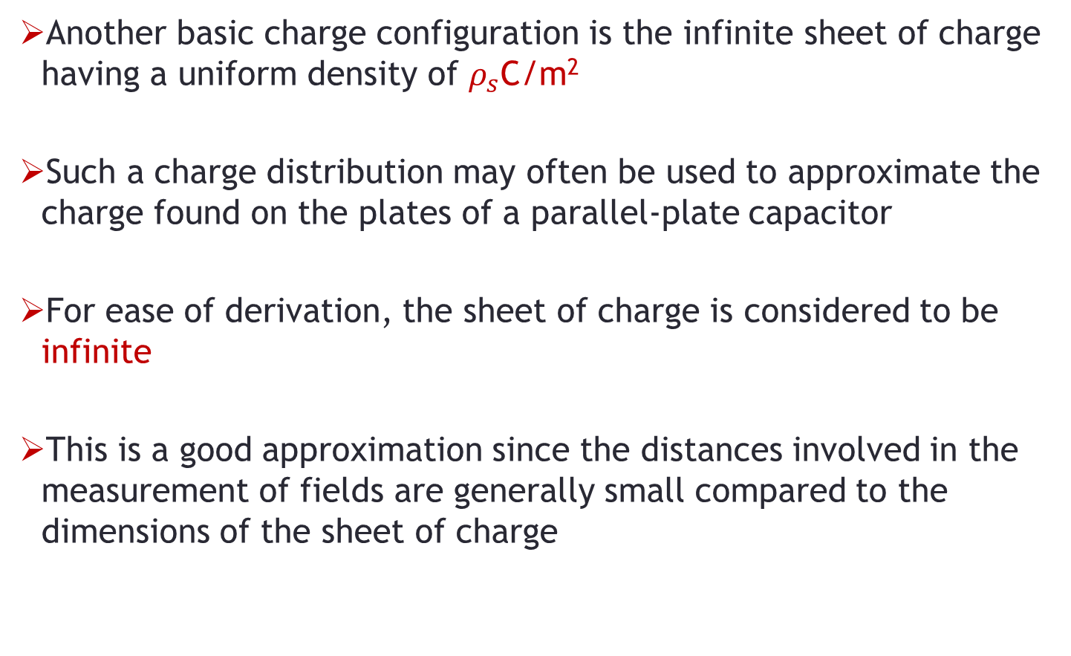
Introduction
Another basic charge configuration is the infinite sheet of charge having a uniform density of $ρ_{s}$C/m²
Such a charge distribution may often be used to approximate the charge found on the plates of a parallel-plate capacitor
For ease of derivation, the sheet of charge is considered to be infinite
This is a good approximation since the distances involved in the measurement of fields are generally small compared to the dimensions of the sheet of charge

Slide 3
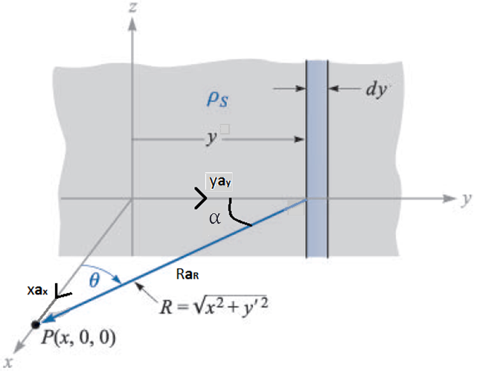
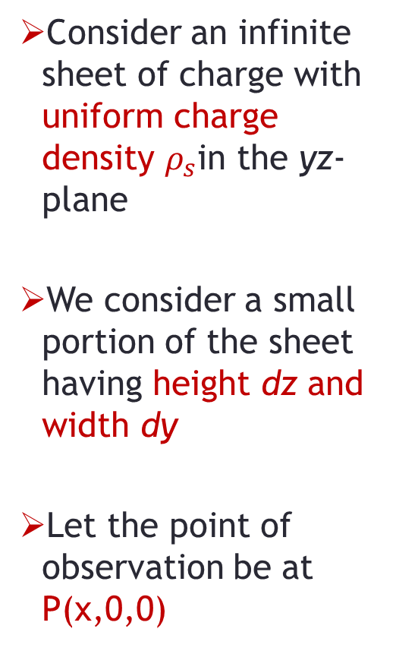
Sheet of Charge
Consider an infinite sheet of charge with uniform charge density $ρ_{s}$in the yz-plane
We consider a small portion of the sheet having height dz and width dy
Let the point of observation be at P(x,0,0)

Slide 4
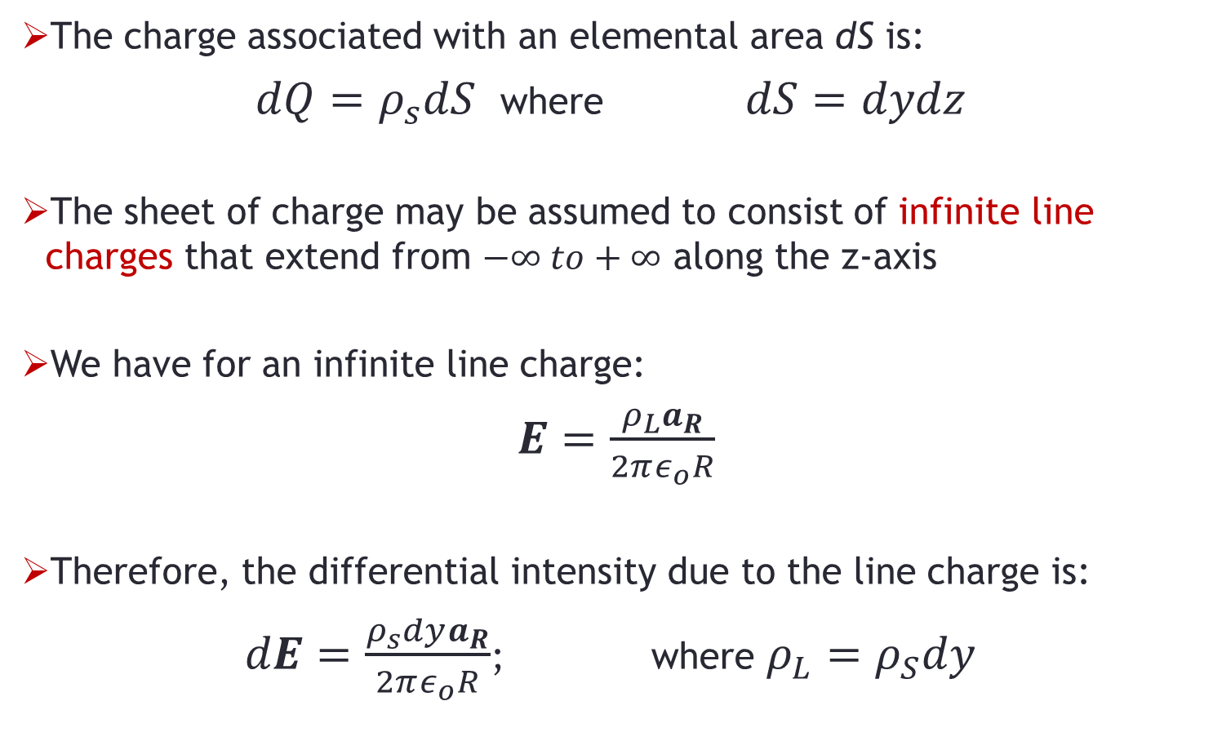
Sheet of Charge
The charge associated with an elemental area dS is:
$dQ=ρ_{s}dS$ where $dS=dydz$
The sheet of charge may be assumed to consist of infinite line charges that extend from $−∞ to+∞$ along the z-axis
We have for an infinite line charge:
$E=\frac{ρ_{L}a_{R}}{2πε_{o}R}$
Therefore, the differential intensity due to the line charge is:
$dE=\frac{ρ_{s}dya_{R}}{2πε_{o}R}$; where $ρ_{L}=ρ_{S}dy$

Slide 5
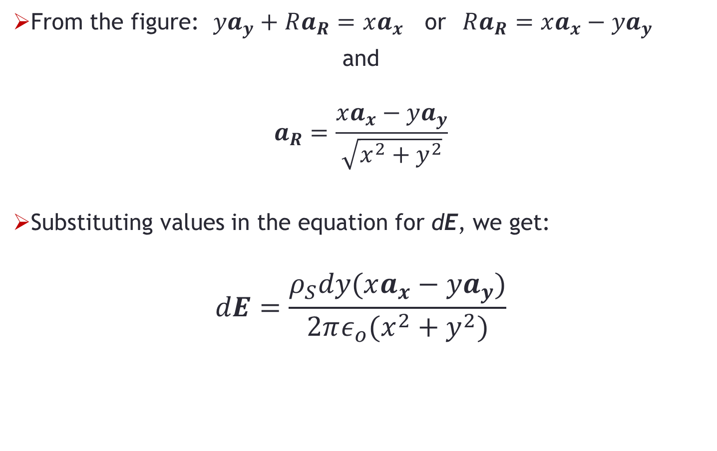
Sheet of Charge
From the figure: $ya_{y}+Ra_{R}=xa_{x}$ or $Ra_{R}=xa_{x}−ya_{y}$
and
$$a_{R}=\frac{xa_{x}−ya_{y}}{\sqrt{x^{2}+y^{2}}}$$
Substituting values in the equation for dE, we get:
$$dE=\frac{ρ_{S}dy(xa_{x}−ya_{y})}{2πε_{o}(x^{2}+y^{2})}$$

Slide 6
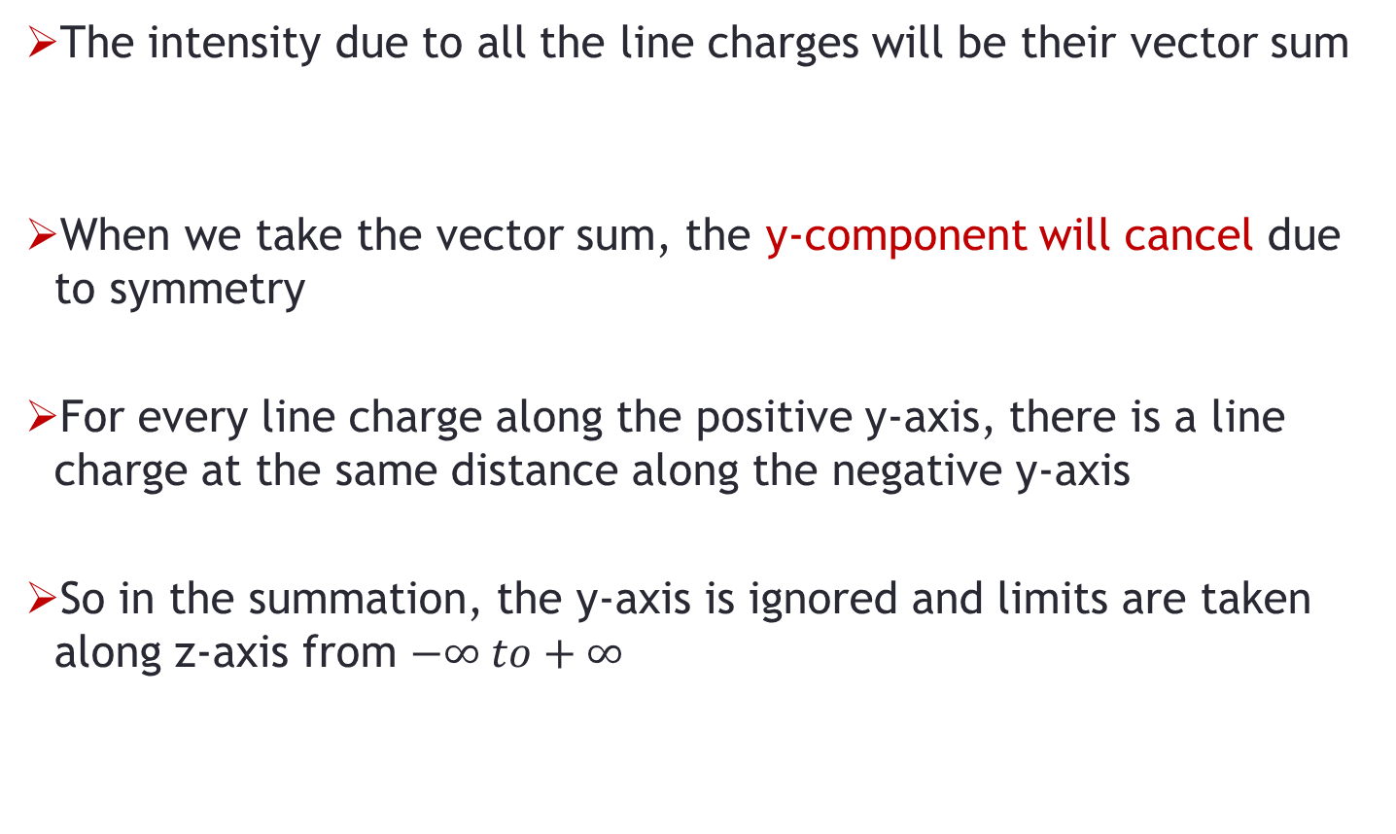
Sheet of Charge
The intensity due to all the line charges will be their vector sum
When we take the vector sum, the y-component will cancel due to symmetry
For every line charge along the positive y-axis, there is a line charge at the same distance along the negative y-axis
So in the summation, the y-axis is ignored and limits are taken along z-axis from $−∞ to+∞$

Slide 7
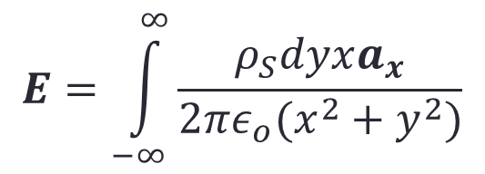
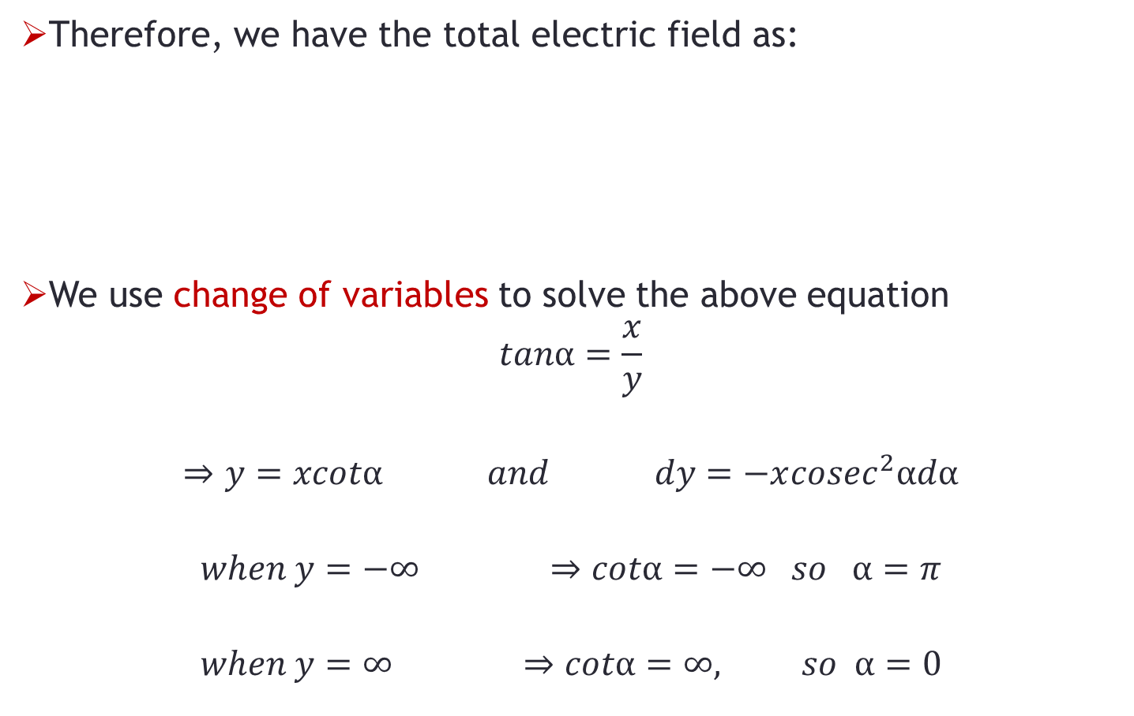
Sheet of Charge
Therefore, we have the total electric field as:
We use change of variables to solve the above equation
$$tanα=\frac{x}{y}$$
$$⇒y=xcotα and dy=−x{cosec}^{2}αdα$$
$$when y=−∞ ⇒cotα=−∞ so α=π$$
$$when y=∞ ⇒cotα=∞, so α=0$$
$$E=\int_{−∞}^{∞}{\frac{ρ_{S}dyxa_{x}}{2πε_{o}(x^{2}+y^{2})}}$$

Slide 8
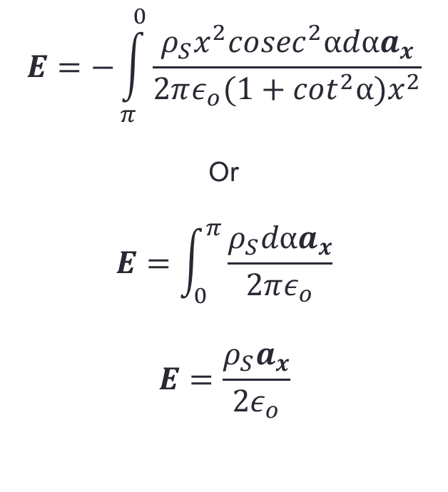
Sheet of Charge
$$E=−\int_{π}^{0}{\frac{ρ_{S}x^{2}{cosec}^{2}αdαa_{x}}{2πε_{o}(1+\cot^{2}α)x^{2}}}$$
Or
$$E=\int_{0}^{π}{\frac{ρ_{S}dαa_{x}}{2πε_{o}}}$$
$$E=\frac{ρ_{S}a_{x}}{2ε_{o}}$$
So, we get:
We see that for an infinite sheet of charge, the intensity does not depend upon any coordinate
So if we take P anywhere, the intensity will remain the same but the direction will change

Slide 9
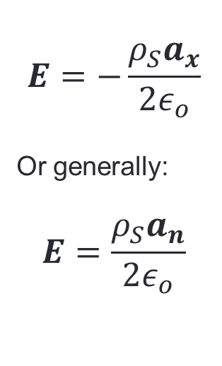
Sheet of Charge
If the point of observation is located at the back of the sheet, then we have:
Where a_{n} is a vector normal to the sheet
$$E=−\frac{ρ_{S}a_{x}}{2ε_{o}}$$
Or generally:
$$E=\frac{ρ_{S}a_{n}}{2ε_{o}}$$

Slide 10
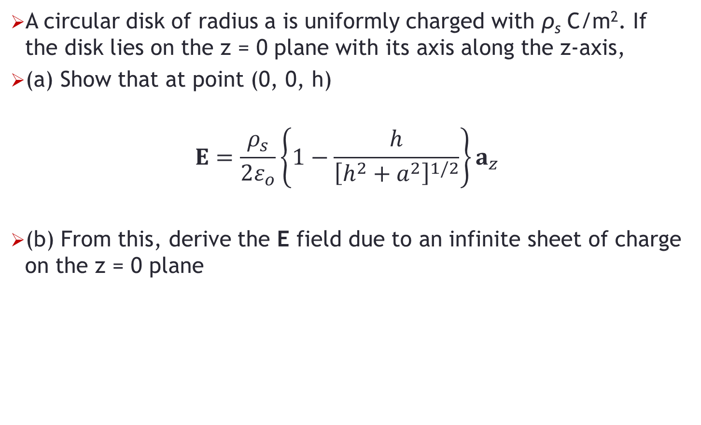
Problem-1
A circular disk of radius a is uniformly charged with ρ_{s} C/m². If the disk lies on the z = 0 plane with its axis along the z-axis,
(a) Show that at point (0, 0, h)
$$E=\frac{ρ_{s}}{2ε_{o}}\left\{1−\frac{h}{{\left[h^{2}+a^{2}\right]}^{1/2}}\right\}a_{z}$$
(b) From this, derive the E field due to an infinite sheet of charge on the z = 0 plane

