Slide 1
DT Convolution – problem session

Slide 2
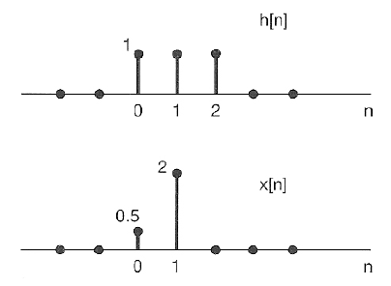
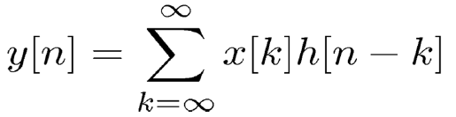

DT Convolution – Problem 1

Slide 3
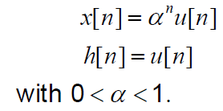
DT Convolution – Problem 2
Consider an input x[n] and a unit impulse response h[n] given by:
Find:
What is the maximum value of y[n]?

Slide 4
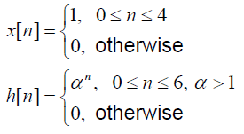
DT Convolution – Problem 3
Consider an input x[n] and a unit impulse response h[n] given by:
Find

Slide 5
END

