Slide 1
PROBLEM SESSION-1

Slide 2
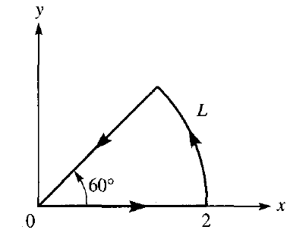
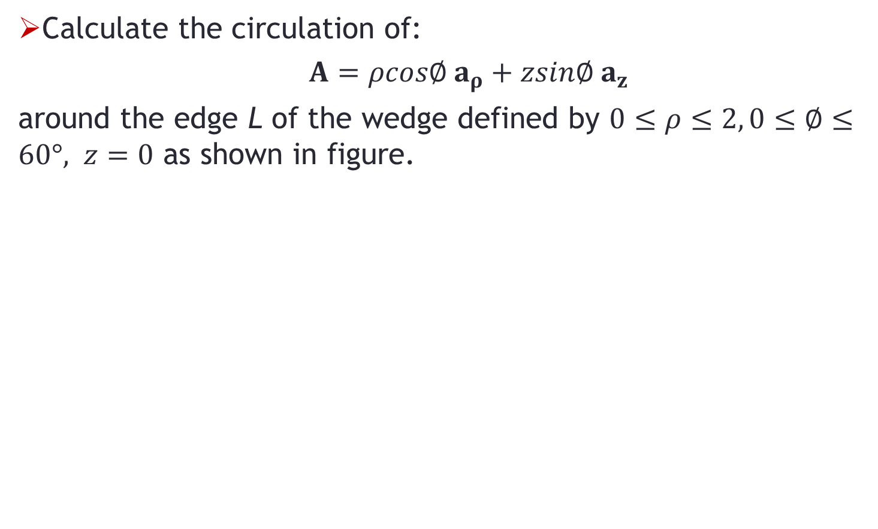
Problem-1
Calculate the circulation of:
$A=ρcos∅ a_{ρ}+zsin∅ a_{z}$
around the edge L of the wedge defined by $0≤ρ≤2, 0≤∅≤60°, z=0$ as shown in figure.

Slide 3
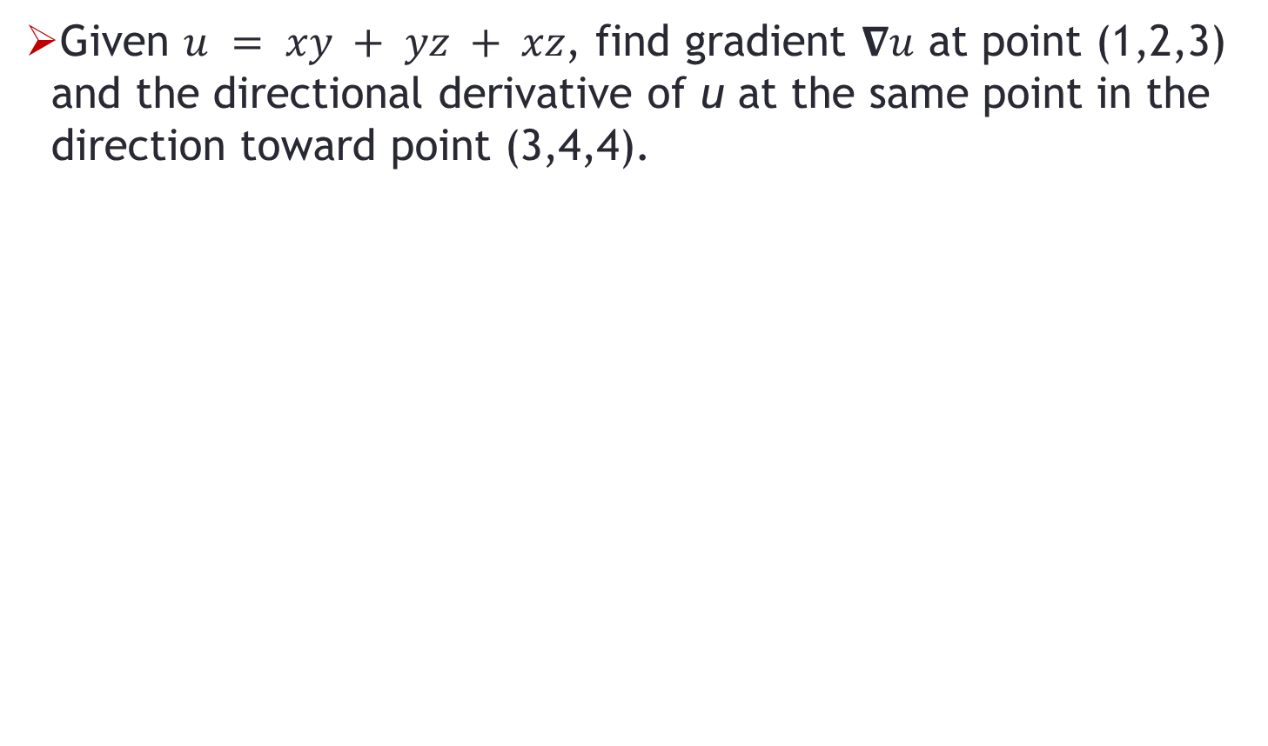
Problem-2
Given $u = xy + yz + xz$, find gradient $∇u$ at point (1,2,3) and the directional derivative of u at the same point in the direction toward point (3,4,4).

Slide 4
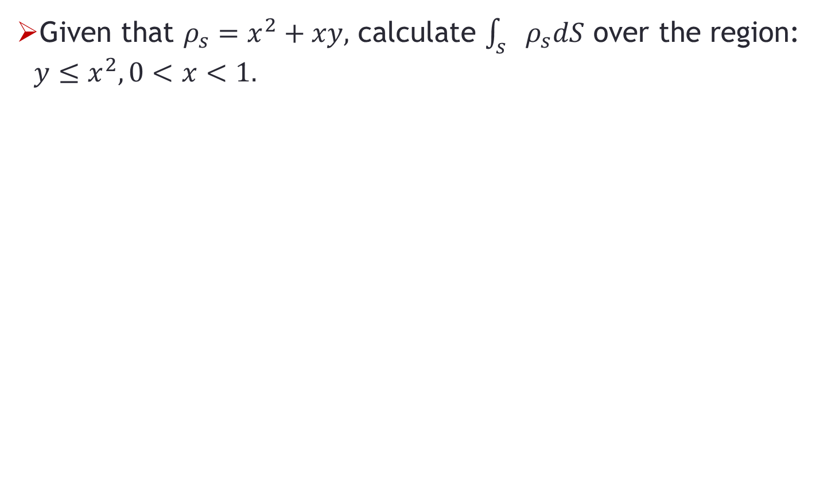
Problem-3
Given that $ρ_{s}=x^{2}+xy,$ calculate $\int_{s}{ρ_{s}dS}$ over the region: $y≤x^{2}, 0<x<1.$

