Slide 1
Linear Time-Invariant (LTI) Systems – DT Convolution

Slide 2
Linear Time-Invariant (LTI) Systems
Systems that are linear and time-invariant
Focus of most of this course
LTI systems are of practical importance
A basic fact: If we know the response of an LTI system to some inputs, we can find the response to many inputs
LTI systems can be characterized in terms of its response to a unit impulse (CT) or unit sample (DT)

Slide 3
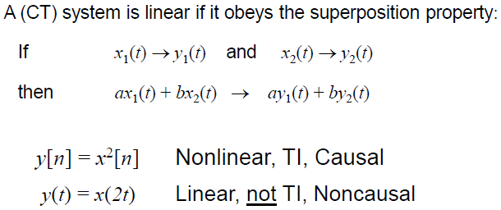
System Properties – Linearity

Slide 4
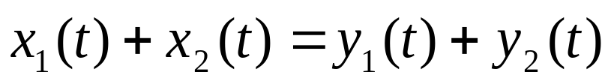
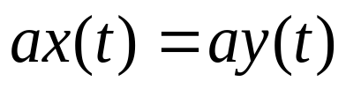
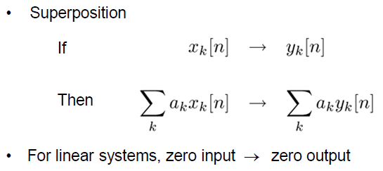
System Properties – Linearity
Superposition is a combination of Additivity and Homogeneity
Additivity:
Homogeneity:

Slide 5
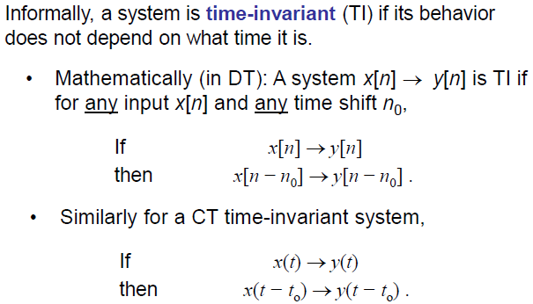
System Properties – Time Invariance

Slide 6
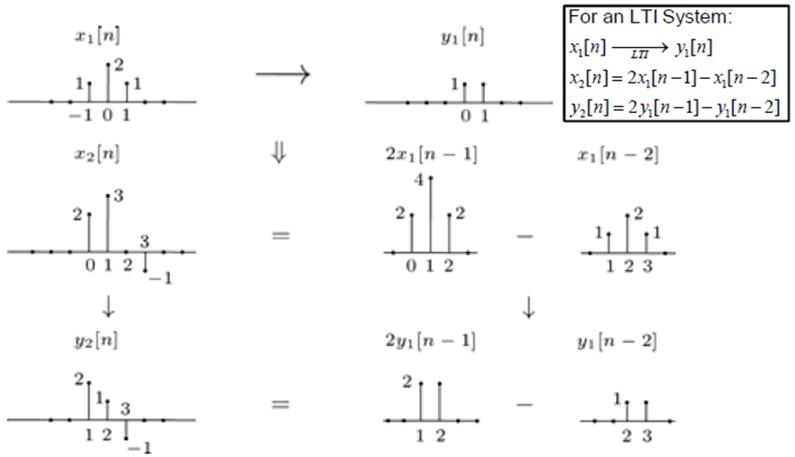
LTI System Example
The outputs for different inputs can be obtained as shown below:

Slide 7

Representation of Signals
Unit impulse (CT) or unit sample (DT) signals can be used as building blocks for LTI systems
For example, a DT LTI signal can be represented as the sum of scaled and shifted unit samples as shown in next slide

Slide 8
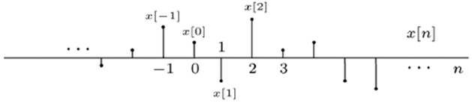
Representation of DT Signals
We need to write this signal as a sum of scaled and shifted unit samples

Slide 9
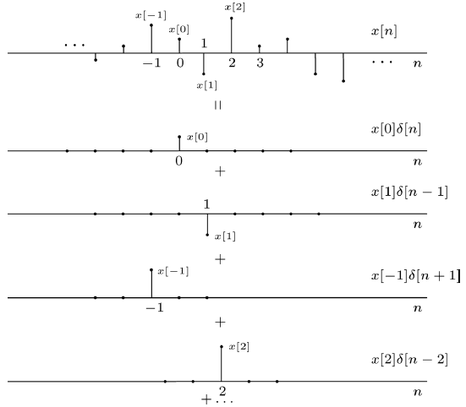
Representation of DT Signals

Slide 10
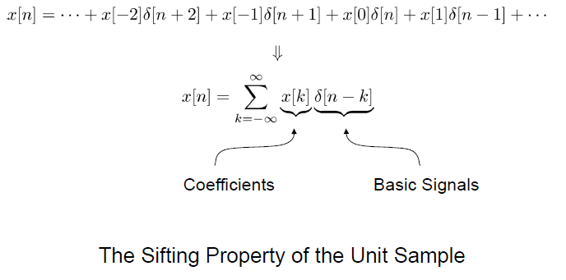
Representation of DT Signals

Slide 11
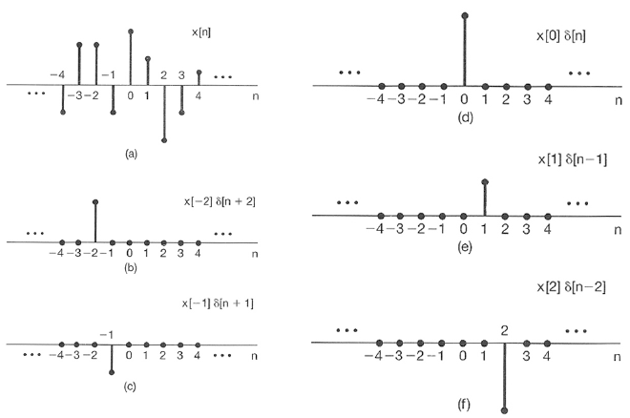
Representation of DT Signals

Slide 12
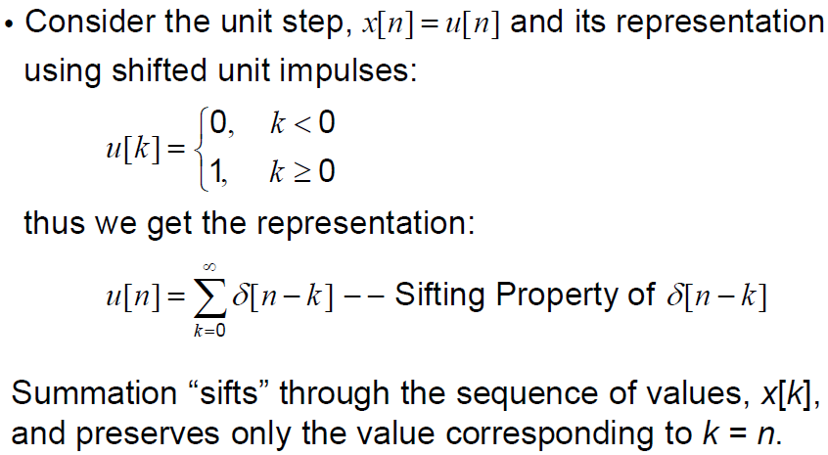
Representation of DT - Unit Step

Slide 13
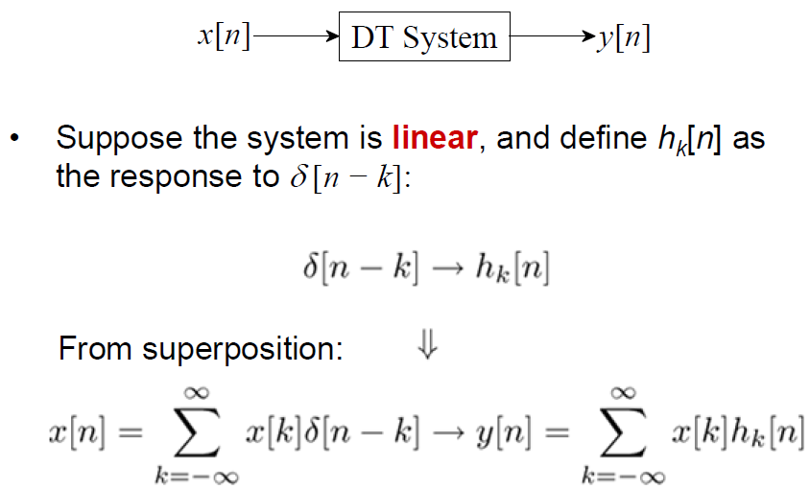
DT Unit Impulse Response
Notes:
In this slide, we assume linear only, so TI is not considered and hence there is a separate output impulse response for each shifted impulse at the input.

Slide 14
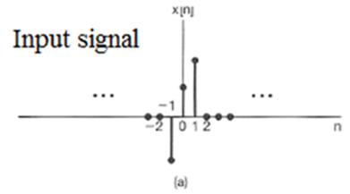

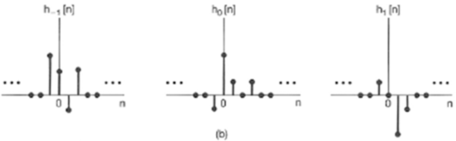
Superposition Sum

Slide 15
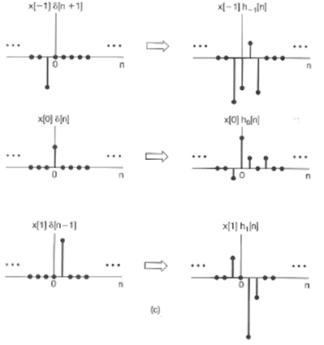
Superposition Sum

Slide 16
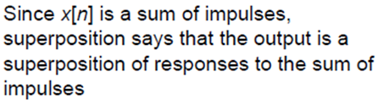
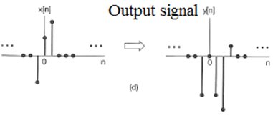
Superposition Sum

Slide 17
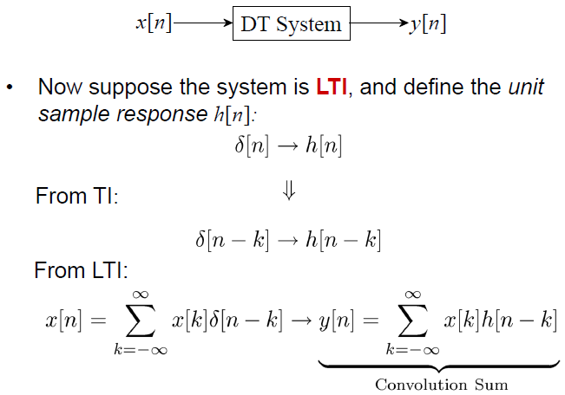
Convolution Sum
Notes:
Here we have a linear + TI system. So we need input x[n] and the impulse response of the system h[n], to find the output for any input.

Slide 18
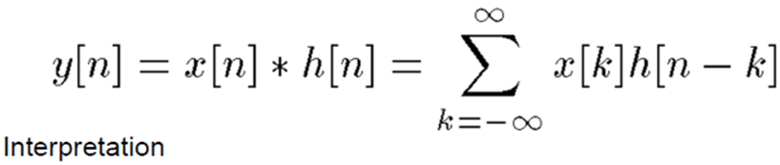
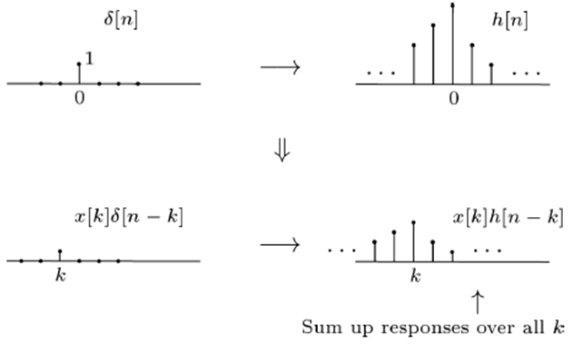
Convolution Sum

Slide 19
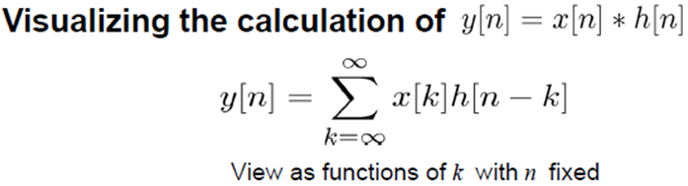
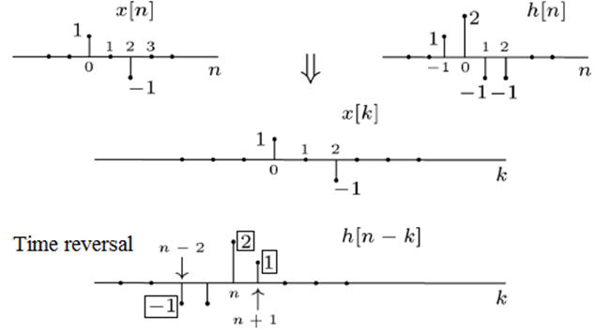
Convolution Sum

Slide 20
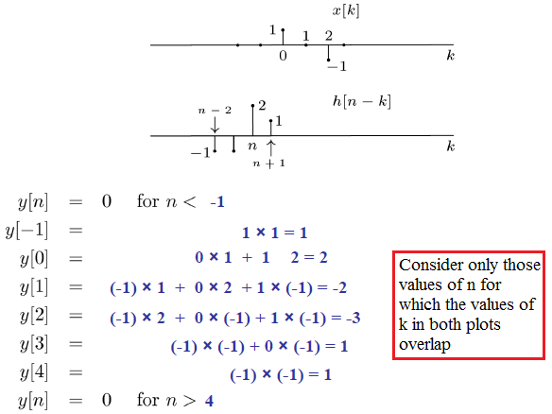
Convolution Sum

Slide 21
END

