Slide 1
Properties of Systems

Slide 2
System Properties
Memory
Invertible
Causal
Stability
Time Variance
Linearity

Slide 3
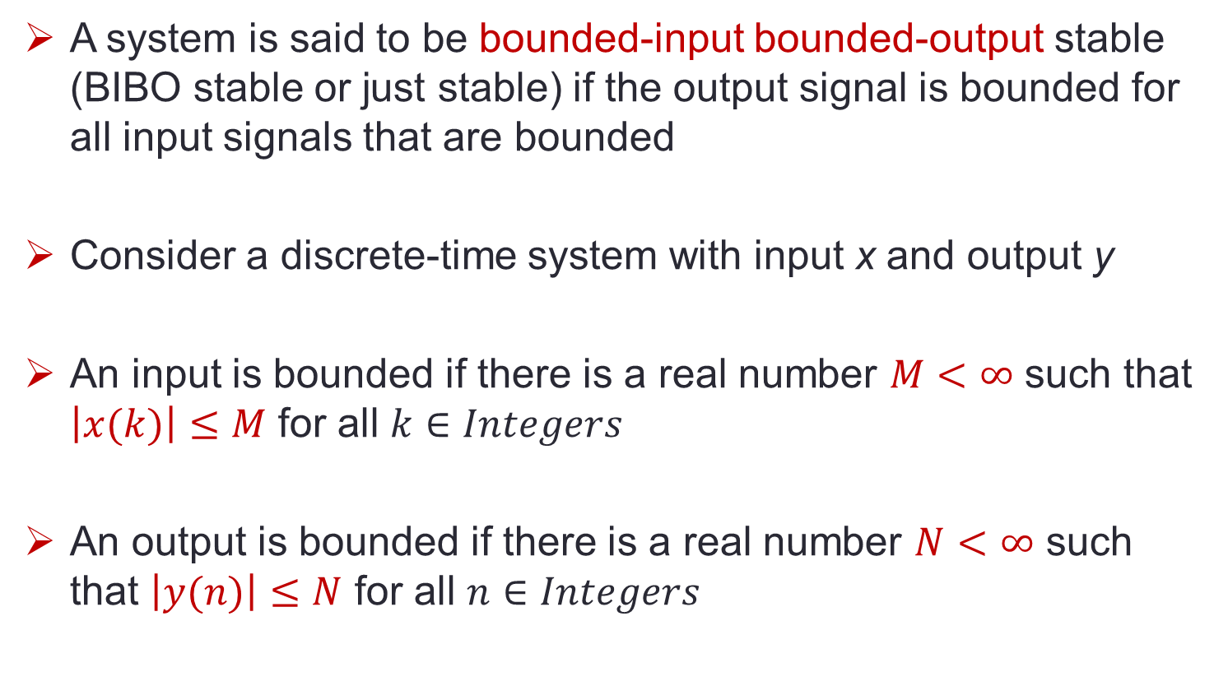
System Properties - Stability
A system is said to be bounded-input bounded-output stable (BIBO stable or just stable) if the output signal is bounded for all input signals that are bounded
Consider a discrete-time system with input x and output y
An input is bounded if there is a real number $M<∞$ such that $\left|x(k)\right|≤M$ for all $k∈Integers$
An output is bounded if there is a real number $N<∞$ such that $\left|y(n)\right|≤N$ for all $n∈Integers$
Notes:
The mathematical model of real world systems are not accurate since they are mostly linear. Hence there can be situations where the model gives unstable results. It can be stable with in certain limits of the input signal.

Slide 4
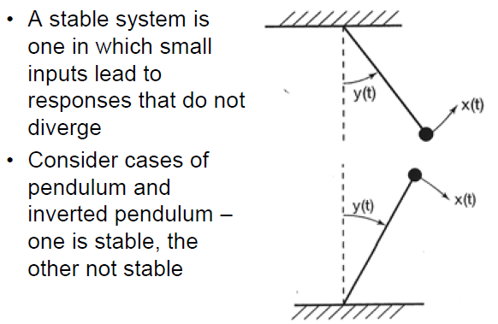
System Properties - Stability
Notes:
A feedback amplifier with positive feedback makes it unstable. The sharp sound coming out of microphones is due to instability.

Slide 5
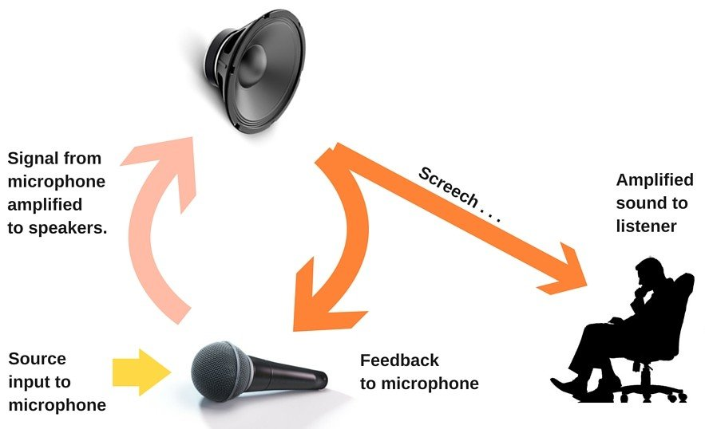
Stability – Example
Notes:
Audio feedback occurs when the microphone picks up the output sound from the speakers and then sends it back to the speakers to re-amplify it, kick-starting an endless loop unless interfered with externally.
Solution: Singers use headphones in the studio.

Slide 6
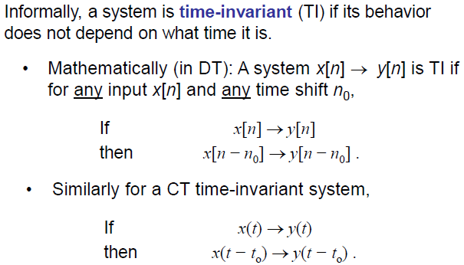
System Properties – Time Invariance
Notes:
This means that any known output can be used to find the output at any other time.

Slide 7
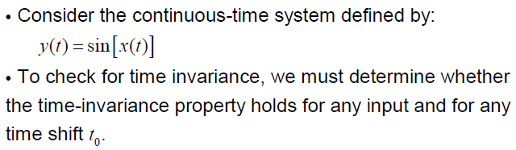
System Properties – Time Invariance

Slide 8
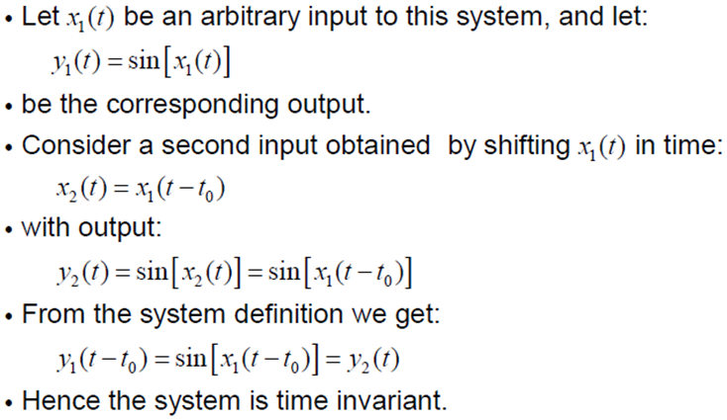
System Properties – Time Invariance

Slide 9
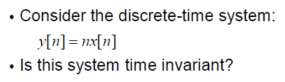
System Properties – Time Invariance
Notes:
For x1[n] = $δ\left[n\right]$, the output is: y1[n] = n$δ\left[n\right]$. For x2[n] = $δ\left[n−1\right]$, the output is: y2[n] = n$δ\left[n−1\right].$ But this is not the shifted version of y1[n] which is: y1[n-1] = (n-1) $δ\left[n−1\right]$. The system has a time varying gain, so it is not TI.

Slide 10

System Properties – Time Invariance
Is the system time-variant?

Slide 11
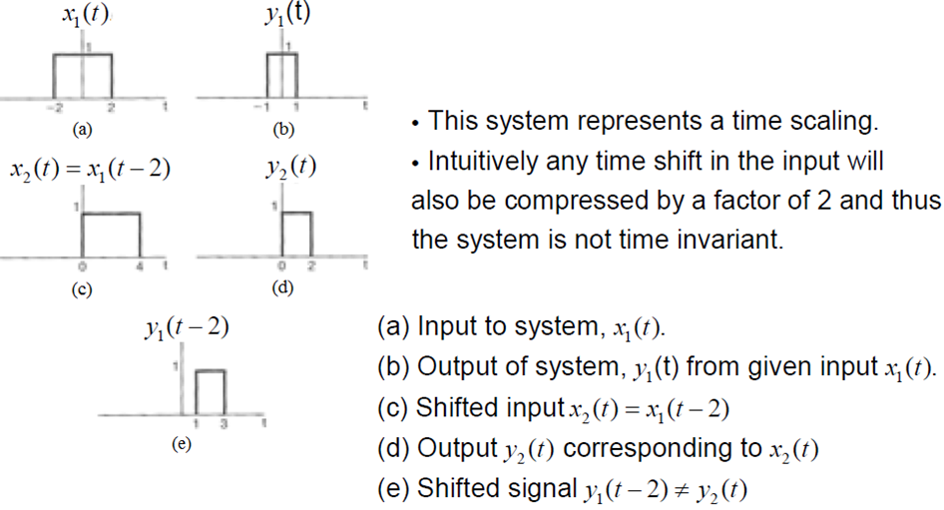
System Properties – Time Invariance

Slide 12
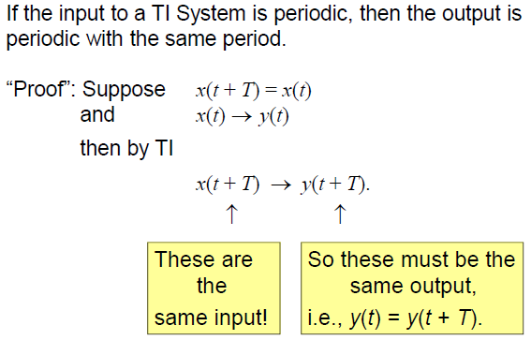
System Properties – Time Invariance

Slide 13


System Properties – Time Invariance
Does the behaviour change with time?
Does the behaviour change with time?
Notes:
For x1(t), y1(t) = ${x1}^{2}(t+1)$. For x2(t) = x1(t-1), y2(t) = ${x2}^{2}\left(t+1\right)={x1}^{2}\left(t\right)=$y1(t-1). So the system in Ex 1 is TI.
For Ex 2, let x1[n] = $δ\left[n\right]$, then y1[n] = ${\frac{1}{2}}^{n+1}δ^{3}\left[n−1\right]. Let x2\left[n\right]= δ\left[n+1\right], then y2\left[n\right]={\frac{1}{2}}^{n+1}δ^{3}\left[n\right]. But this is not equal to y2\left[n\right]=y1\left[n+1\right]={\frac{1}{2}}^{n+2}δ^{3}\left[n\right]$. So Ex 2 is not TI.

Slide 14
System Properties – Linearity
Notes:
The nonlinearity can be proved by making x3[n] = ax1[n] + bx2[n], where x1[n] = 2 and x3[n] = 3.

Slide 15
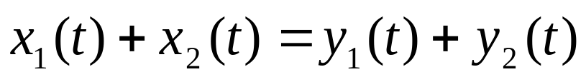
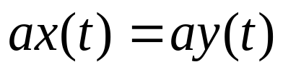
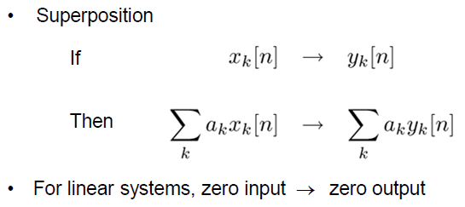
System Properties – Linearity
Superposition is combination of Additivity and Homogeneity
Additivity:
Homogeneity:

Slide 16


System Properties – Linearity
Are the systems below linear or nonlinear? Are they time invariant?
Notes:
The nonlinearity can be proved by making x3[n] = ax1[n] + bx2[n], where x1[n] = 2 and x3[n] = 3.

Slide 17
System Properties – Linearity
Notes:
The nonlinearity can be proved by making x3[n] = ax1[n] + bx2[n], where x1[n] = 2 and x3[n] = 3.

Slide 18
System Properties – Linearity
Many systems are nonlinear, for example circuit elements such as diodes and transistors
However, in this course we focus mainly on linear systems
WHY?
Linear models provide accurate representations of the behaviour of many systems such as resistors and capacitors
We can often linearize models to examine “small signal” perturbations around “operating points”

Slide 19

Problem-1
Is this system Linear? Prove your answer.
Notes:
Let x3(t) = ax1(t) + bx2(t). y3(t) = ${[ax1\left(t\right)+bx2(t)]}^{2}$. This will not be the same as: y3(t) = ay1(t) + by2(t)

Slide 20

Problem-2
Is this system Linear? Prove your answer.
Notes:
Let x1[n]=2, x2[n]=3 and x3[n] = x1[n]+x2[n].This system will violate ADDITIVITY PROPERTY and is not linear.

Slide 21
END

