Slide 1
ELECTRIC FIELDS DUE TO CONTINUOUS CHARGE DISTRIBUTIONS –
LINE CHARGE

Slide 2
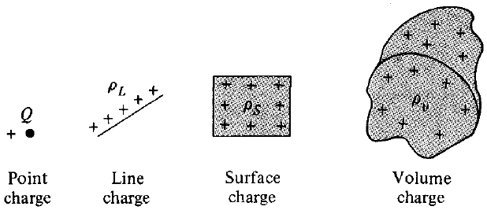
Introduction
So far we have only considered forces and electric fields due to point charges, which are essentially charges occupying very small physical space
It is also possible to have a continuous charge distribution along a line, on a surface, or in a volume, as shown below:

Slide 3
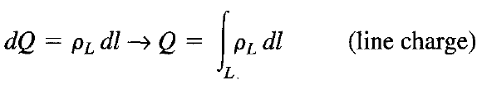
Introduction
It is customary to denote the line charge density, surface charge density, and volume charge density by ρ_{L} (in C/m), ρ_{s} (in C/m²), and ρ_{v} (in C/m³), respectively
These must not be confused with ρ (without subscript) used for radial distance in cylindrical coordinates
The charge element dQ and the total charge Q due to line charge distribution is obtained as:

Slide 4
Line Charge Distribution
Practical example of a line charge distribution is a charged conductor of very small radius and a sharp beam in a cathode-ray tube
In the case of the electron beam, the charges are in motion, and it is true that we do not have an electrostatic problem
However, the electron beam may be considered as composed of stationary electrons:
If the electron motion is steady and uniform (a DC beam) and
If we ignore for the moment the magnetic field which is produced

Slide 5


Line Charge Distribution
The equation for electric field due to point charge is:
The electric field intensity due to line charge distribution ρ_{L} may be regarded as the summation of the field contributed by the numerous point charges making up the charge distribution
Thus by replacing Q in the equation with charge element dQ = ρ_{L} dl, we get:
We shall now apply this formula to line charge distribution

Slide 6
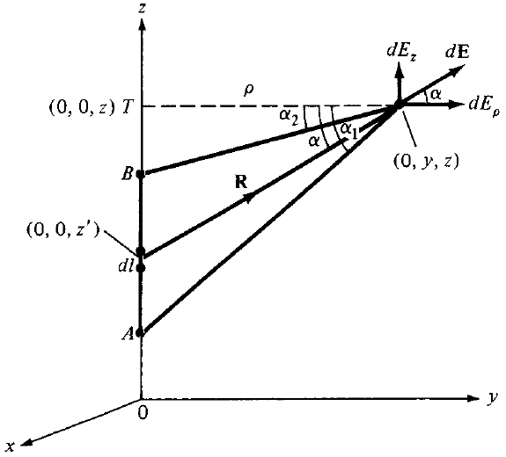
Line Charge Distribution
Consider a line charge with uniform charge density ρ_{L} extending from A to B along the z-axis as shown
Since the field does not vary with a variation in Φ, for simplicity, we choose an arbitrary point P(0,y,z) to find the electric field intensity

Slide 7




Line Charge Distribution
Field point is denoted by (x, y, z) and the source point by (x', y', z')
We have from the figure:
Converting to cylindrical coordinates gives:
Therefore:
By substitution into the equation for E, we get:

Slide 8
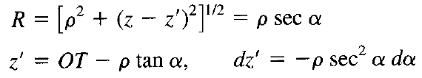
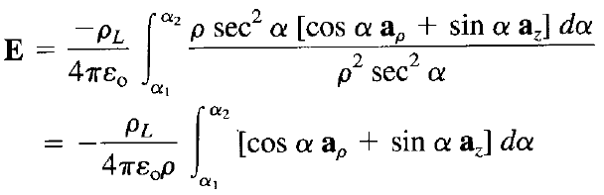
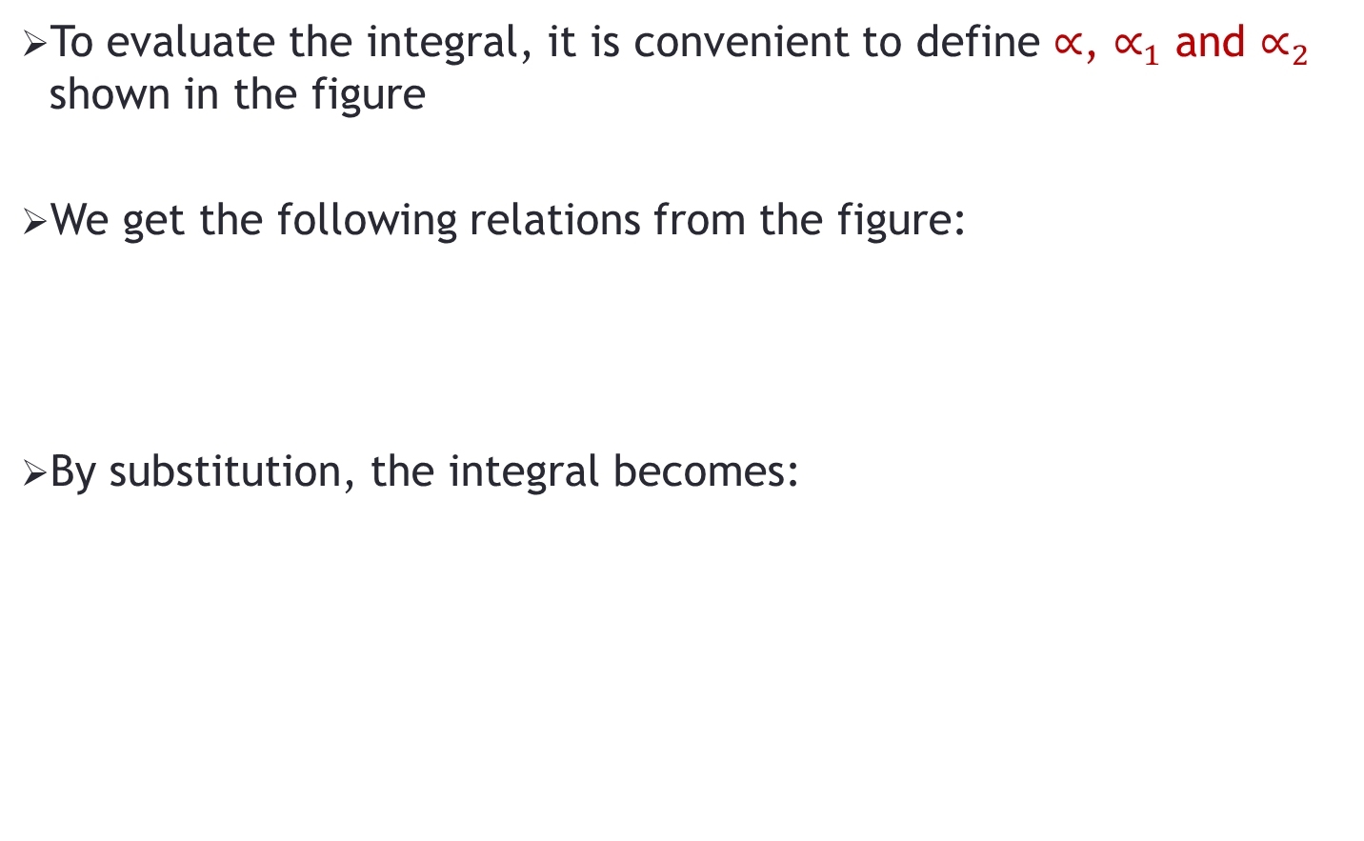
Line Charge Distribution
To evaluate the integral, it is convenient to define $∝$, $∝_{1}$ and $∝_{2}$ shown in the figure
We get the following relations from the figure:
By substitution, the integral becomes:

Slide 9

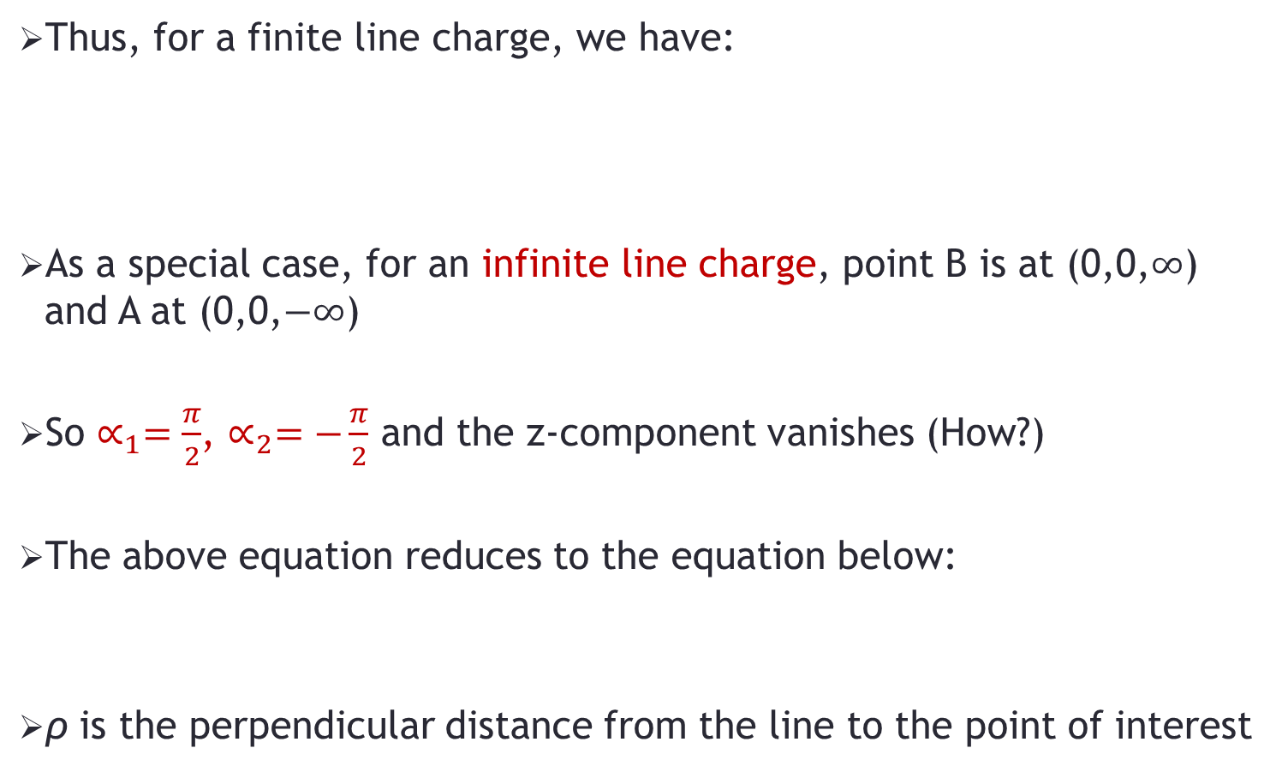
Line Charge Distribution
Thus, for a finite line charge, we have:
As a special case, for an infinite line charge, point B is at (0,0,$∞$) and A at (0,0,$−∞$)
So $∝_{1}=\frac{π}{2}$, $∝_{2}=−\frac{π}{2}$ and the z-component vanishes (How?)
The above equation reduces to the equation below:
ρ is the perpendicular distance from the line to the point of interest

Slide 10
Problem-1
A circular ring of radius a carries a uniform charge ρ_{L} C/m and is placed on the xy-plane with axis the same as the z-axis. Calculate the electric field intensity E on z-axis at a distance of h from the origin.

