Slide 1
Introduction to System and properties of Systems

Slide 2
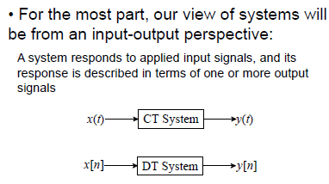
System
System processes input signals to produce output signals

Slide 3
How Are Signal & Systems Related
How to design a system to process a signal in particular ways?
Design a system to restore or enhance a particular signal
  Remove high frequency background communication noise
Assume a signal is represented as
  x(t) = d(t) + n(t)
Design a system to remove the unknown “noise” component n(t), so that y(t) ≈ d(t)
x(t) = d(t) + n(t)
System
?
y(t) ≈ d(t)

Slide 4
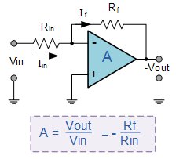
CT System Example
Figure below shows an example of a continuous-time system
The system is an operational amplifier, so the output is a scaled version of the input signal

Slide 5
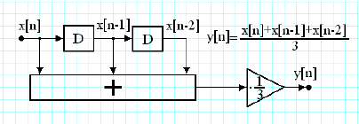
DT System Example
Figure below shows an example of a discrete-time system
The system is a digital system and is called a moving average filter (running average), so the output is an average of the current and previous two inputs

Slide 6
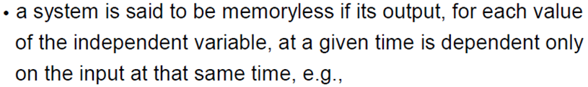

System Properties - Memory

Slide 7
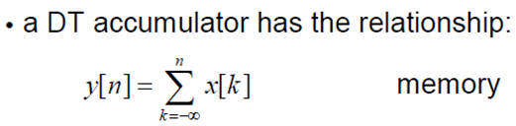
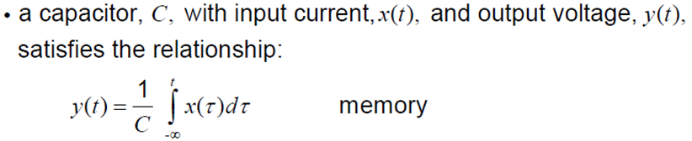
System Properties - Memory

Slide 8

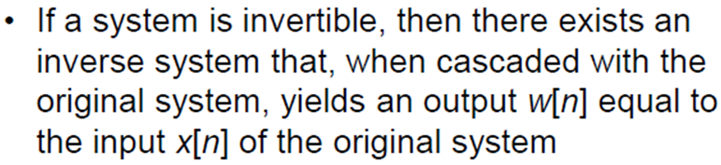

System Properties - Invertible
- What is an example of a non-invertible electrical system?
Notes:
What is an example of a non-invertible electrical system? a rectifier, specified by an equation y(t) = |x(t)|, is non-invertible because the rectification operation cannot be undone

Slide 9
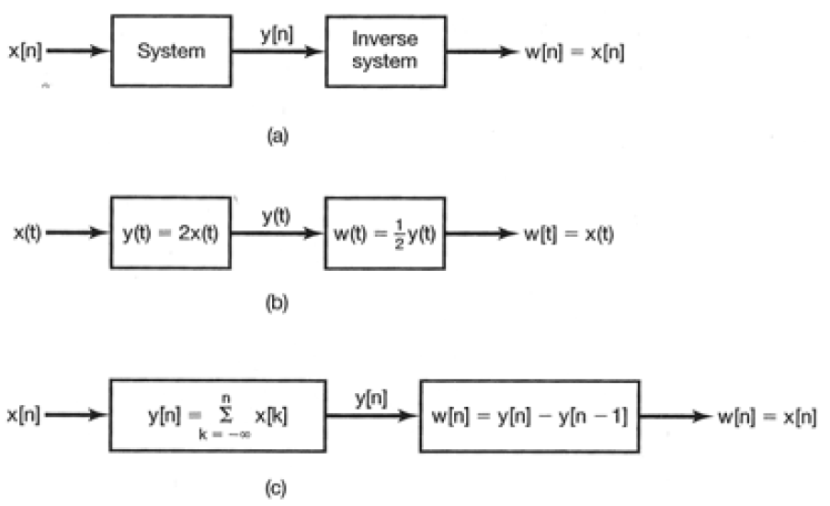
System Properties - Invertible
Notes:
“The concept of invertibility is important in many contexts. One example arises in systems for encoding used in a wide variety of communications applications. In such a system, a signal that we wish to transmit is first applied as the input to a system known as an encoder.
There are many reasons for doing this, ranging from the desire to encrypt the original message for secure or private communications to the objective of providing some redundancy in the signal (for example, by adding what are known as parity bits) so that any errors that occur in transmission can be detected and possibly corrected. For lossless coding, the input to the encoder must be exactly recoverable from the output; i.e., the encoder must be invertible.

Slide 10
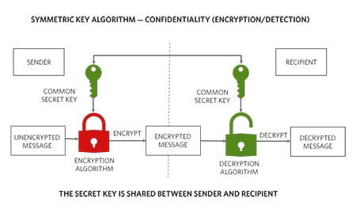
System Properties - Invertible
Encrypted signals are outputs of a system (the encryption algorithm).
To decrypt, we need the inverse system.
https://www.analog.com/en/resources/glossary/cryptography.html
Notes:
“The concept of invertibility is important in many contexts. One example arises in systems for encoding used in a wide variety of communications applications. In such a system, a signal that we wish to transmit is first applied as the input to a system known as an encoder.
There are many reasons for doing this, ranging from the desire to encrypt the original message for secure or private communications to the objective of providing some redundancy in the signal (for example, by adding what are known as parity bits) so that any errors that occur in transmission can be detected and possibly corrected. For lossless coding, the input to the encoder must be exactly recoverable from the output; i.e., the encoder must be invertible.

Slide 11
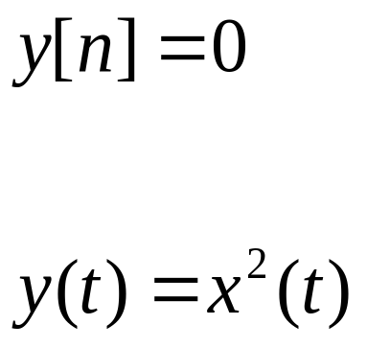
System Properties - Invertible
Are the systems mentioned below Invertible or Non-invertible?
System-1:
System-2:
Notes:
Both are non-invertible

Slide 12
System Properties - Causality
A system is causal if the output does not anticipate future values of the input
Or in a Causal system, the output at any time depends only on the past and present values of the input
All real-time physical systems are causal, because time only moves forward, effect occurs after cause
Causality does not apply to systems processing recorded signals, e.g. taped sports games vs. live broadcast
Notes:
What are practical examples of electrical causal and non-causal systems? Recorded data

Slide 13

System Properties - Causality
Is the system defined by the equation below a Causal or Non-Causal?

Slide 14

System Properties - Causality

Slide 15

System Properties - Causality
Is the system defined by the equation below a Causal or Non-Causal?
Notes:
Cos(t+1) is not the input, it’s a factor that is being multiplied by the system

Slide 16

System Properties - Causality
Notes:
Cos(t+1) is not the input, it’s a factor that is being multiplied by the system

Slide 17


System Properties – Causality Examples

Slide 18
System Properties – Causality Examples

Slide 19


System Properties – Causality Examples

Slide 20

System Properties – Causality Examples

Slide 21
END

