Slide 1
ELECTROSTATIC FIELDS-
COULOMB’S LAW AND FIELD INTENSITY

Slide 2
Introduction
An electrostatic field is produced by a static charge distribution
Two fundamental laws governing electrostatic fields:
(1) Coulomb's law, and (2) Gauss's law
Both of these laws are based on experimental studies and they are interdependent
Based on Coulomb's law, the concept of electric field intensity will be introduced and applied to cases involving point, line, surface, and volume charges

Slide 3
Coulomb’s Law
Deals with the force a point charge exerts on another point charge
By a point charge we mean a charge that is located on a body whose dimensions are much smaller than other relevant dimensions
Coulomb's law states that the force F between two point charges Q1 and Q2 is:
1. Along the line joining them
2. Directly proportional to the product Q₁Q₂ of the charges
3. Inversely proportional to the square of the distance R between them

Slide 4

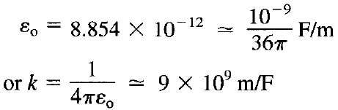
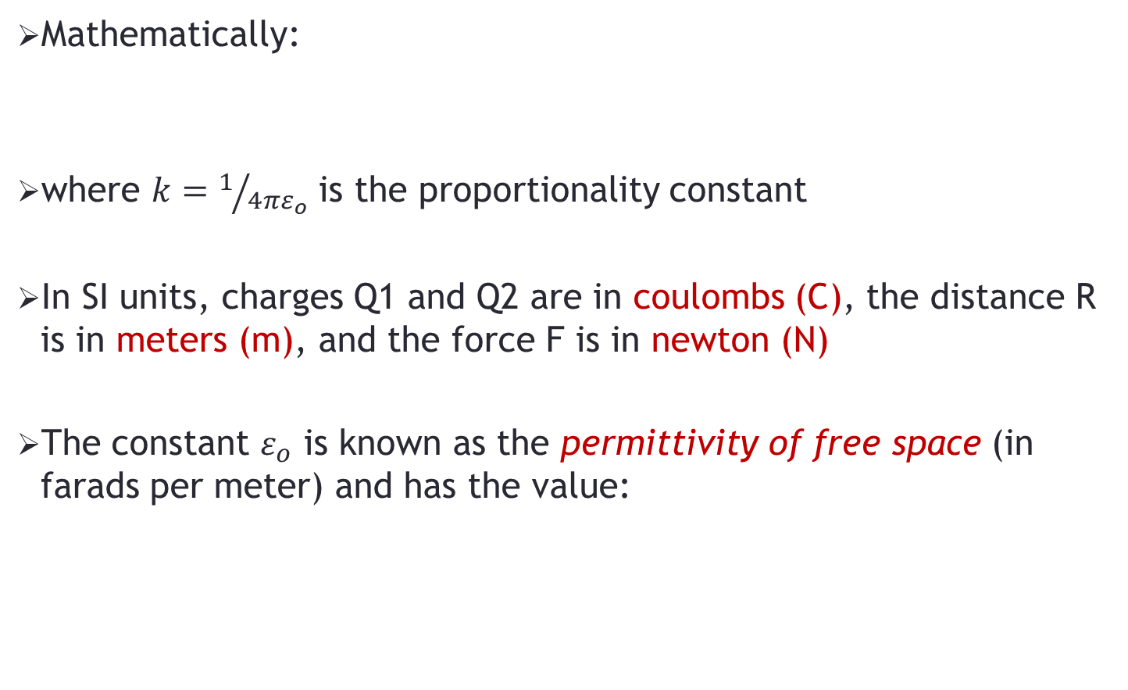
Coulomb’s Law
Mathematically:
where $k=1/{4πε_{o}}$ is the proportionality constant
In SI units, charges Q1 and Q2 are in coulombs (C), the distance R is in meters (m), and the force F is in newton (N)
The constant $ε_{o}$ is known as the permittivity of free space (in farads per meter) and has the value:

Slide 5

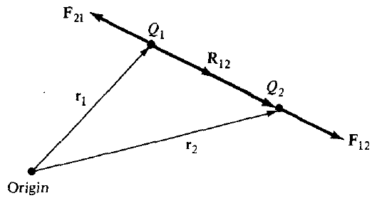
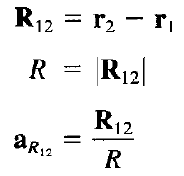
Coulomb’s Law
If point charges Q1 and Q2 are located at points having position vectors r1 and r2, then the force F₁₂ due to Q1 on Q2:
Where

Slide 6


Coulomb’s Law
Using the equations on the previous slide, the relation for force may also be written as:
OR

Slide 7



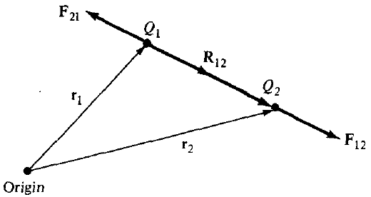
Coulomb’s Law – Important Points
The force F₂₁ due to Q2 on Q1 is given by:
OR , Since

Slide 8
Coulomb’s Law – Important Points
Like charges (charges of the same sign) repel each other while unlike charges attract, as illustrated below:
The distance R between the charged bodies Q1 and Q2 must be large compared with the linear dimensions of the bodies; that is, Q1 and Q2 must be point charges
Q1 and Q2 must be static (at rest)
The signs of Q1 and Q2 must be taken into account while solving problems

Slide 9

Coulomb’s Law – Principle of Superposition
If we have more than two point charges, we can use the principle of superposition to determine the force on a particular charge
The principle states that if there are N charges Q1, Q2, …... QN located, respectively, at points with position vectors r₁, r₂,….r_{N}, the resultant force F on a charge Q located at point r is the vector sum of the forces exerted on Q by each of the charges Q1, Q2, …... QN, that is:
OR

Slide 10


Electric Field Intensity
The electric field intensity (or electric field strength) E is the force per unit charge when placed in the electric field
The electric field intensity E is obviously in the direction of the force F and is measured in newton/coulomb or volts/meter
The electric field intensity at point r due to a point charge located at r' is obtained from Coulomb’s law as:

Slide 11


Electric Field Intensity – Principle of Superposition
For N point charges Q1, Q2,….., Q_{N} located at r₁, r₂,….., r_{N}, the electric field intensity at point r is obtained as:
OR

Slide 12
Problem-1
Point charges 5 nC and —2 nC are located at (2,0,4) and (-3,0,5), respectively.
(a) Determine the force on a 1 nC point charge located at (1,-3, 7)
(b) Find the electric field E at (1,-3,7)

