Slide 1
VECTOR CALCULUS II

Slide 2

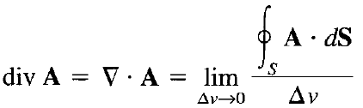
Divergence of a Vector
Divergence of vector A at a given point P is the outward flux per unit volume as the volume shrinks about P
Net outflow of the flux of a vector field A from a closed surface S is obtained from the integral:
The divergence of A as the net outward flow of flux per unit volume over a closed incremental surface:
where Δv is the volume enclosed by the closed surface S in which P is located

Slide 3
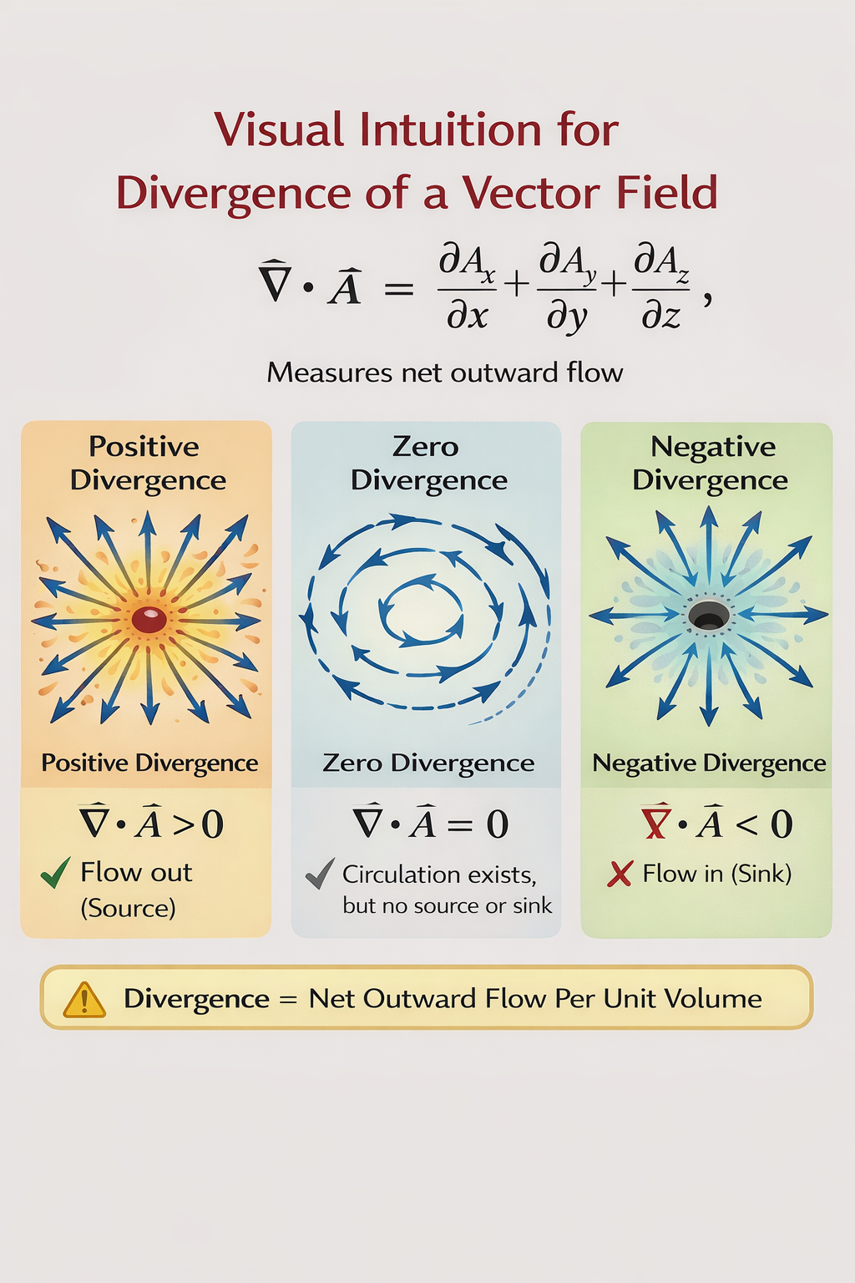
Divergence of a Vector
Physically, divergence of the vector field A at a given point is a measure of how much the field diverges or emanates from that point

Slide 4



Divergence of a Vector
In Cartesian coordinate system:
Cylindrical coordinate system:
Spherical coordinate system:

Slide 5

Divergence Theorem
From the definition of divergence of A, we have the divergence theorem as:
The total outward flux of a vector field A through the closed surface S is the same as the volume integral of the divergence of A
It will soon become apparent that volume integrals are easier to evaluate than surface integrals
For this reason, to determine the flux of A through a closed surface, we simply find the right-hand side of the divergence theorem equation
Notes:
Since the volume integral is over the complete volume, the closed surface will now also be different than what it was for the differential volume.

Slide 6


Curl of a Vector
We defined the circulation of a vector field A around a closed path L as the integral:
The curl of A is an axial (or rotational) vector whose magnitude is the maximum circulation of A per unit area as the area tends to zero and whose direction is the normal direction of the area when the area is oriented so as to make the circulation maximum
where the area ΔS is bounded by the curve L and a_{n} is the unit vector normal to the surface ΔS and is determined using the right-hand rule
Notes:
Circulation will be maximum when the path is along the vector A

Slide 7
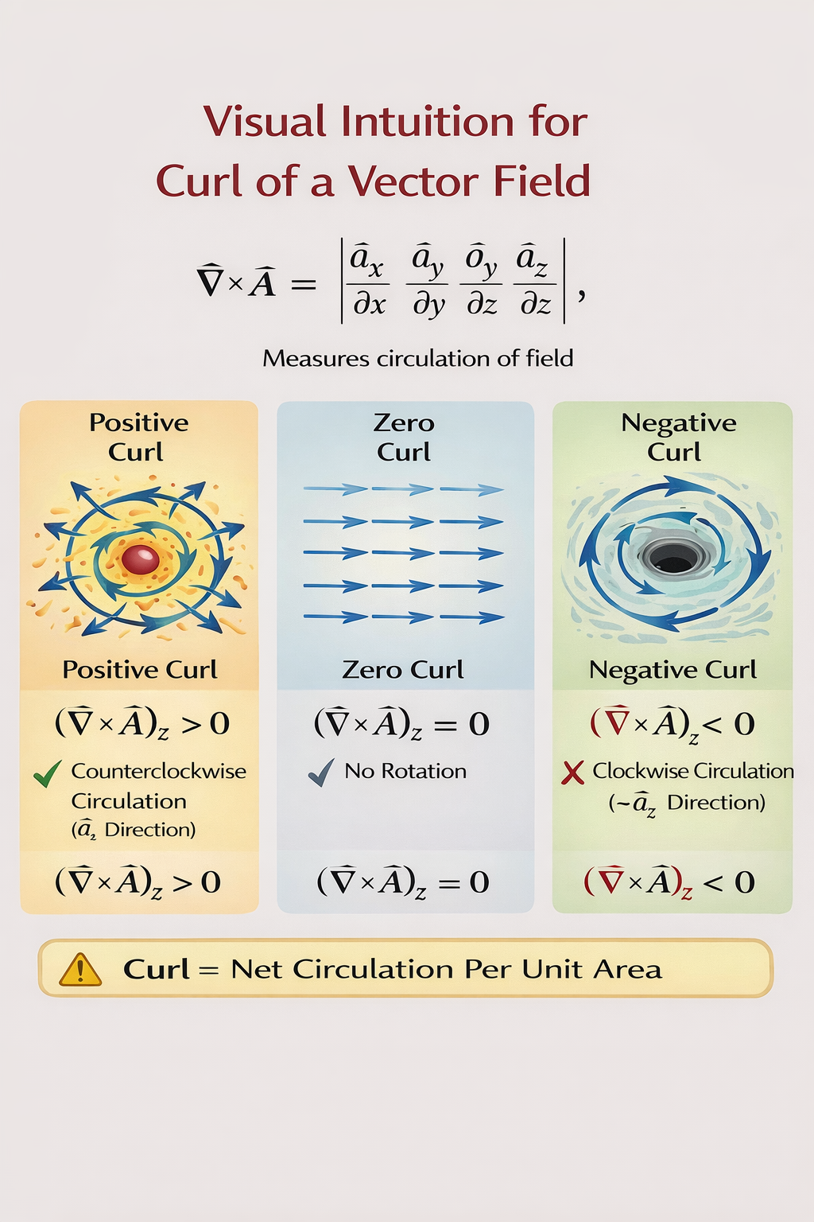
Curl of a Vector
The curl provides the maximum value of the circulation of the field per unit area (or circulation density) and indicates the direction along which this maximum value occurs
Notes:
For (a), the path L is along the direction of the vector.

Slide 8
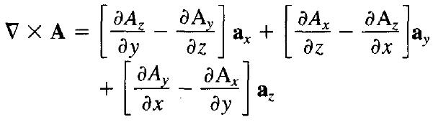
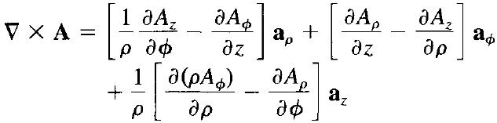
Curl of a Vector
Cartesian coordinates:
Cylindrical coordinates:

Slide 9
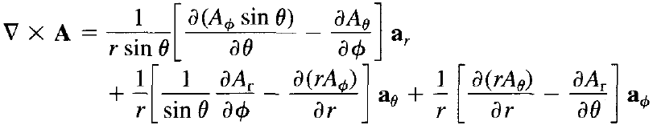
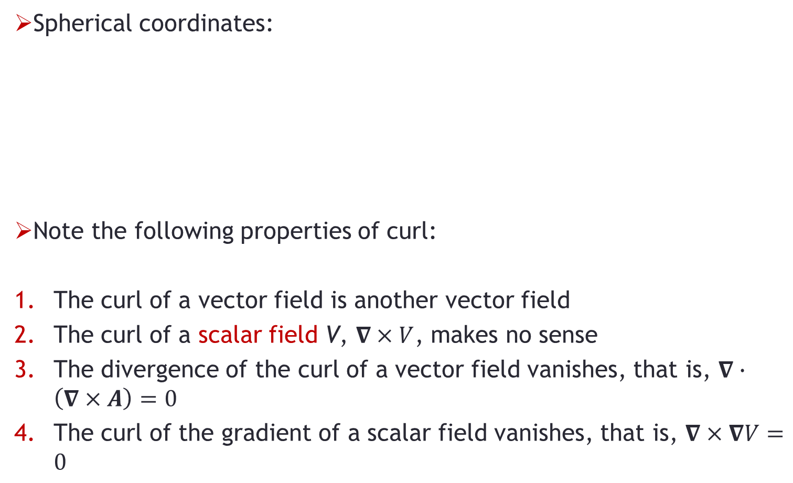
Curl of a Vector
Spherical coordinates:
Note the following properties of curl:
The curl of a vector field is another vector field
The curl of a scalar field V, $∇×V$, makes no sense
The divergence of the curl of a vector field vanishes, that is, $∇∙\left(∇×A\right)=0$
The curl of the gradient of a scalar field vanishes, that is, $∇×∇V=0$

Slide 10

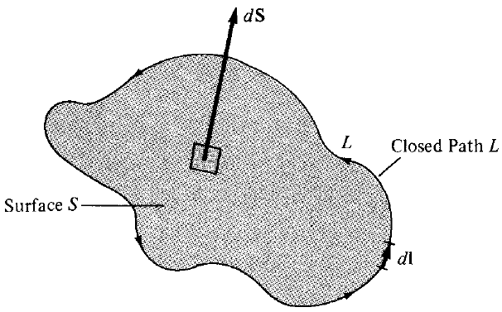
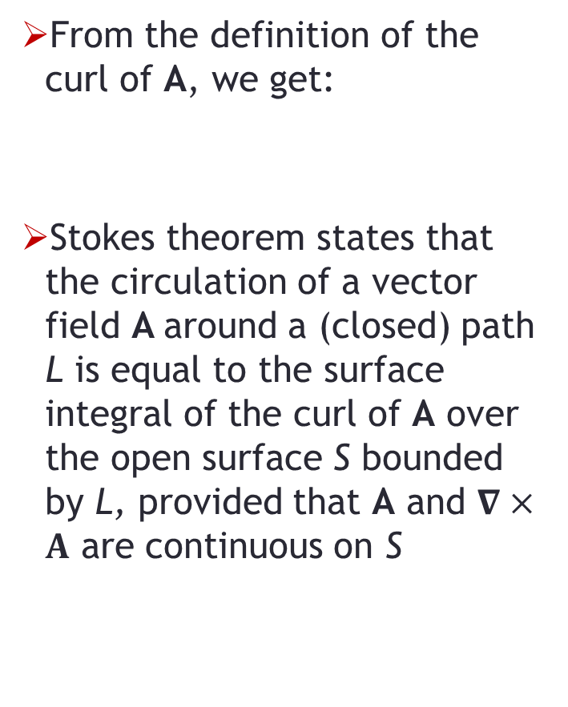
Stokes Theorem
From the definition of the curl of A, we get:
Stokes theorem states that the circulation of a vector field A around a (closed) path L is equal to the surface integral of the curl of A over the open surface S bounded by L, provided that A and $∇×A$ are continuous on S

Slide 11
Stokes Theorem
The direction of dl and dS in Stokes theorem equation must be chosen using the right-hand rule
Using the right-hand rule, if we let the fingers point in the direction of dl, the thumb will indicate the direction of dS
Note that the divergence theorem relates a surface integral to a volume integral
Stokes's theorem relates a line integral (circulation) to a surface integral

Slide 12



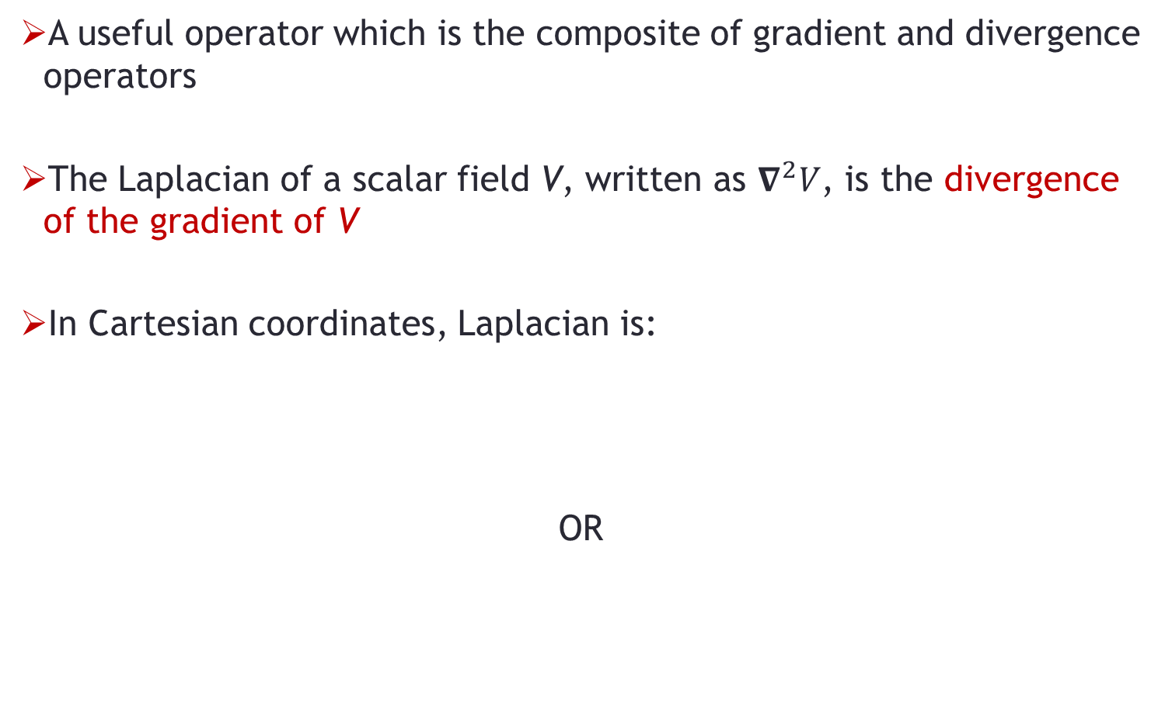
Laplacian of a Scalar
A useful operator which is the composite of gradient and divergence operators
The Laplacian of a scalar field V, written as $∇^{2}V$, is the divergence of the gradient of V
In Cartesian coordinates, Laplacian is:
OR

Slide 13


Laplacian of a Scalar
In cylindrical coordinates:
In spherical coordinates:

Slide 14
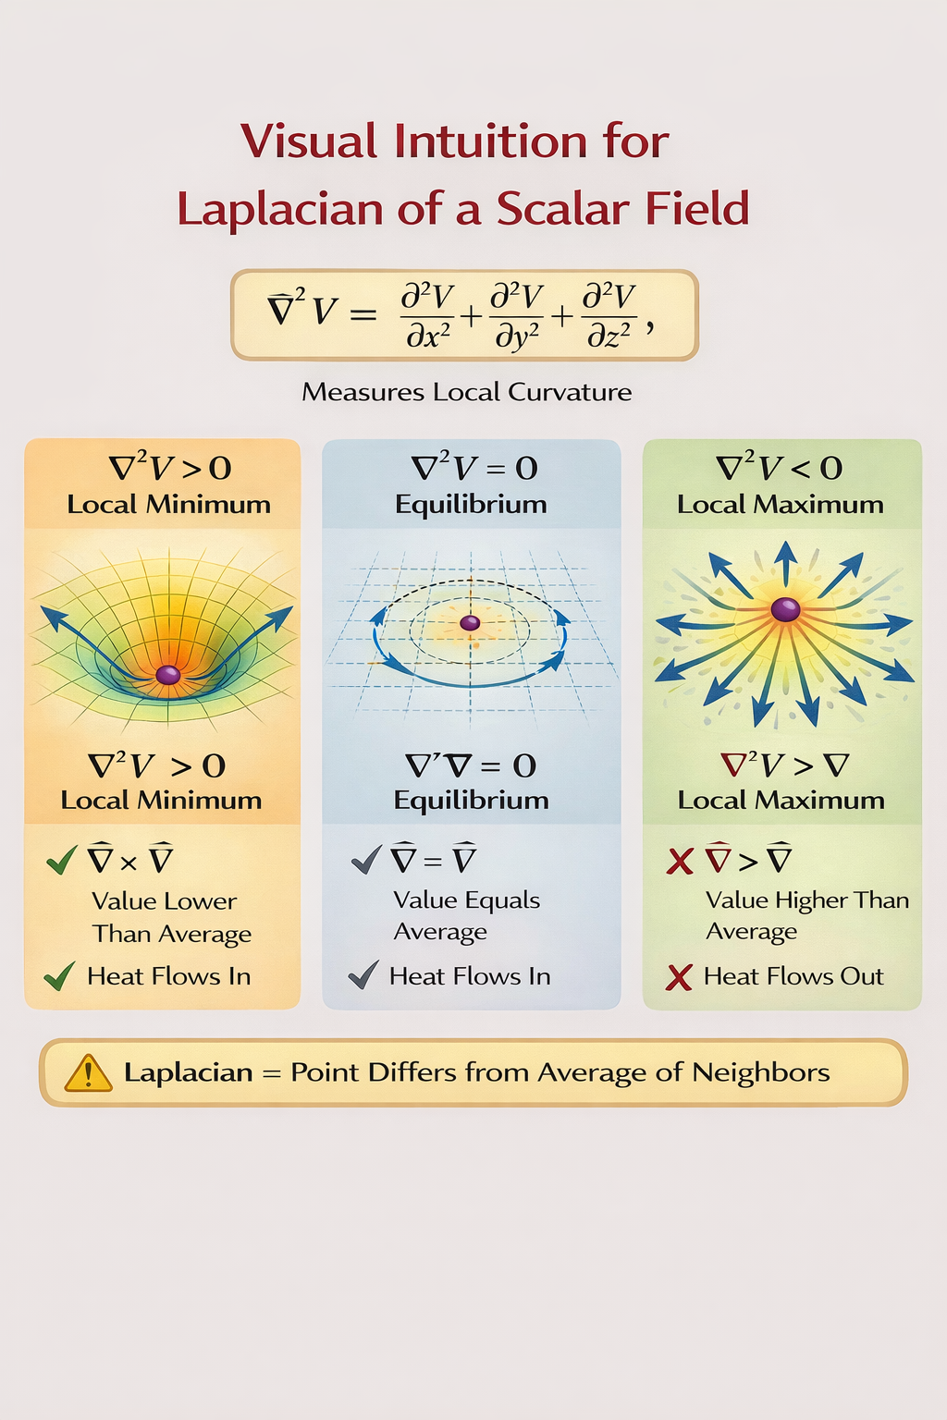

Laplacian of a Scalar
A scalar field V is said to be harmonic in a given region if its Laplacian vanishes in that region, that is:
No sources or sinks in the region
Value at any point equals the average of its neighbors
Field is in equilibrium

Slide 15
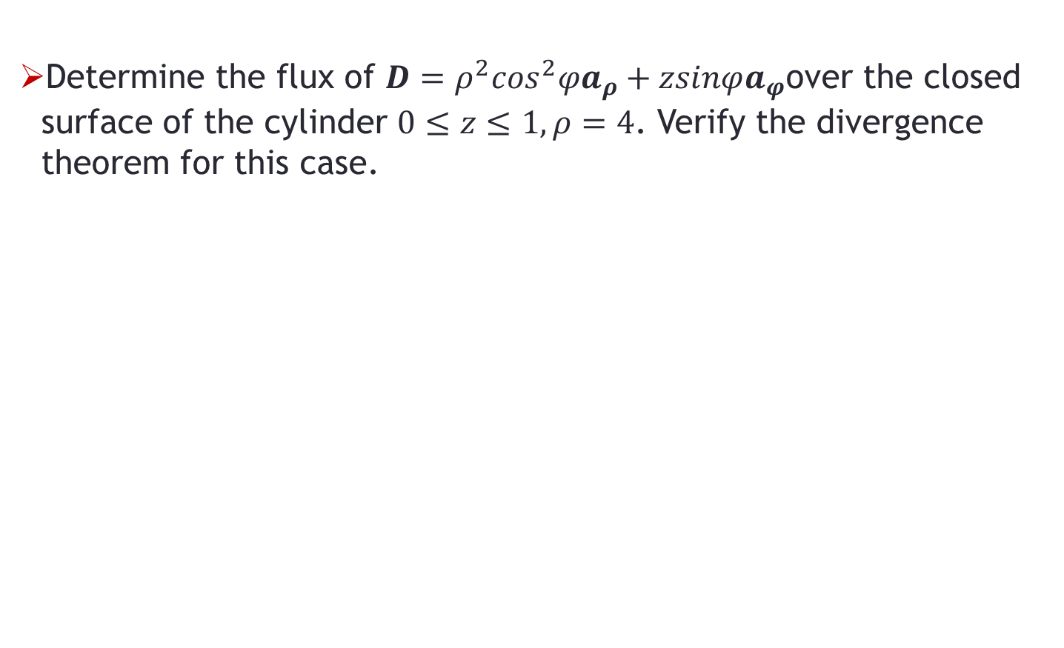
Problem-1
Determine the flux of $D=ρ^{2}\cos^{2}φa_{ρ}+zsinφa_{φ}$over the closed surface of the cylinder $0≤z≤1, ρ=4$. Verify the divergence theorem for this case.

