Slide 1
important Signals – Discrete Time

Slide 2




Discrete Time Unit Functions
The discrete-time unit step, is defined as:
The discrete time unit impulse is defined as:
The discrete-time unit impulse is the first difference of the discrete-time step as:
Notes:
OR a unit step can be written as an infinite sum of time-delayed unit impulses

Slide 3
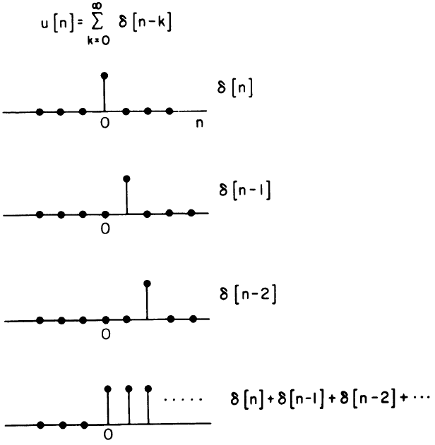
Discrete Time Unit Functions
A unit step can be written as an infinite sum of time-delayed unit impulses
Notes:
OR a unit step can be written as an infinite sum of time-delayed unit impulses

Slide 4
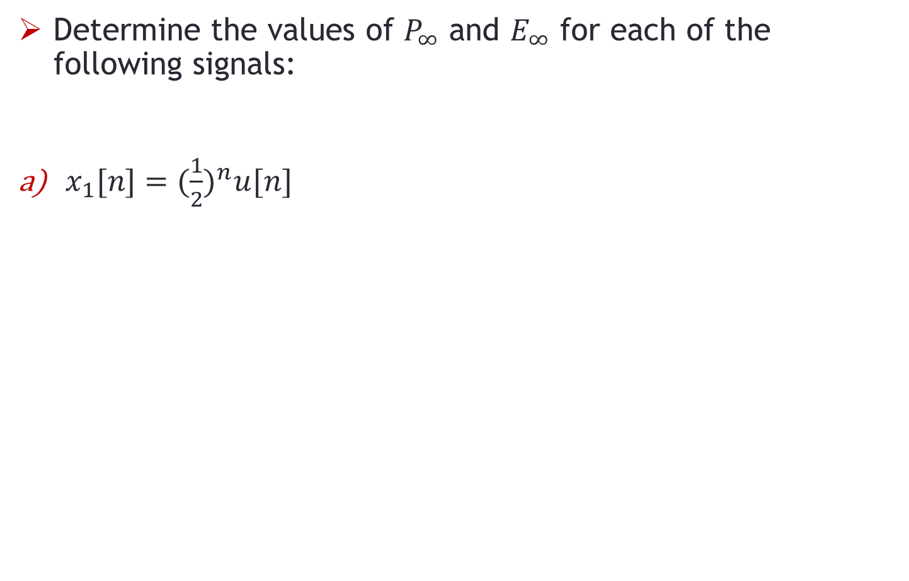
Problem-1
Determine the values of $P_{∞}$ and $E_{∞}$ for each of the following signals:
$x_{1}[n]=({\frac{1}{2})}^{n}u[n]$

Slide 5
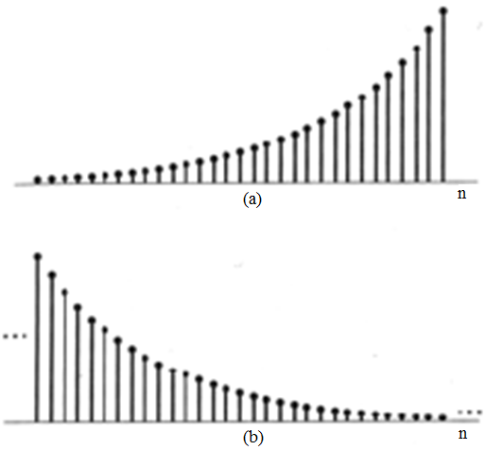
Exponential Signals
Real Exponential signal x[n] = Ae^{an}; A and a are Real
a > 0 and A >0;
exponential rise
a < 0 and A >0;
exponential decay
a > 0 and A <0;
a < 0 and A <0;
How will (c) and (d)
look like ???

Slide 6
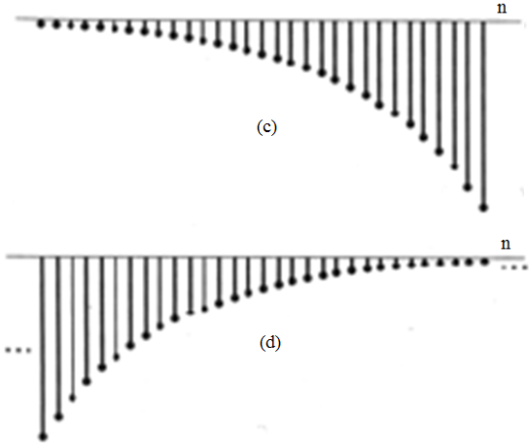
Exponential Signals
Real Exponential signal x[n] = Ae^{an}; A and a are Real
a > 0 and A <0;
a < 0 and A <0;

Slide 7
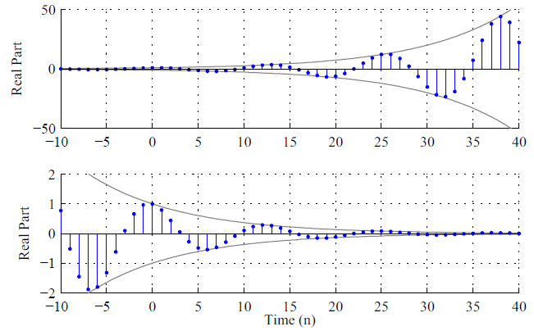
Damped Complex Sinusoidal Exponentials

Slide 8
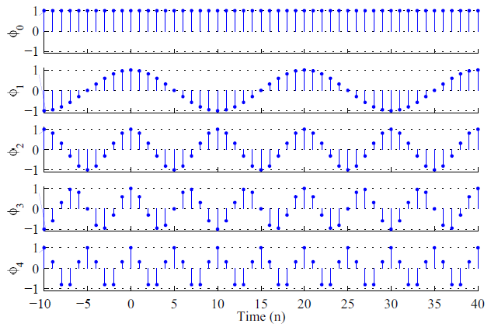
Sinusoidal Exponential Harmonics
Example of Discrete-time harmonics

Slide 9
Periodicity of Discrete-Time Sinusoids
A periodic discrete-time signal x[n] has the property that for a positive integer N,
x[n] = x[n + N], for all values of n.
The discrete time signal x[n] is periodic with period N if it is unchanged by a time shift of N
x[n] = Ae^{ωn}; then:
x[n+N] = Ae^{jω(n+N)} = Ae^{jωn} . e^{jωN} = x[n];
Possible if:
e^{jωN} = 1

Slide 10
Periodicity of Discrete-Time Sinusoids
Or ωN = 2πm or N = 2πm/ω
Here m and N should be integers
We can also write the above as:
ω = (2m/N) . π
Therefore, a discrete-time sinusoid is periodic if its radian frequency ω is a rational multiple (integer/integer) of π

Slide 11
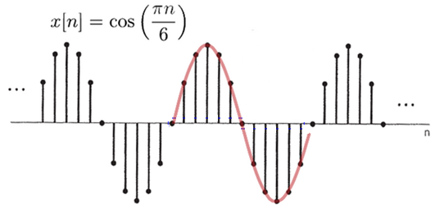
Periodicity of Discrete-Time Sinusoids
EXAMPLE: Is the sinusoid periodic? What is the fundamental period?

Slide 12
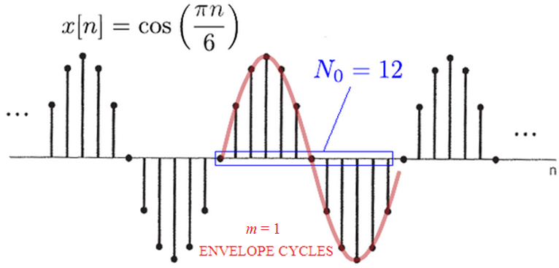
Periodicity of Discrete-Time Sinusoids
Periodic with fundamental period 12.

Slide 13

Periodicity of Discrete-Time Sinusoids
EXAMPLE: Is the sinusoid periodic? What is the fundamental period?

Slide 14
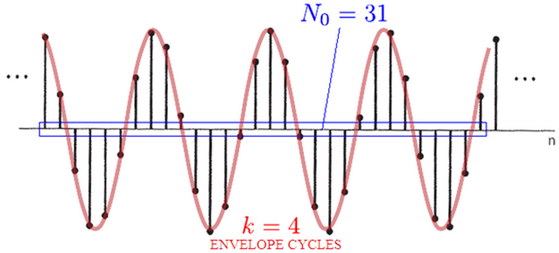
Periodicity of Discrete-Time Sinusoids

Slide 15

Periodicity of Discrete-Time Sinusoids
EXAMPLE: Is the sinusoid periodic? What is the fundamental period?

Slide 16
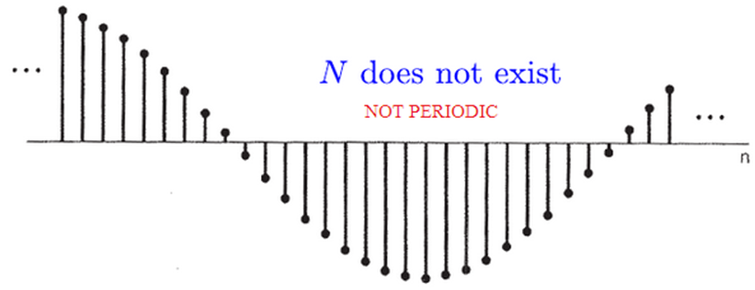
Periodicity of Discrete-Time Sinusoids

Slide 17
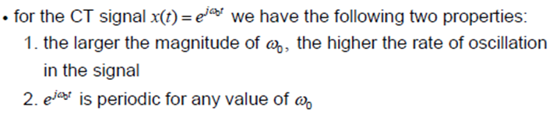
DT Sinusoids Frequency & Rate of Oscillation

Slide 18
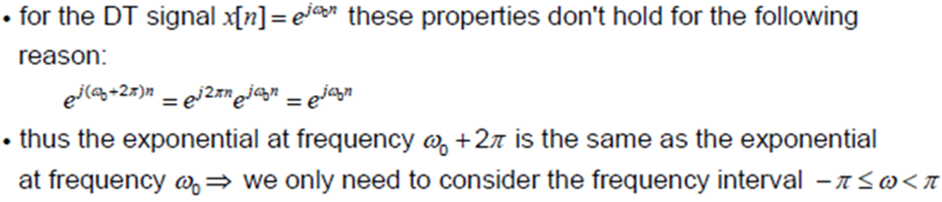
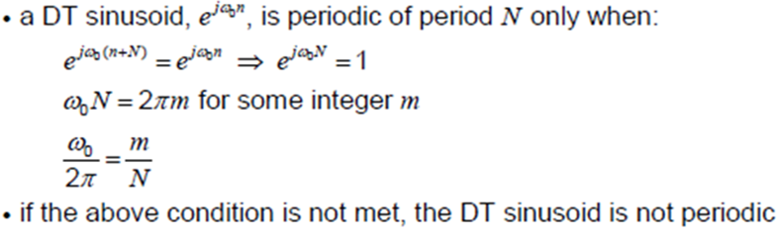
DT Sinusoids Frequency & Rate of Oscillation
Notes:
In CT, the product 2*pi*t depends upon the value of t which could be non-integer

Slide 19
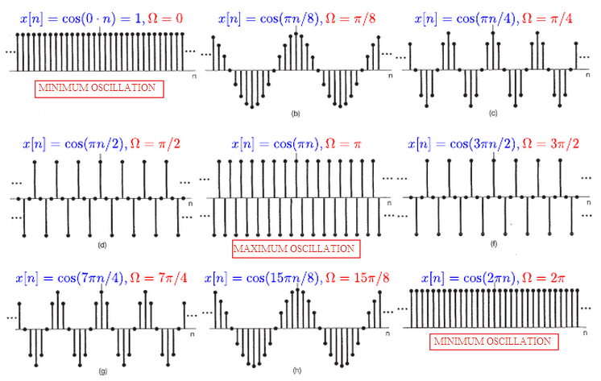
DT Sinusoids Frequency & Rate of Oscillation
Notes:
$ω$ can take any value but not all are periodic. Here only the values giving periodic signals are considered. Also, the oscillation rate increases with $ω$ up to a certain value and starts decreasing again. u[n] is not periodic.

Slide 20
Problem-2
Determine the fundamental period of the DT signal:
Notes:
The fundamental period of the combine signal is the LCM of the periods of the two separate signals.

Slide 21
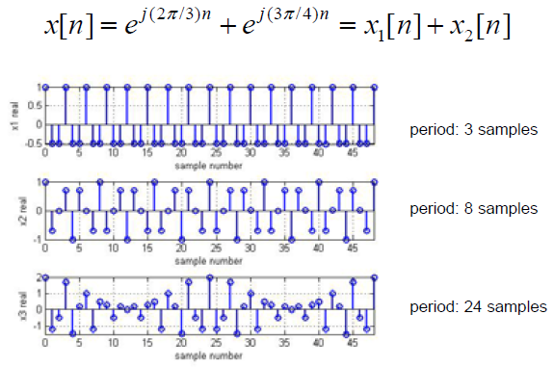
DT Sinusoids Frequency & Rate of Oscillation

Slide 22
END

