Slide 1
VECTOR CALCULUS I

Slide 2
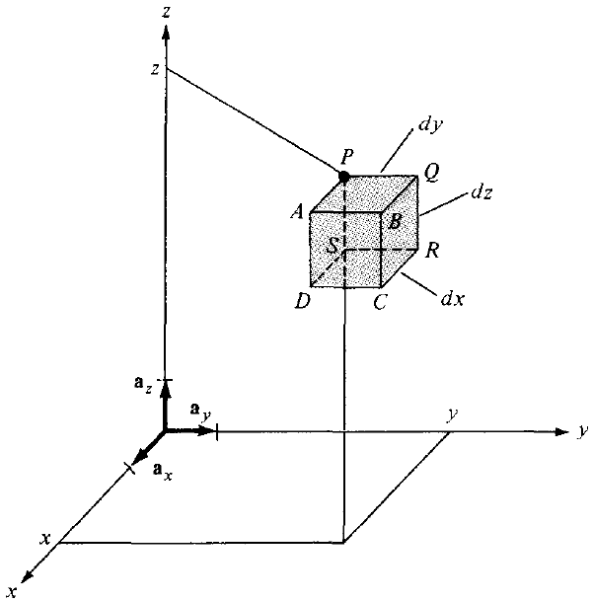

Differential Elements – Cartesian Coordinates
Differential elements in length, area, and volume are useful in vector calculus
Differential displacement or length is given by:

Slide 3
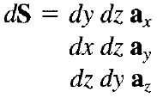

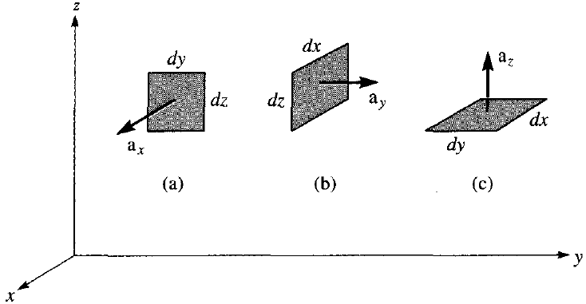
Differential Elements – Cartesian Coordinates
Differential normal areas are given by:
Differential volume is given by:

Slide 4
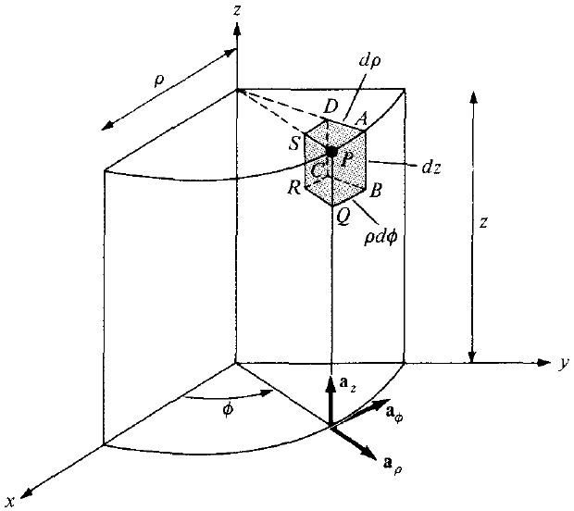
Differential Elements –Cylindrical Coordinates
Differential displacement or length is given as:

Slide 5
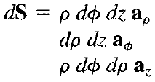

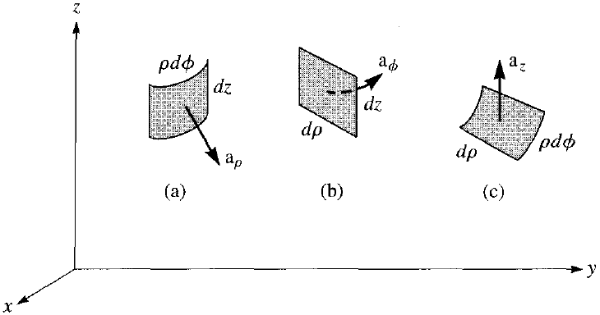
Differential Elements –Cylindrical Coordinates
Differential normal areas are given as:
Differential volume is given as:

Slide 6
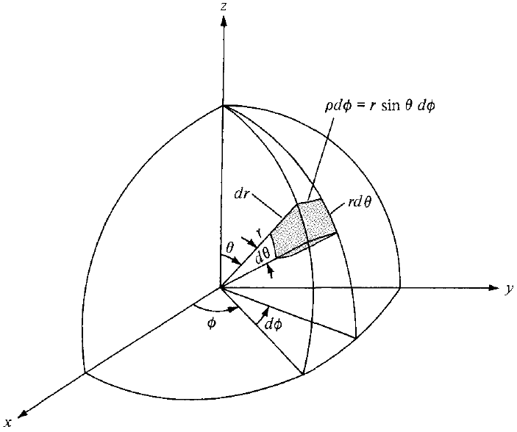
Differential Elements – Spherical Coordinates
Differential displacement or length is given as:

Slide 7
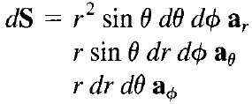

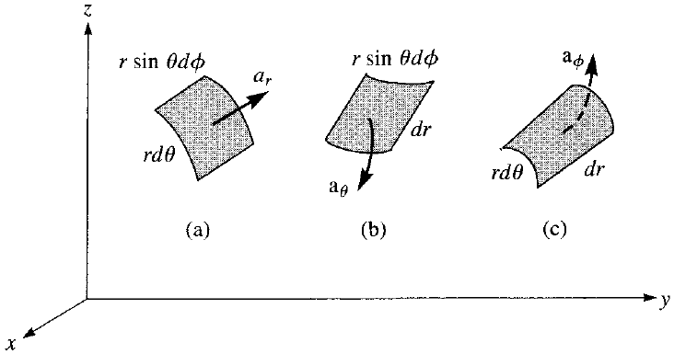
Differential Elements – Spherical Coordinates
Differential normal areas are:
Differential volume is:

Slide 8
Differential Elements
These differential elements are very important as they will be referred to again and again throughout the course
The student is encouraged to learn to derive them from the figures

Slide 9

Line Integral
Concept of integration will now be extended to cases when the integrand involves a vector
By a line we mean the path in space
The line integral of A along curve L is the integral of the tangential component of A along curve L:
Also called line integral of A around L (shown in figure on next slide)

Slide 10

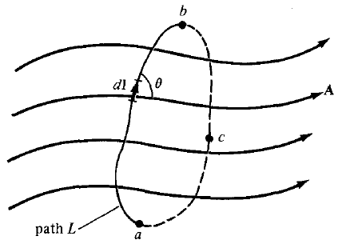
Line Integral
If the path of integration is a closed curve – the line integral becomes a closed contour integral
This is called the circulation of A around L

Slide 11


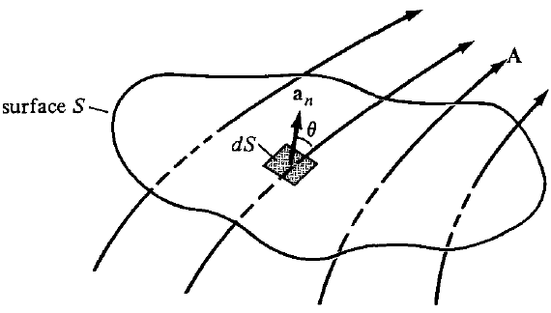
Surface Integral
Given a vector field A, continuous in a region containing the smooth surface S, the surface integral or the flux of A through S is:

Slide 12

Volume Integral
A closed line path defines an open surface whereas a closed surface defines a volume
If the scalar ρ_{v} is the volume density of a certain quantity, then the volume integral of ρ_{v} over the volume v is:
The physical meaning of a line, surface, or volume integral depends on the nature of the physical quantity represented by A or ρ_{v}
For example, line integral of an electric field around a closed loop is equal to the voltage generated in that loop

Slide 13

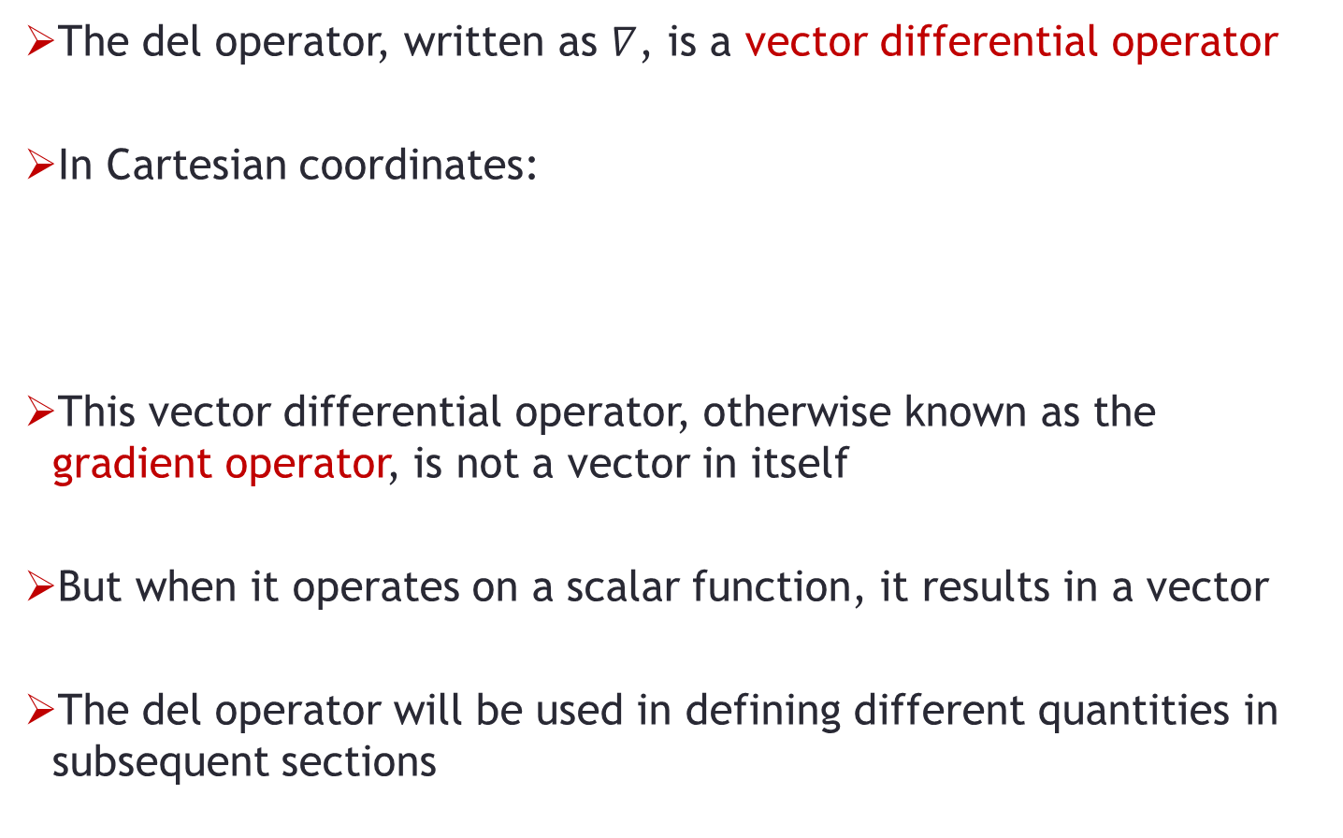
DEL Operator
The del operator, written as $∇$, is a vector differential operator
In Cartesian coordinates:
This vector differential operator, otherwise known as the gradient operator, is not a vector in itself
But when it operates on a scalar function, it results in a vector
The del operator will be used in defining different quantities in subsequent sections

Slide 14

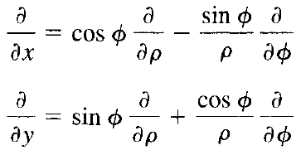

DEL Operator – Cylindrical Coordinate System
We have:
Hence:
By substitution:
Notes:
$\frac{∂}{∂x}=\frac{∂}{∂ρ}\frac{∂ρ}{∂x}+\frac{∂}{∂∅}\frac{∂∅}{∂x},$and $\frac{d}{dx}\left[\tan^{−1}\left(u\right)\right]=\frac{1}{1+u^{2}}\frac{d}{dx}[u]$ are required

Slide 15

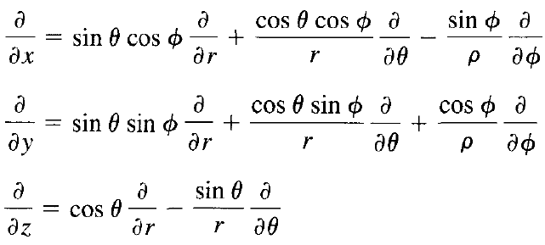

DEL Operator – Spherical Coordinate System
We have:
Hence:
By substitution:

Slide 16
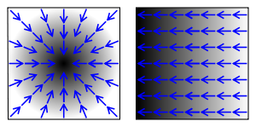
Gradient of a Scalar
The gradient of a scalar field V is a vector that represents both the magnitude and the direction of the maximum space rate of increase of V

Slide 17



Gradient of a Scalar
In Cartesian coordinates, we have:
For Cylindrical coordinates:
For Spherical coordinates:

Slide 18
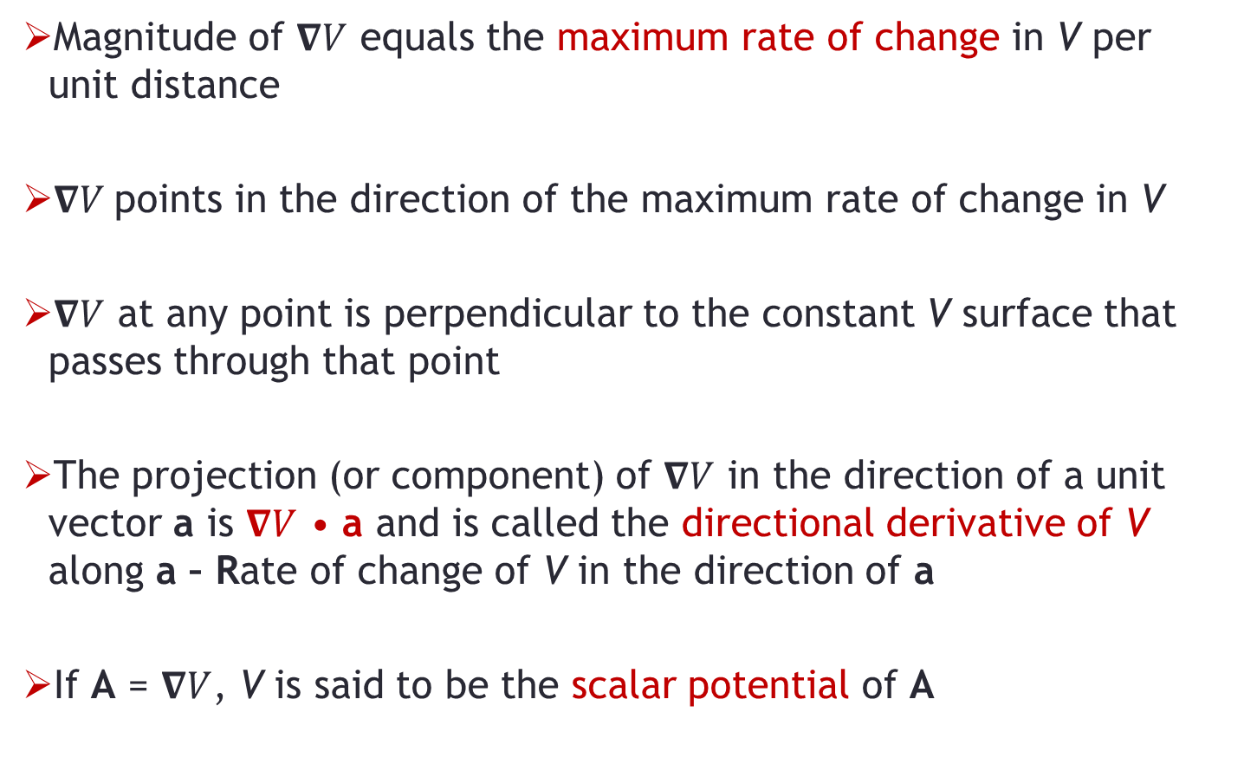
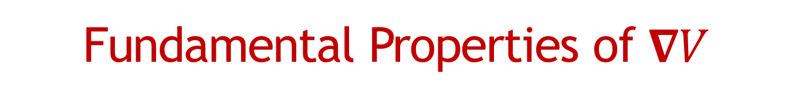
Fundamental Properties of $∇V$
Magnitude of $∇V$ equals the maximum rate of change in V per unit distance
$∇V$points in the direction of the maximum rate of change in V
$∇V$ at any point is perpendicular to the constant V surface that passes through that point
The projection (or component) of $∇V$ in the direction of a unit vector a is $∇V$ • a and is called the directional derivative of V along a – Rate of change of V in the direction of a
If A = $∇V$, V is said to be the scalar potential of A

Slide 19
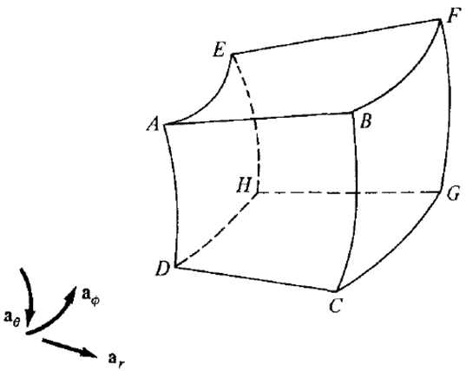
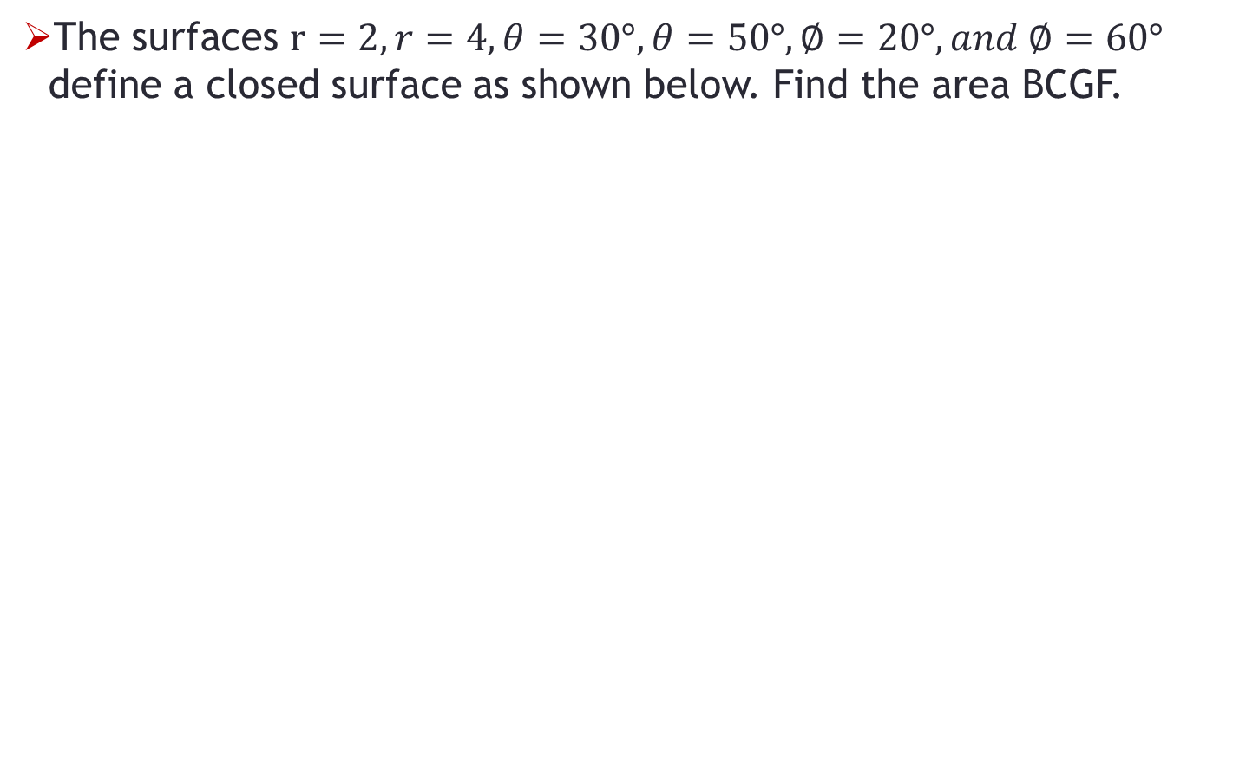
Problem-1
The surfaces $r=2, r=4, θ=30°, θ=50°, ∅=20°, and ∅=60°$ define a closed surface as shown below. Find the area BCGF.

