Slide 1
important Signals – Continuous Time

Slide 2
Motivation
These signals occur frequently in nature
They serve as basic building blocks from which we can construct many other signals
Sinusoidal and periodic complex signals are used to describe the characteristics of many physical processes
Constructing signals in this way will allow us to examine and understand more deeply the properties of both signals and systems

Slide 3

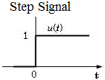
Continuous Time Unit Step Function
A basic continuous-time signal unit step function:
Note that u(t) is discontinuous at t = 0
The unit step function will be very important in examination of the properties of the systems

Slide 4
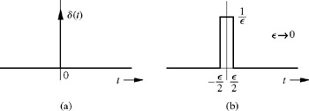
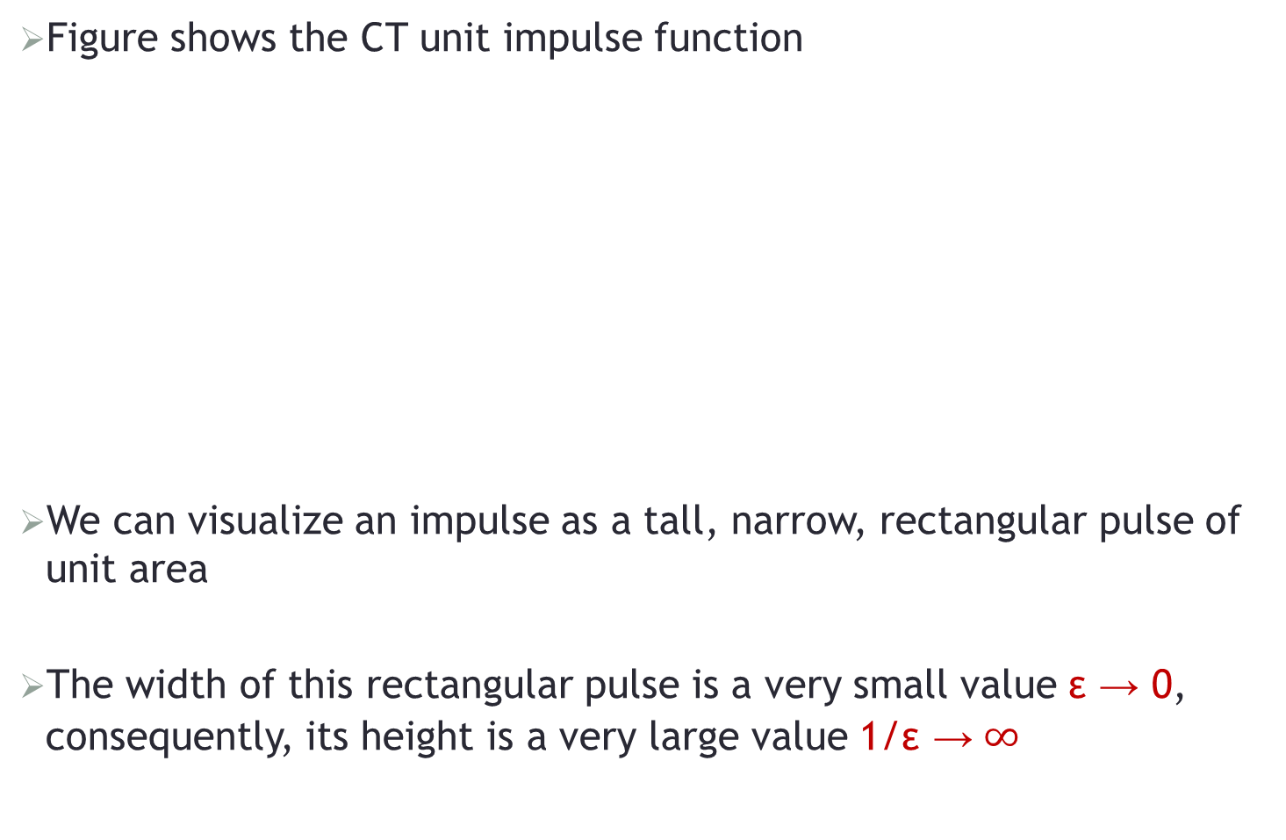
Continuous Time Unit Impulse Function
Figure shows the CT unit impulse function
We can visualize an impulse as a tall, narrow, rectangular pulse of unit area
The width of this rectangular pulse is a very small value ε → 0, consequently, its height is a very large value 1/ε →$∞$

Slide 5
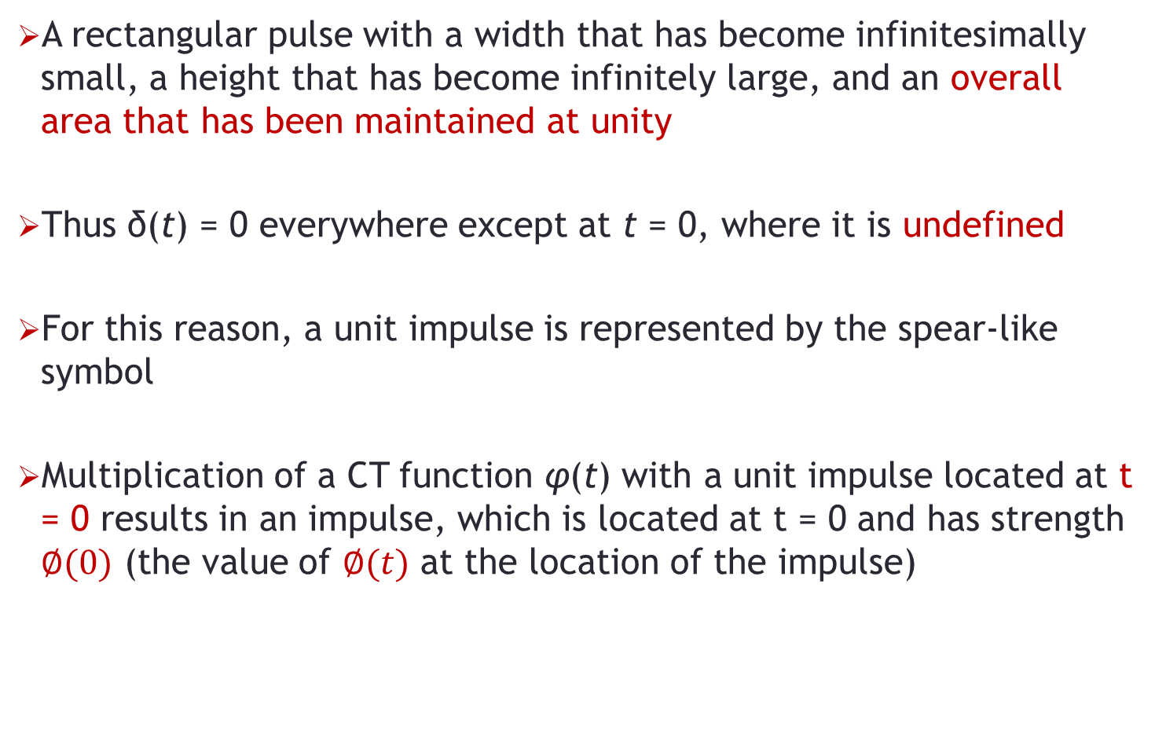
Continuous Time Unit Impulse Function
A rectangular pulse with a width that has become infinitesimally small, a height that has become infinitely large, and an overall area that has been maintained at unity
Thus δ(t) = 0 everywhere except at t = 0, where it is undefined
For this reason, a unit impulse is represented by the spear-like symbol
Multiplication of a CT function φ(t) with a unit impulse located at t = 0 results in an impulse, which is located at t = 0 and has strength $∅(0)$ (the value of $∅(t)$ at the location of the impulse)

Slide 6


Unit Impulse Function
The unit step function is the running integral of unit impulse function
The CT unit impulse is the first derivative of the CT unit step as:
Since u(t) is discontinuous at t = 0, it is not formally differentiable

Slide 7
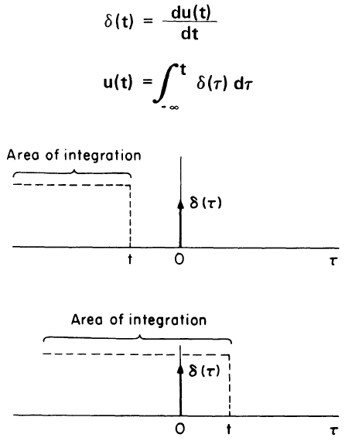
Continuous Time Unit Functions
The unit step expressed as the running integral of the unit impulse

Slide 8
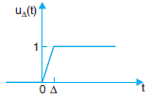

Practical Continuous Time Unit Functions
In practice, the unit step u_{Δ}(t) rises from the value 0 to the value 1 in a short-time interval of length Δ
The unit step can be thought of as an idealisation of u_{Δ}(t) for Limit Δ → 0
As Δ → 0 and the derivative becomes the impulse in practical sense as shown - (Unity area)

Slide 9
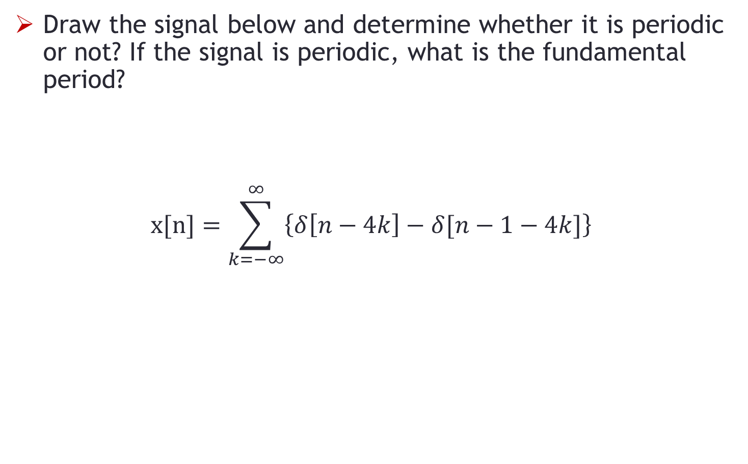
Problem-1
Draw the signal below and determine whether it is periodic or not? If the signal is periodic, what is the fundamental period?
$$x[n]=\sum_{k=−∞}^{∞}{\left\{δ\left[n−4k\right]−δ[n−1−4k]\right\}}$$

Slide 10
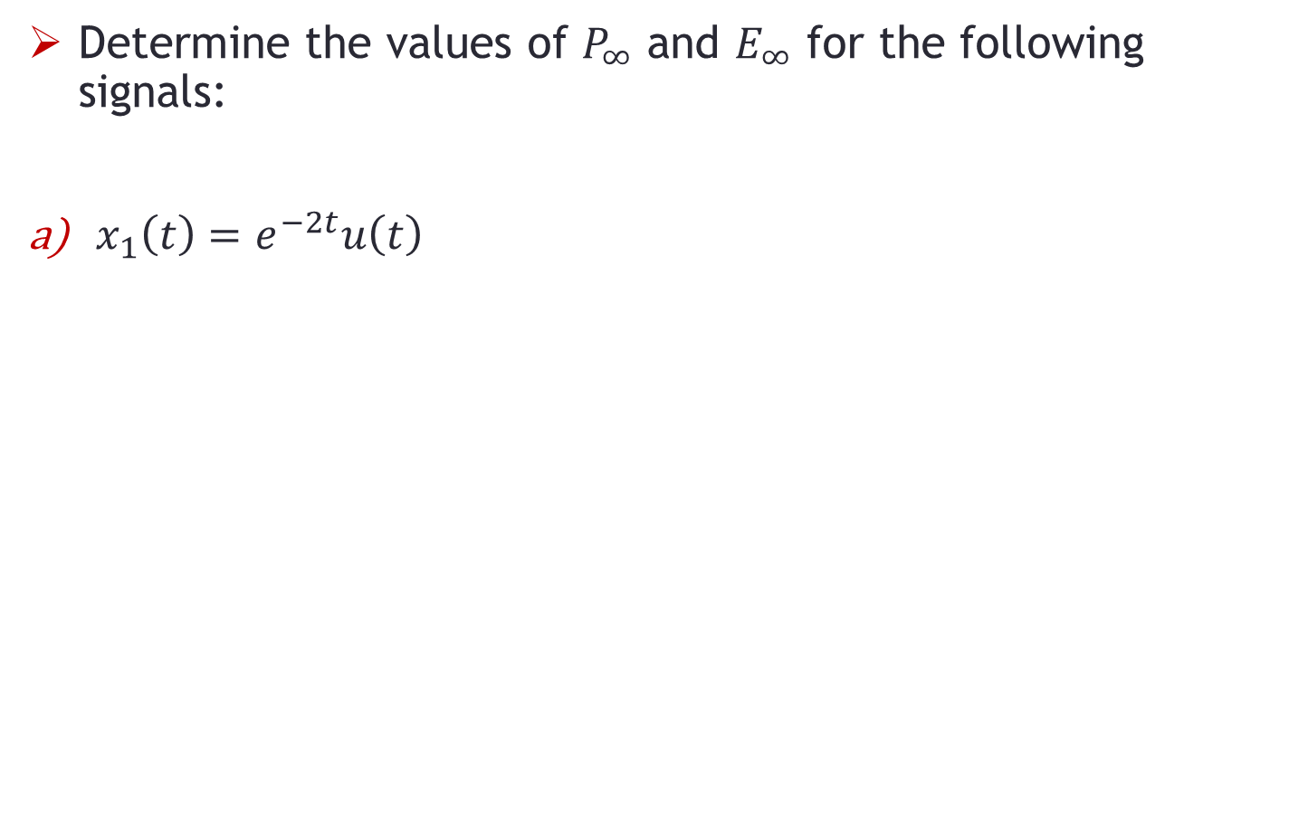
Problem-2
Determine the values of $P_{∞}$ and $E_{∞}$ for the following signals:
$x_{1}\left(t\right)=e^{−2t}u\left(t\right)$

Slide 11
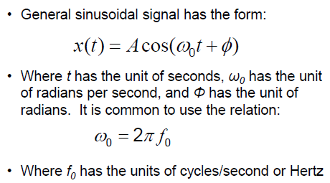
Sinusoidal Signals

Slide 12
Complex Numbers
Complex numbers are used when dealing with sinusoidal sources
Complex Numbers represent points in a two dimensional complex plane or s-plane that are referenced to two distinct axes
The horizontal axis is called the "real axis" while the vertical axis is called the "imaginary axis"
The real and imaginary parts of a complex number, Z are abbreviated as Re(Z) and Im(Z), respectively

Slide 13
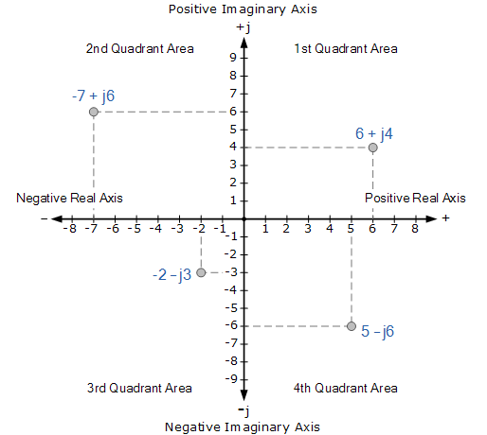
Complex Numbers
Complex numbers shown on the complex plane

Slide 14
Complex Numbers
We can use phasors to represent sinusoidal waveforms
The amplitude and phase angle of phasors can be written in the form of a complex number
A complex number can be represented in one of three ways:
Z = x + jy » Rectangular Form
Z = A ∠Φ » Polar Form
Z = A e^{jΦ} » Exponential Form

Slide 15
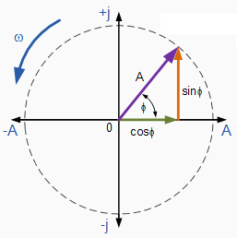
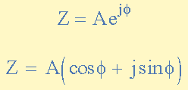

Complex Numbers
Complex numbers in exponential form are represented as below:
The phasor will rotate as the angle ф changes

Slide 16
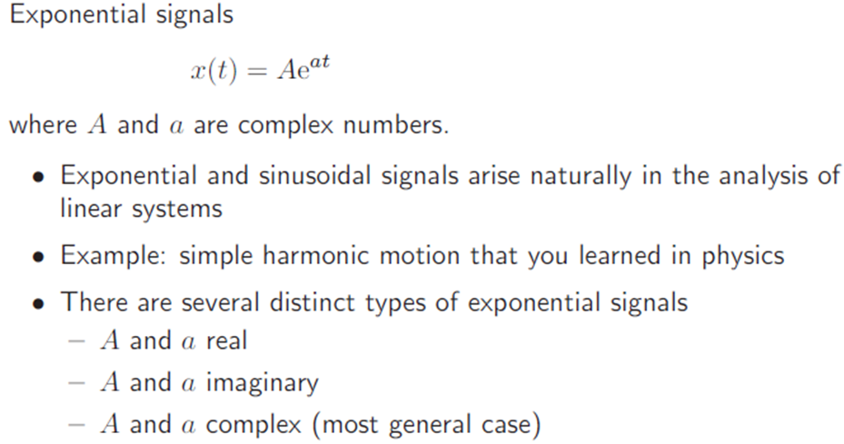
Exponential Signals
Notes:
Φρομ: ηττπ://βεττερεξπλαινεδ.χομ/αρτιχλεσ/αν−ιντυιτιϖε−γυιδε−το−εξπονεντιαλ−φυνχτιονσ−ε/
e is NOT Just a Number
Describing e as “a constant approximately 2.71828…” is like calling pi “an irrational number, approximately equal to 3.1415…”. Sure, it’s true, but you completely missed the point.
Pi is the ratio between circumference and diameter shared by all circles. It is a fundamental ratio inherent in all circles and therefore impacts any calculation of circumference, area, volume, and surface area for circles, spheres, cylinders, and so on. Pi is important and shows all circles are related, not to mention the trigonometric functions derived from circles (sin, cos, tan).
e is the base rate of growth shared by all continually growing processes. e lets you take a simple growth rate (where all change happens at the end of the year) and find the impact of compound, continuous growth, where every nanosecond (or faster) you are growing just a little bit.
e shows up whenever systems grow exponentially and continuously: population, radioactive decay, interest calculations, and more. Even jagged systems that don’t grow smoothly can be approximated by e.
Just like every number can be considered a “scaled” version of 1 (the base unit), every circle can be considered a “scaled” version of the unit circle (radius 1), and every rate of growth can be considered a “scaled” version of e (the “unit” rate of growth). So e is not an obscure, seemingly random number. e represents the idea that all continually growing systems are scaled versions of a common rate.

Slide 17
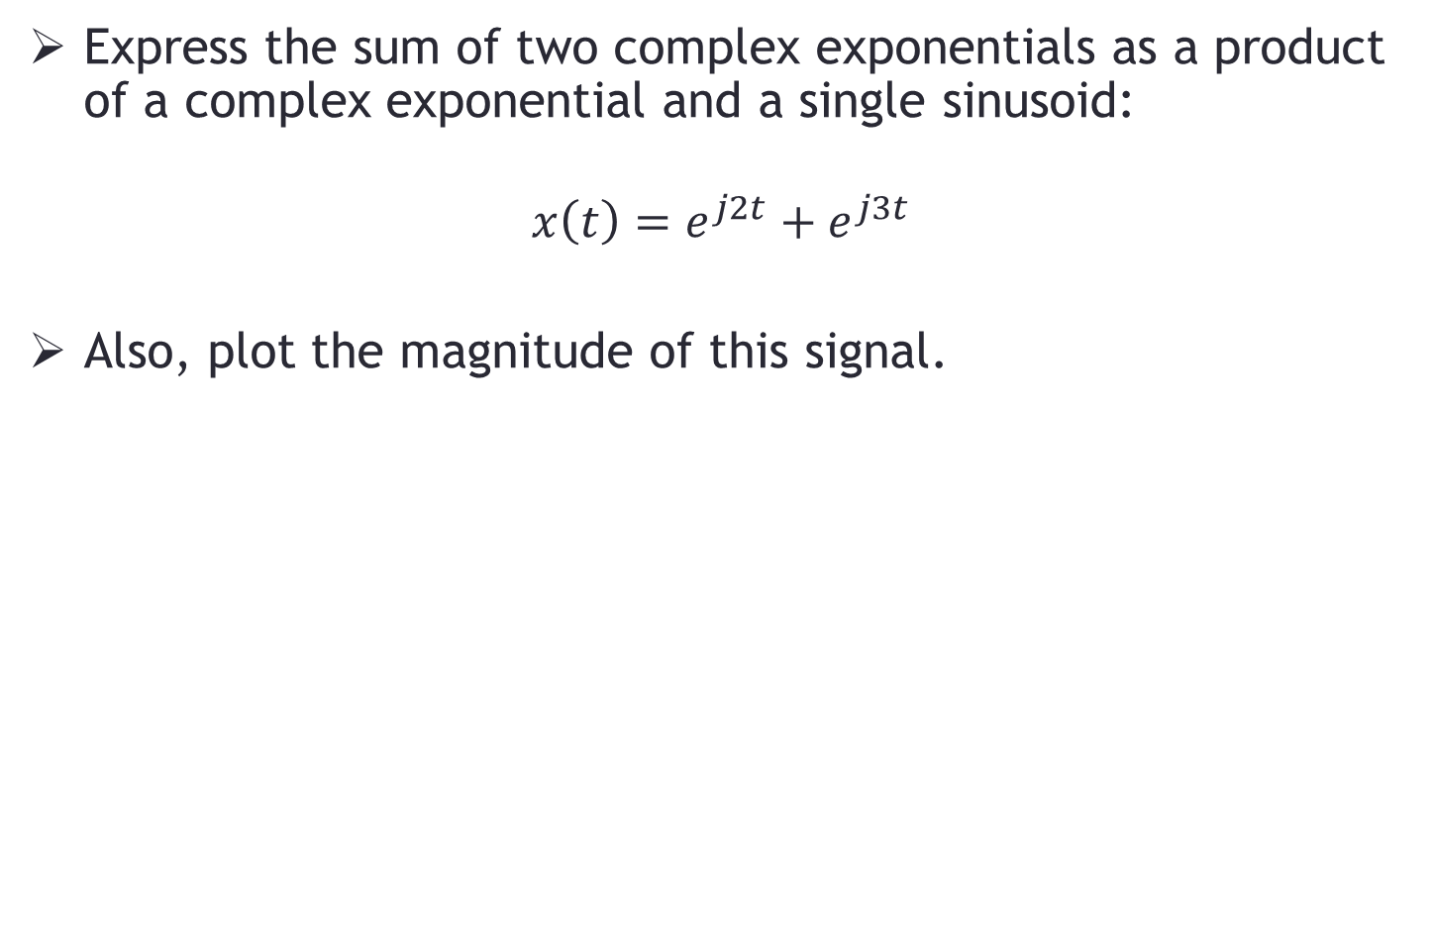
Problem-3
Express the sum of two complex exponentials as a product of a complex exponential and a single sinusoid:
$$x\left(t\right)=e^{j2t}+e^{j3t}$$
Also, plot the magnitude of this signal.

Slide 18
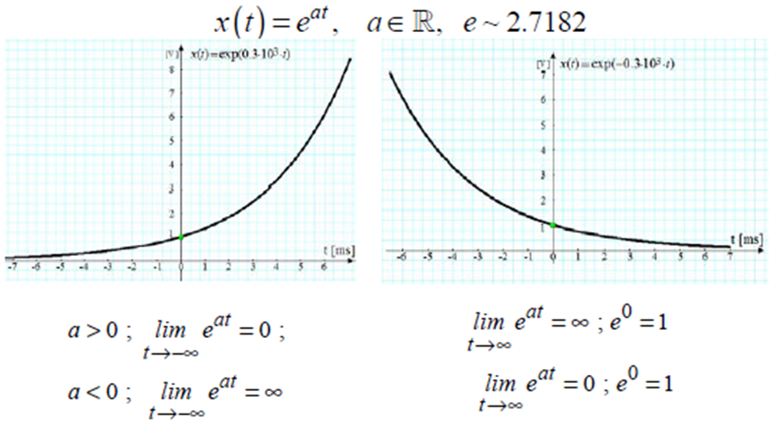
Exponential Signals
A and a are real
Notes:
Richard Feynman called Euler's formula "our jewel” and "one of the most remarkable, almost astounding, formulas in all of mathematics.”
So what’s so remarkable about this elegant mathematical formula. For one it combines in one equation, imaginary numbers, exponents, and trigonometric functions.
The following explanation is from: http://mathchaostheory.suite101.com/article.cfm/formulating_eulers_identity
One form of writing the Euler’s formula is e^{j*pi} +1 =0.
The beauty of Euler's Identity arises from a number of directions. Most evidently, there is the sheer number of mathematical ideas being used in a single expression, resulting in the simplest possible answer - 0. Within the equation one finds themselves utilizing the standard algebraic ideas of addition (or subtraction depending on how it is written), multiplication, powers and mathematical equivalence. In addition, five of math's most fundamental constants find their values working together in a mysteriously interconnected way:
e is Euler's number, with a value of roughly 2.718.
i is the Imaginary number, equivalent to the idea of the square root of negative one.
pi is the well-known constant which refers to the simple, yet irrational relationship between a circle's circumference and diameter, with a value of approximately 3.14159.
The other two fundamental constants at use here are 0 and 1 which are very useful, multipurpose constant which can be used in countless algebraic capacities.
The true beauty of Euler's Identity comes from the fact that, while the true nature of several of these constants continues to remain a mystery to mathematicians (though it is clear that they possess many real-world manifestations), within the confines of this equation they all work together in such a way that they interlock like pieces of a mathematical jigsaw puzzle, the end result of which has the mathematical traveler ending up right back where he began - at the journey's origin.
An intuitive way of looking at Complex Exponential:
[http://johnlawrenceaspden.blogspot.com/2009/10/ei-pi-1.html]
Complex numbers are arrows. They have direction and length.
When you exponentiate something, you are growing it by a multiple of itself.
e^t is the number which 1 becomes after t seconds of smooth exponential growth.
e^2t is the number which 1 becomes after t seconds of growing at twice that rate.
e^(-t) is t seconds of growth in the opposite direction (a big thing gets smaller at a rate proportional to itself). (Otherwise known as exponential decay)
But multiplication by a complex number can also involve turning.
Consider i*9 -> 9i
The complex number 9 is an arrow pointing east length 9
The complex number i is an arrow pointing north length 1
Multiply them together and you get an arrow length 9 pointing north.
Multiplication by i is the same as rotation through 90 degrees anticlockwise.
What does it mean to grow at right angles to yourself?
It means to turn. And because the direction you're growing in is always at right angles to the direction you're pointing in, you never get longer or shorter.
So e^(it) is what happens after t seconds of turning anticlockwise.
How fast are we turning? Well, our length is always 1, so the speed of turning is always 1. After t seconds, the tip of the turning arrow will have moved along an arc of length t.
Once it's moved along an arc of length pi, the arrow is pointing in the opposite direction to where it started.
An arrow length 1 pointing west is also known as -1.
So e^(i pi) = -1.
In fact e^(it) is where the turning arrow is after t seconds. It will have traced out an arc of length t.
So e^(i pi/2) is an arrow pointing north. e^(i pi/2) = i
More generally, if you resolve the turning arrow into a north arrow and an east arrow, the east component will be one side of a triangle with an angle of t radians and the north component will be the other.
e^(i t) = cos t + i sin t.
Text Courtsey of Dr Junaid Qadir

Slide 19
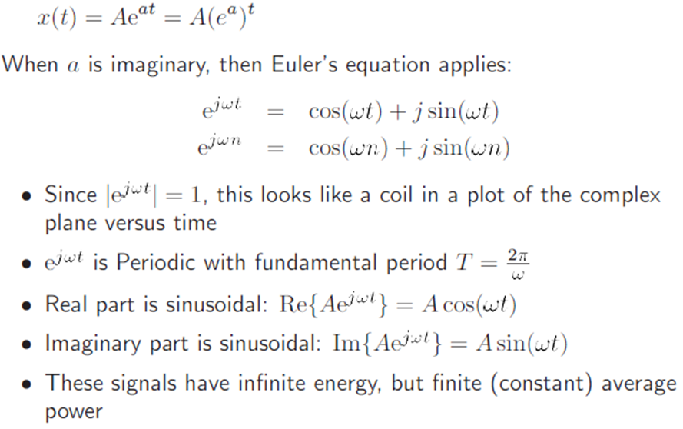
Exponential Signals
a is imaginary

Slide 20
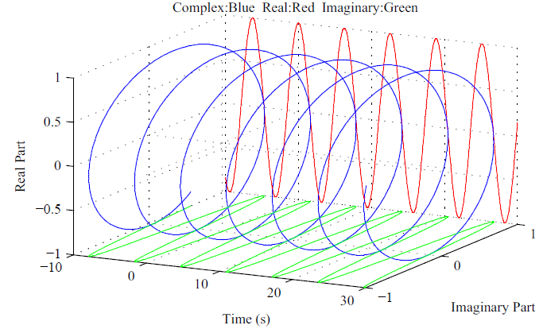
Exponential Signals
a is imaginary:
Notes:
From www.dspdesignline.com:
[http://www.dspdesignline.com/howto/208403158]
That e^{j2πf}_{o}^{t} signal is not just mathematical mumbo jumbo! We can physically generate an e^{j2πf}_{o}^{t} signal and transmit it to a laboratory down the hall. All we need is two equal-amplitude sinusoidal signal generators, set to the same frequency f_{o}. (However, somehow we have to synchronize those two hardware generators so that their relative phase shift is fixed at 90°. Their outputs need to be orthogonal.) Next we connect coax cables to the generators' output connectors and run those two cables, labeled 'Cosine' for our cosine signal and 'Sine' for our sinewave signal, down the hall to their destination. In the other lab, if the continuous real signals were connected to the horizontal and vertical input channels of an oscilloscope, as shown at http://i.cmpnet.com/dspdesignline/2008/06/lyons_pt2_4.gif, we'd see a bright spot rotating counterclockwise in a circle on the scope's display. (Remembering, of course, to set the scope's Horizontal Sweep control to the 'External' position.)
%Matlab code for the above figure
clear all;
clc;
A=1;
f0=1;
Phi=0;
w=2*pi*f0;
phse=Phi*pi/180;
i=0;
for t=0.01:0.01:3
i=i+1;
y(i)=A*cos(w*t+phse);
x(i)=A*sin(w*t+phse);
z(i)=t;
figure(1)
plot3(z,x,y),xlabel('time'),ylabel('sin'),zlabel('cos');
end

Slide 21
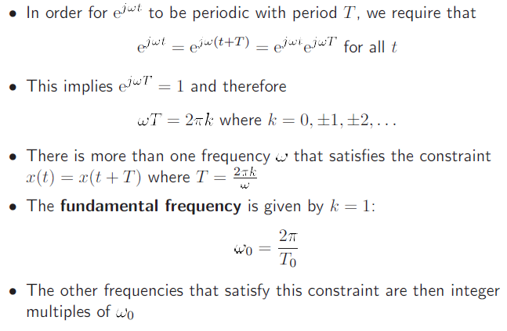
Sinusoidal Exponential Harmonics
Notes:
From Signal Processing First:
The inverse Euler’s formula for cosine signals is cos (ϴ) = ½*{ e^{jϴ) + e^{-jϴ)}.
Similarly, sine signal is sin (ϴ) = 1/2j*{ e^{jϴ) - e^{-jϴ)}.
These formulas have an interesting interpretation. The real cosine signal with frequency ω is actually composed of two complex exponential signals; one with positive frequency ω and one with negative frequency –ω. The complex amplitude of the positive frequency is ½*X and the complex amplitude of the negative frequency is ½* X* where X* is the complex conjugate of X.
From [http://en.wikipedia.org/wiki/Negative_frequency]:
The concept of negative and positive frequency can be as simple as a wheel rotating one way or the other way. A signed value of frequency indicates both the rate and direction of rotation. The rate is expressed in units such as revolutions (aka cycles) per second (hertz) or radians/second (where 1 cycle corresponds to 2π radians).

Slide 22
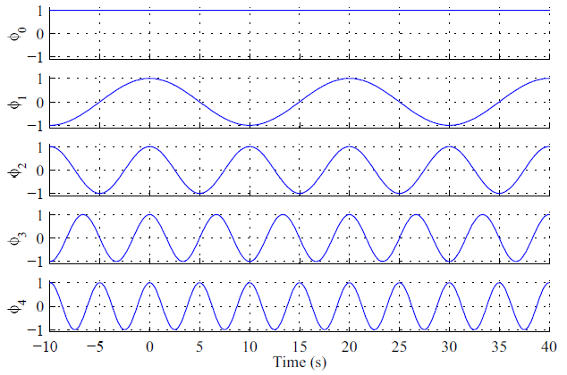
Sinusoidal Exponential Harmonics
Example of continuous-time harmonics

Slide 23
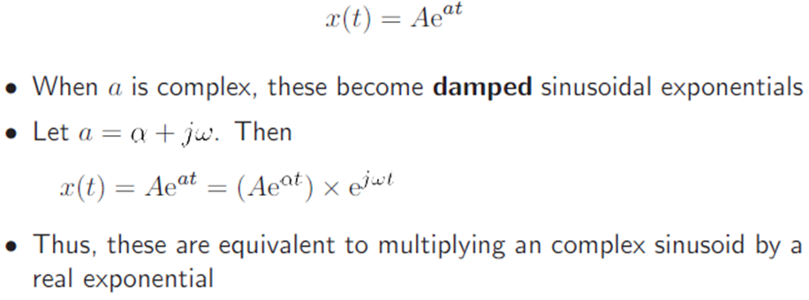
Damped Complex Sinusoidal Exponentials

Slide 24
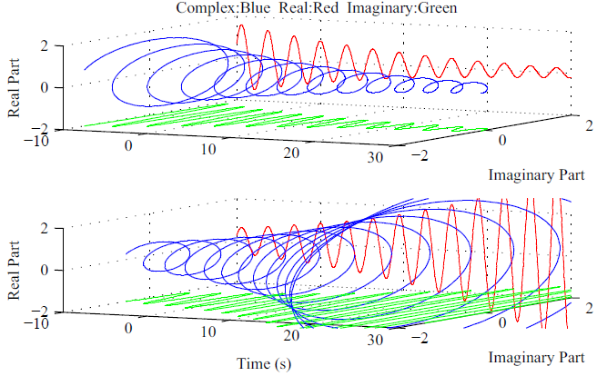
Damped Complex Sinusoidal Exponentials

Slide 25
END

