Slide 1
spherical COORDINATES

Slide 2
Spherical Coordinates (r,θ,Φ)
Most appropriate when dealing with problems having a degree of spherical symmetry
A point P in spherical coordinates can be represented as (r,θ,Φ)
r is defined as the distance from the origin to point P or the radius of a sphere centered at the origin and passing through P
θ is the angle between the z-axis and the position vector of P
Φ is measured from the x-axis and is the same angle as in cylindrical coordinates

Slide 3
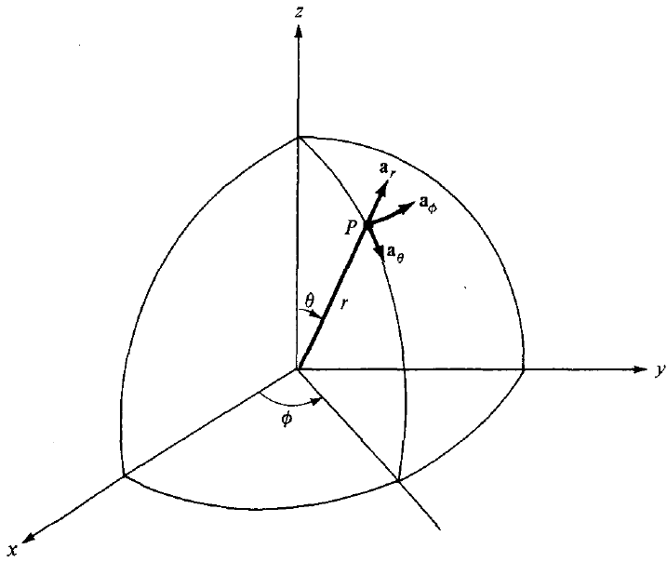
Spherical Coordinates (r,θ,Φ)

Slide 4
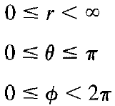

Spherical Coordinates (r,θ,Φ)
The ranges of the variables are:
A vector in spherical coordinates may be written as:
a_{r}, a_{θ}, and a_{Φ} are unit vectors in the r, θ and Φ directions
The magnitude of A is:

Slide 5

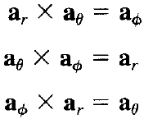
Spherical Coordinates (r,θ,Φ)
a_{r} being directed along the radius – In the direction of increasing r
a_{θ} in the direction of increasing θ
a_{Φ} in the direction of increasing Φ. Therefore:
AND

Slide 6
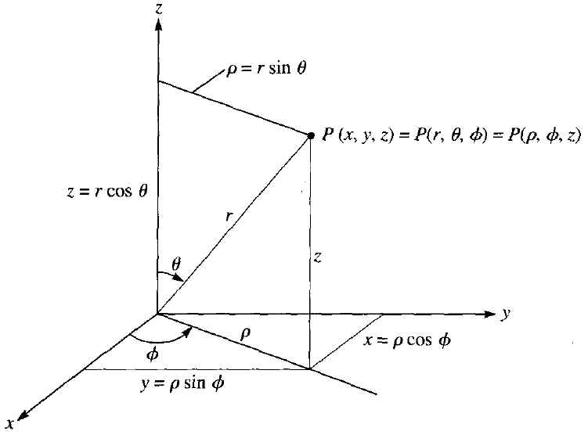
Point Transformations
Relation of space variables (x, y, z) in Cartesian coordinates with variables (r,θ,Φ) of a spherical coordinate system

Slide 7

Point Transformations
For transforming a point from Cartesian (x, y, z) to spherical (r,θ,Φ) coordinates:
For transforming a point from Spherical (r,θ,Φ) to Cartesian (x, y, z) coordinates:

Slide 8
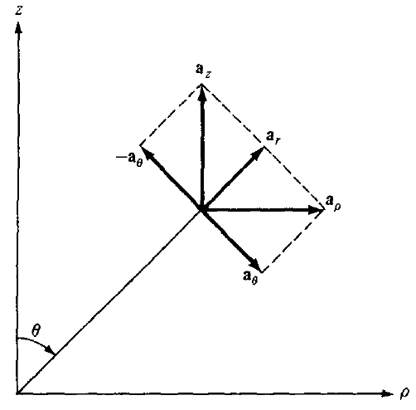
Unit Vector Transformations

Slide 9
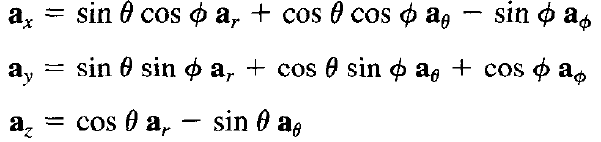
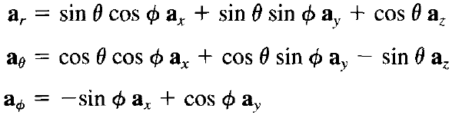
Unit Vector Transformations
The unit vectors (a_{x}, a_{y}, a_{z}) and (a_{r}, a_{θ}, a_{Φ}) are related as follows:
OR

Slide 10

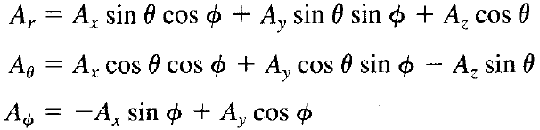
Vector Transformations
Substitute the unit vector transformations into the equation below:
After collecting terms, we get:
OR

Slide 11
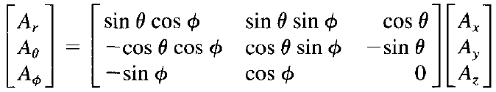
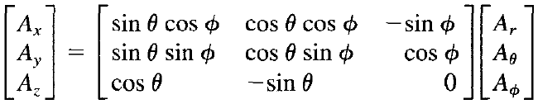
Vector Transformations
The transformations may be written in matrix form as:
AND

Slide 12

Distance between two points
In point or vector transformation the point or vector has not changed; it is only expressed differently
For example, the magnitude of a vector will remain the same after the transformation and this may serve as a way of checking the result of the transformation
The distance between two points is usually necessary in Electromagnetic theory
The distance d between two points with position vectors r₁ and r₂ is generally given by:

Slide 13

Distance between two points
Using point transformation, this distance may be expressed in Cartesian, cylindrical and spherical coordinates as below:

Slide 14
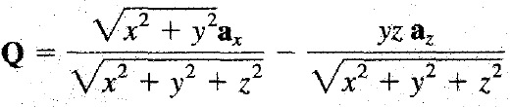
Problem-1
Convert point P(0, - 4 , 3) from Cartesian to spherical coordinates
Evaluate Q at P in Cartesian and spherical coordinate systems

