Slide 1
Properties of Signals

Slide 2
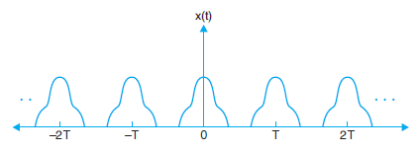
Periodic Signals
A periodic continuous-time signal x(t) has the property that for a positive value of time T,
x(t) = x(t + T), for all value of t
Then x(t) is periodic with time period T
The fundamental period T₀ is the smallest positive value of T for which the above equation holds.
Thus x(t) is also periodic with period 2T, 3T, …….

Slide 3
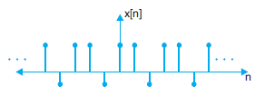
Periodic Signals
A periodic discrete-time signal x[n] has the property that for a positive integer N,
x[n] = x[n + N], for all values of n.
The discrete time signal x[n] is periodic with period N if it is unchanged by a time shift of N
The fundamental period N₀ is the smallest positive value of N for which the above equation holds
Thus x[n] is periodic with period 2N, 3N, ........

Slide 4
Periodic Signals – Sine Wave
An important periodic signal is the sinusoidal signal shown in figure below:
Unit of t is seconds, unit of ф is radians and that of ω₀ radians/second, respectively
ω₀ = 2πf₀ = 2π/T₀, where f₀ is in cycles/second or hertz(Hz)
The sinusoidal signal is periodic with fundamental period T₀ = 1/f₀
Signals that are not periodic are said to be aperiodic

Slide 5
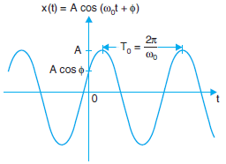
Periodic Signals – Sine Wave

Slide 6

Energy of a Signal
We may consider the area under a signal x(t) as a possible measure of its size because it takes account not only of the amplitude but also of the duration
However, this will be a defective measure because even for a large signal x(t), its positive and negative areas could cancel each other, indicating a signal of small size
This difficulty can be corrected by defining the signal size as the area under x²(t), which is always positive

Slide 7

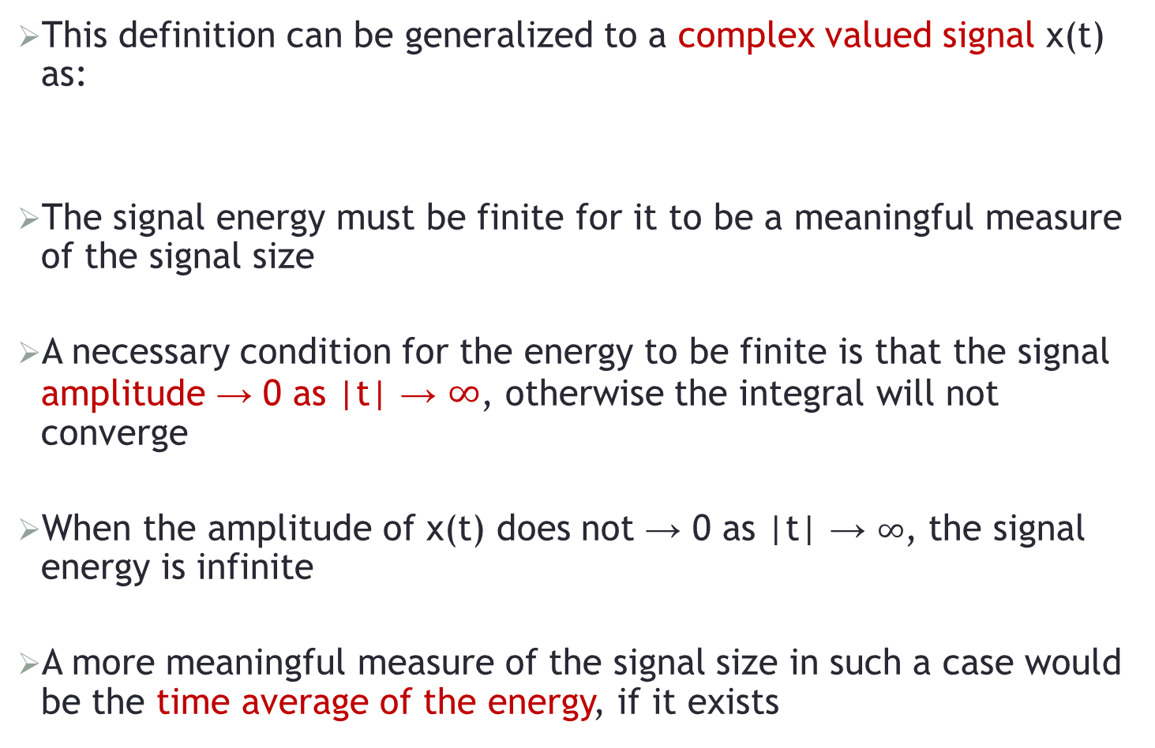
Energy of a Signal
This definition can be generalized to a complex valued signal x(t) as:
The signal energy must be finite for it to be a meaningful measure of the signal size
A necessary condition for the energy to be finite is that the signal amplitude → 0 as |t| → $∞$, otherwise the integral will not converge
When the amplitude of x(t) does not → 0 as |t| → $∞$, the signal energy is infinite
A more meaningful measure of the signal size in such a case would be the time average of the energy, if it exists
Notes:
If we have already considered magnitude, then why do we need to take the square of the signal to find the energy?
Taking the square of the signal when calculating energy serves several important purposes:
Non-Negative Value: Just considering the magnitude ensures that the result is non-negative, but it doesn't adequately capture the intensity or power of the signal. By squaring the magnitude, you ensure that the energy is always positive and that larger values of the signal contribute more to the energy, emphasizing the significance of higher signal amplitudes.
Weighting: Squaring the signal effectively weights the contributions of different points in time (for continuous signals) or different samples (for discrete signals) based on their amplitudes. Larger values contribute more to the energy calculation, reflecting their higher power.
Mathematical Simplicity: The square of the magnitude simplifies the energy calculation and leads to a consistent mathematical expression. It allows for easier mathematical manipulation, integration (for continuous signals), or summation (for discrete signals), making energy calculations more tractable.
Physical Interpretation: The square of the magnitude results in energy units that match the square of the original signal units. This is physically meaningful and aligns with the concept of energy as the ability to do work. It provides a clear interpretation of energy that corresponds to the signal's intensity.
Compatibility with Power Calculations: In many applications, energy is closely related to power. Power is the rate at which energy is transferred or used, and it is often proportional to the square of the signal's magnitude. Therefore, using the square of the magnitude ensures consistency when comparing energy and power.
In summary, taking the square of the signal when calculating energy is a common and meaningful approach because it provides a non-negative value that reflects the intensity and power of the signal. It simplifies mathematical calculations, aligns with physical interpretations, and is compatible with related concepts like power. This squared magnitude is a standard and widely accepted way to quantify the energy of a signal in both continuous and discrete domains.

Slide 8


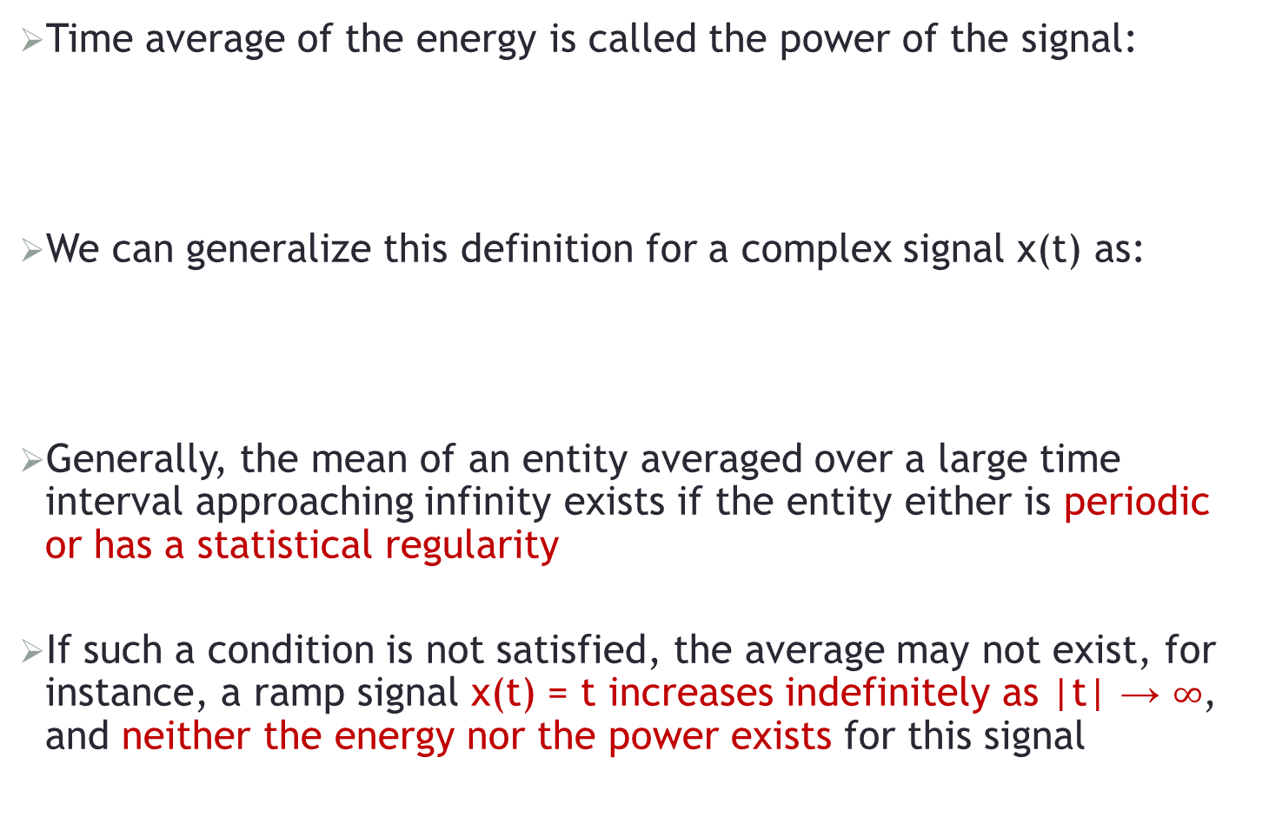
Power of a Signal
Time average of the energy is called the power of the signal:
We can generalize this definition for a complex signal x(t) as:
Generally, the mean of an entity averaged over a large time interval approaching infinity exists if the entity either is periodic or has a statistical regularity
If such a condition is not satisfied, the average may not exist, for instance, a ramp signal x(t) = t increases indefinitely as |t| → $∞$, and neither the energy nor the power exists for this signal

Slide 9
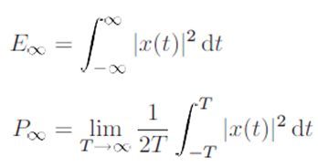
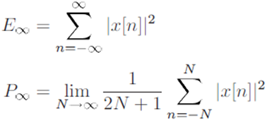
Energy & Power of a DT Signal
The energy and power for a CT signal are given as:
The energy and power for a DT signal are given as:

Slide 10
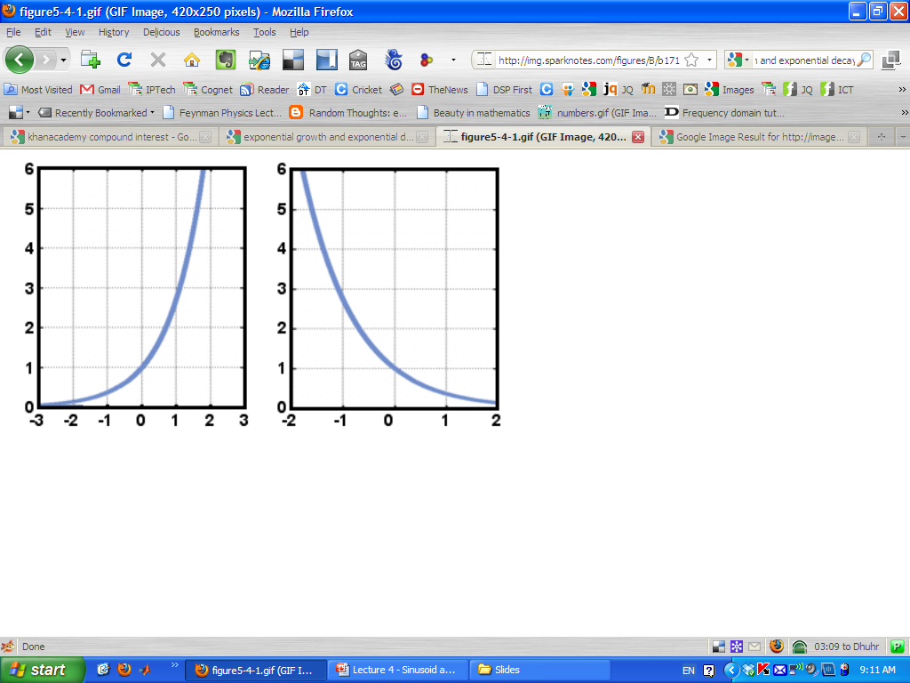
Classification of Signals based upon Energy and Power
1
?
Notes:
With the definition of energy and power, we can define three important signals:
Signals with finite total energy and with zero average power:
These are signals for which E < ∞.
Such a signal must have zero average power since in the CT case, to calculate P, T -> ∞; any finite value of E divided by infinite T would give zero power
b) Signals with infinite total energy and finite average power:
We know that P > 0 gives us infinite total energy because if the power/ unit time is non-zero then integrating/ or summing this over an infinite time-interval will give us infinite energy.
For example, a constant signal having value of 4 has infinite energy but average power P=16.
c) Signals with infinite total energy and infinite average power:
A simple example is the ‘ramp’ signal in which x(t) = t. Such a signal has infinite energy/ power.
Text Courtesy of Dr Junaid Qadir

Slide 11
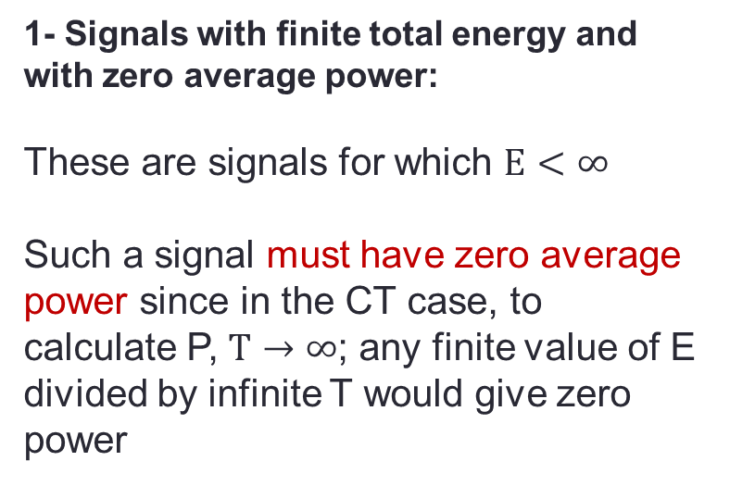
Classification of Signals based upon Energy and Power
1- Signals with finite total energy and with zero average power:
These are signals for which $E<∞$
Such a signal must have zero average power since in the CT case, to calculate P, $T→∞$; any finite value of E divided by infinite T would give zero power
1
Finite Energy and Zero Power
Notes:
With the definition of energy and power, we can define three important signals:
Signals with finite total energy and with zero average power:
These are signals for which E < ∞.
Such a signal must have zero average power since in the CT case, to calculate P, T -> ∞; any finite value of E divided by infinite T would give zero power
b) Signals with infinite total energy and finite average power:
We know that P > 0 gives us infinite total energy because if the power/ unit time is non-zero then integrating/ or summing this over an infinite time-interval will give us infinite energy.
For example, a constant signal having value of 4 has infinite energy but average power P=16.
c) Signals with infinite total energy and infinite average power:
A simple example is the ‘ramp’ signal in which x(t) = t. Such a signal has infinite energy/ power.
Text Courtesy of Dr Junaid Qadir

Slide 12
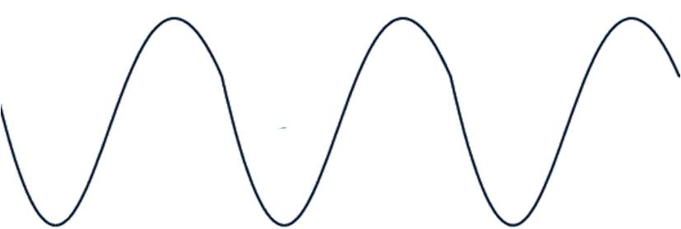
Classification of Signals based upon Energy and Power
2
?
Notes:
With the definition of energy and power, we can define three important signals:
Signals with finite total energy and with zero average power:
These are signals for which E < ∞.
Such a signal must have zero average power since in the CT case, to calculate P, T -> ∞; any finite value of E divided by infinite T would give zero power
b) Signals with infinite total energy and finite average power:
We know that P > 0 gives us infinite total energy because if the power/ unit time is non-zero then integrating/ or summing this over an infinite time-interval will give us infinite energy.
For example, a constant signal having value of 4 has infinite energy but average power P=16.
c) Signals with infinite total energy and infinite average power:
A simple example is the ‘ramp’ signal in which x(t) = t. Such a signal has infinite energy/ power.
Text Courtesy of Dr Junaid Qadir

Slide 13
Classification of Signals based upon Energy and Power
2
2- Signals with infinite total energy and finite average power:
Infinite Energy and Finite Power
Notes:
With the definition of energy and power, we can define three important signals:
Signals with finite total energy and with zero average power:
These are signals for which E < ∞.
Such a signal must have zero average power since in the CT case, to calculate P, T -> ∞; any finite value of E divided by infinite T would give zero power
b) Signals with infinite total energy and finite average power:
We know that P > 0 gives us infinite total energy because if the power/ unit time is non-zero then integrating/ or summing this over an infinite time-interval will give us infinite energy.
For example, a constant signal having value of 4 has infinite energy but average power P=16.
c) Signals with infinite total energy and infinite average power:
A simple example is the ‘ramp’ signal in which x(t) = t. Such a signal has infinite energy/ power.
Text Courtesy of Dr Junaid Qadir

Slide 14
Classification of Signals based upon Energy and Power
3
?
Notes:
With the definition of energy and power, we can define three important signals:
Signals with finite total energy and with zero average power:
These are signals for which E < ∞.
Such a signal must have zero average power since in the CT case, to calculate P, T -> ∞; any finite value of E divided by infinite T would give zero power
b) Signals with infinite total energy and finite average power:
We know that P > 0 gives us infinite total energy because if the power/ unit time is non-zero then integrating/ or summing this over an infinite time-interval will give us infinite energy.
For example, a constant signal having value of 4 has infinite energy but average power P=16.
c) Signals with infinite total energy and infinite average power:
A simple example is the ‘ramp’ signal in which x(t) = t. Such a signal has infinite energy/ power.
Text Courtesy of Dr Junaid Qadir

Slide 15
Classification of Signals based upon Energy and Power
3
3- Signals with infinite total energy and infinite average power
Infinite Energy and Infinite Power
Notes:
With the definition of energy and power, we can define three important signals:
Signals with finite total energy and with zero average power:
These are signals for which E < ∞.
Such a signal must have zero average power since in the CT case, to calculate P, T -> ∞; any finite value of E divided by infinite T would give zero power
b) Signals with infinite total energy and finite average power:
We know that P > 0 gives us infinite total energy because if the power/ unit time is non-zero then integrating/ or summing this over an infinite time-interval will give us infinite energy.
For example, a constant signal having value of 4 has infinite energy but average power P=16.
c) Signals with infinite total energy and infinite average power:
A simple example is the ‘ramp’ signal in which x(t) = t. Such a signal has infinite energy/ power.
Text Courtesy of Dr Junaid Qadir

Slide 16
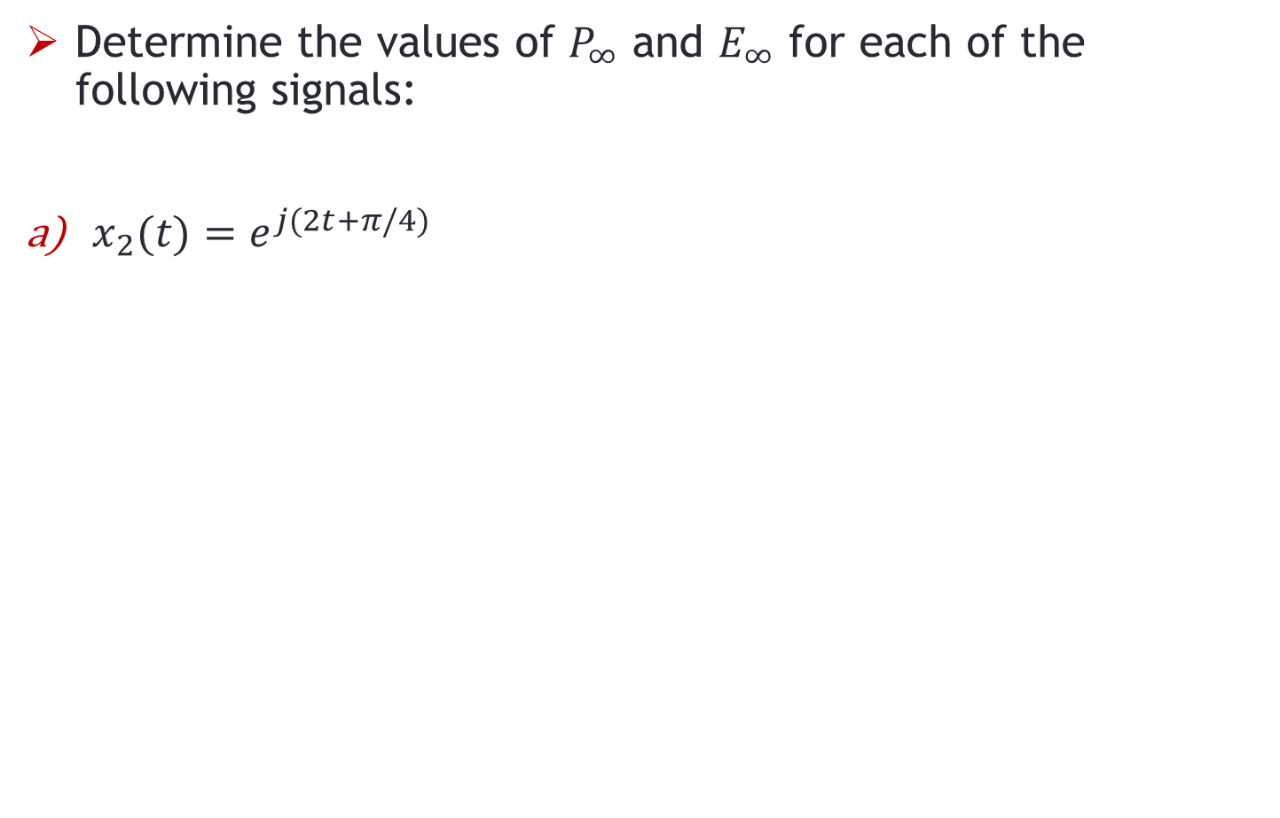
Problem-1
Determine the values of $P_{∞}$ and $E_{∞}$ for each of the following signals:
$x_{2}(t)=e^{j(2t+π/4)}$

Slide 17
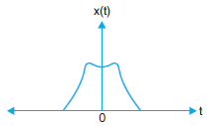
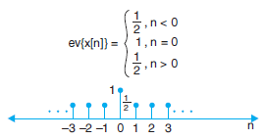
Even Signals
A continuous signal f(t) is referred to as an even signal if it is identical to its time-reversed counterpart, i.e.
The discrete signal f[n] is said to be even if

Slide 18
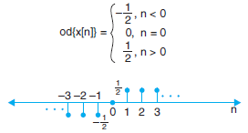
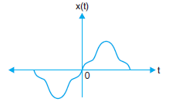
Odd Signals
A continuous signal f(t) is referred to as an odd signal if it is not identical to its time-reversed counterpart, as shown below:
It may be noted that an odd continuous time signal will be zero at origin, i.e., f(0) = 0 at t = 0
The signal f[n] is said to be odd if:

Slide 19
Even and Odd Signal Decomposition
A signal can be decomposed into its even and odd components
Decomposition of continuous signal f(t) can be done as:
Here, f_{e}(t) is the even and f_{o}(t) is the odd component of continuous signal f(t)
Obviously, the even function has the property:
And the odd function has the property:

Slide 20


Even and Odd Signal Decomposition
Replacing t by –t in the expression of f(t), we get:
Solving from the expression of f(t) and f(–t), we get:
AND

Slide 21


DT Even and Odd Signal Decomposition
Similarly, for DT signal f[n], we have:
AND

Slide 22
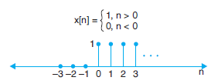
Problem-2 / Signal Decomposition
Find the Even and Odd signal components of the signal below:

Slide 23
END

