Slide 1
Signal Transformations

Slide 2
Time Shifting
Shifting the Independent variable such that x(t-t_{o})
Right Shift if t_{o} > 0, means the signal is delayed
In other words, if we start moving on the time axis in the direction of increasing time, that is from left to right, x(t) will come first than x(t-t_{o})
Left Shift if t_{o} < 0, means the signal is advanced
In other words, if we start moving on the time axis in the direction of increasing time, that is from left to right, x(t) will come later than x(t+t_{o})

Slide 3
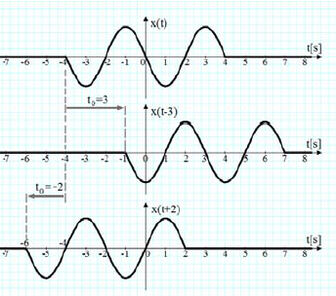
Time Shifting

Slide 4
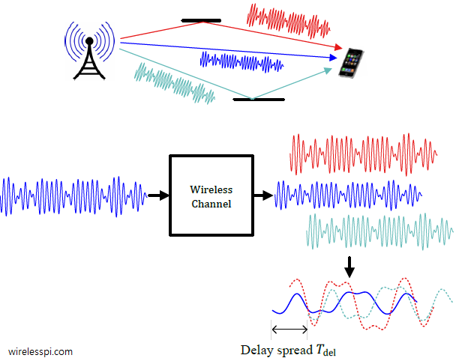
Time Shifting – Practical Scenario

Slide 5
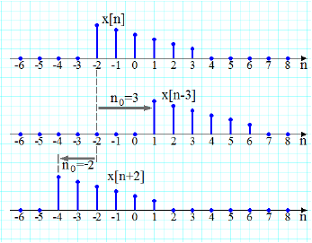
Time Shifting
Discrete Time
x[n-n_{o}]:
Right Shift if:
n_{o} > 0
Left Shift if:
n_{o} < 0

Slide 6
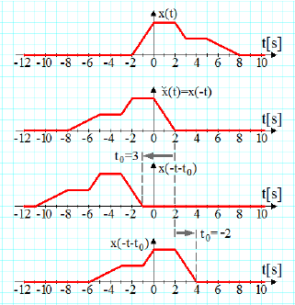
Time Reversal
Reversing the Independent variable
Always rotate the signal by 180º about the vertical axis
Always shift the signal first if required

Slide 7
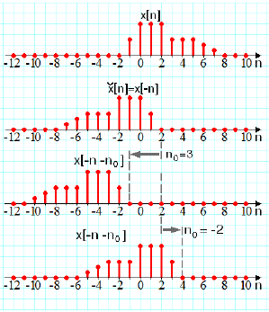
Time Reversal
Discrete time

Slide 8
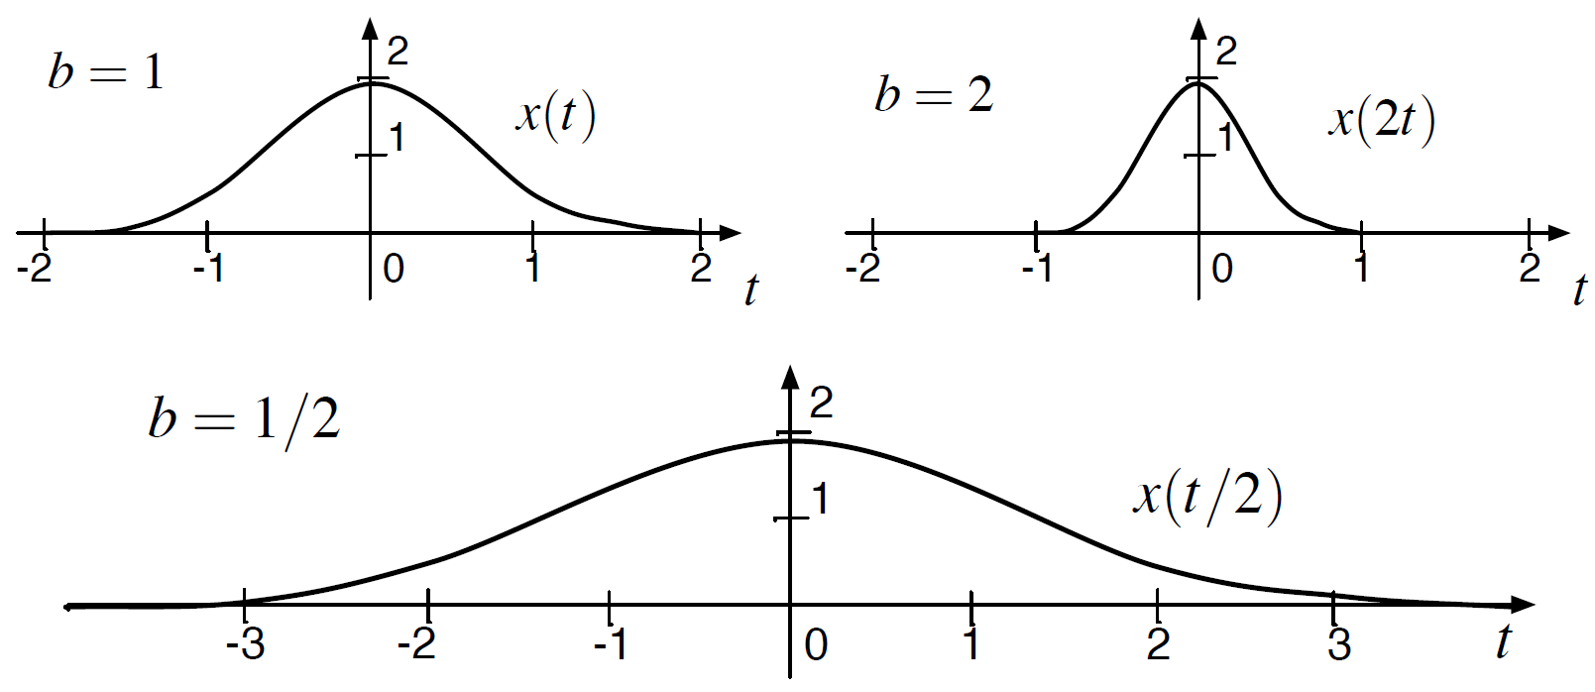
Time Scaling – Continuous Time
  X(t/2) means expansion of signal in time (Playing audio signal at half speed)
  X(2t) means compression of signal in time (Playing audio signal at 2x speed)
Figure Credit: EE102A:Signal Processing and Linear Systems I; Stanford; Robert Gray

Slide 9
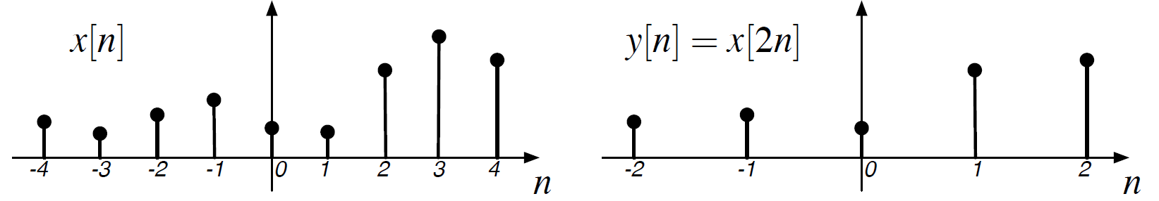
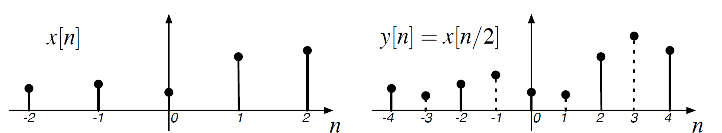
Time Scaling – Discrete Time
Given a signal x[n]
  x[n/2] means expansion of signal in time
  x[2n] means compression of signal in time
Downsampling
Upsampling
Figure Credit: EE102A:Signal Processing and Linear Systems I; Stanford; Robert Gray
Notes:
The time-scaling in discrete-time signals is referred to as downsampling if we multiply the independent variable n in x[n] by 2 to produce x[2n]. This also means that every second sample is being thrown away.
On the other hand, time-scaling in discrete-time signals is referred to as upsampling if we divide the independent variable n in x[n] by 2 to produce x[n/2]. This also means that a new sample of value zero (or with a value that is interpolated from the previous and next sample) is inserted between successive samples.

Slide 10

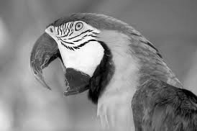

Signal Scaling - Image
Image size h/2 x w/2 – obtained by sampling at 2n
Image size 2h x 2w – obtained by sampling at n/2
Image size h x w

Slide 11
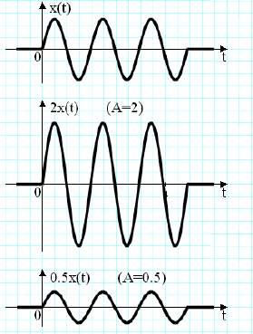
Signal Weighting
Scaling the dependent variable
Amplification: 2x(t)
Attenuation: 0.5x(t)

Slide 12
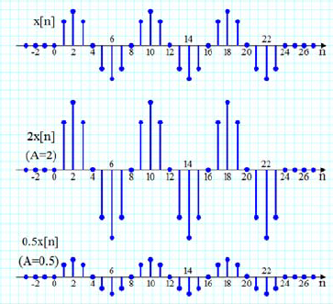
Signal Weighting
Scaling the dependent variable
Amplification:
2x[n]
Attenuation:
0.5x[n]

Slide 13
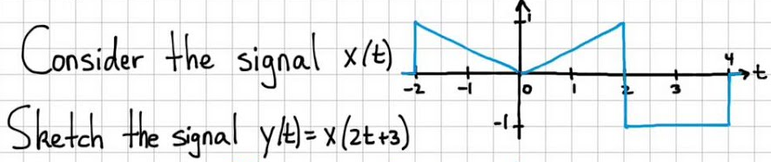
Problem-1

Slide 14

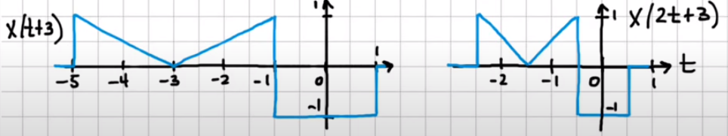
Problem-1
Approach-1

Slide 15
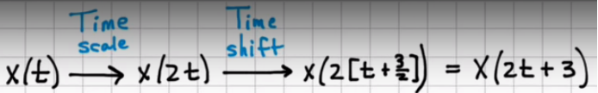
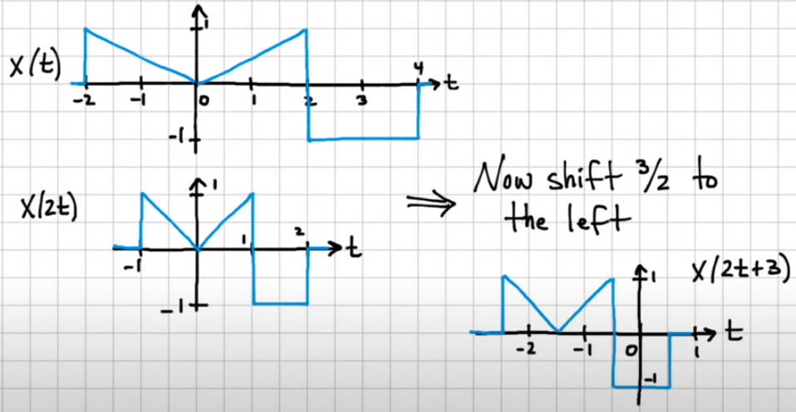
Problem-1
Approach-2

Slide 16


Problem-2
Remember: Shift before you scale or invert !!

Slide 17
END

