Slide 1
CARTESIAN AND CYLINDRICAL coordinates

Slide 2
Coordinate Systems
To describe the spatial variations of the physical quantities, we must be able to define all points uniquely in space in a suitable manner
Requires using an appropriate coordinate system
Considerable amount of work and time may be saved by choosing a coordinate system that best fits a given problem
A hard problem in one coordinate system may turn out to be easy in another system
Three best-known coordinate systems: the Cartesian, Cylindrical and Spherical

Slide 3
Coordinate Systems
The concepts demonstrated in Cartesian coordinates are equally applicable to other systems of coordinates
For example, procedure for finding dot or cross product of two vectors in a cylindrical system is the same as that used in the Cartesian system
Sometimes, it is necessary to transform points and vectors from one coordinate system to another
The techniques for doing this will be presented and illustrated with examples

Slide 4
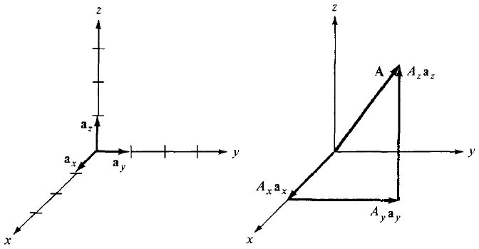
Cartesian Coordinates (X,Y,Z)
A vector A in Cartesian (also known as rectangular) coordinates can be written as:
where a_{x}, a_{y}, and a_{z} are unit vectors along the x-, y-, and z-directions

Slide 5
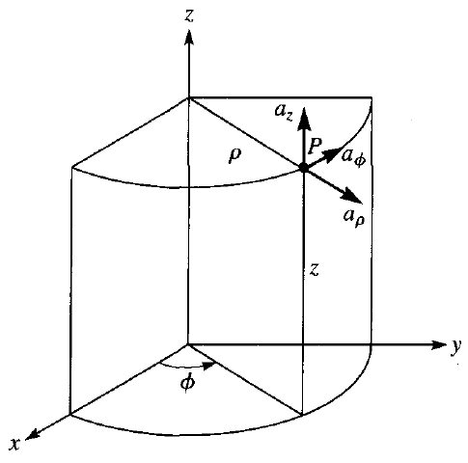
Cylindrical Coordinates (ρ,Φ,z)
Very convenient when dealing with problems having cylindrical symmetry
A point P in cylindrical coordinates is represented as (ρ, Φ, z) as shown in the figure:
ρ is the radius of the cylinder passing through P or the radial distance from the z-axis
Φ is measured from the x-axis in the xy-plane
z is the same as in the Cartesian system

Slide 6
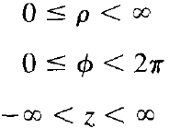

Cylindrical Coordinates (ρ,Φ,z)
The ranges of the variables are:
A vector A in cylindrical coordinates can be written as:
where a_{ρ}, a_{Φ}, and a_{z} are unit vectors in the ρ, Φ and z directions
For example, if a force of 10 N acts on a particle in a circular motion, the force may be represented as F = 10a_{Φ} N
The magnitude of A is:

Slide 7

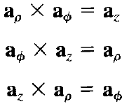
Cylindrical Coordinates (ρ,Φ,z)
Notice that the unit vectors a_{ρ}, a_{Φ}, and a_{z} are mutually perpendicular because our coordinate systems are orthogonal
a_{ρ} points in the direction of increasing ρ, a_{Φ} in the direction of increasing Φ, and a_{z} in the positive z-direction, so we have:

Slide 8
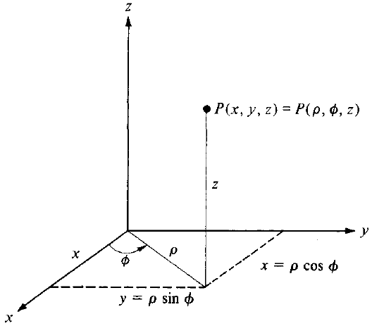
Point Transformations
Relationship between the variables (x, y, z) of the Cartesian coordinate system and those of the cylindrical system (ρ, Φ, z) are easily obtained from figure shown:

Slide 9

Point Transformations
For transforming a point from Cartesian (x, y, z) to Cylindrical (ρ, Φ, z) coordinates:
For transforming a point from Cylindrical (ρ, Φ, z) to Cartesian (x, y, z) coordinates:

Slide 10
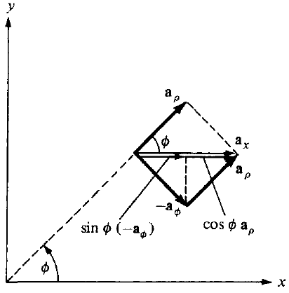

Unit Vector Transformations
The relationships between (a_{x}, a_{y}, a_{z}) and (a_{ρ}, a_{Φ}, a_{z}) are obtained geometrically from figure below showing cylindrical components of a_{x}

Slide 11
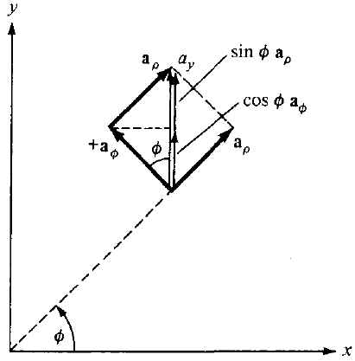

Unit Vector Transformations
The relationships between (a_{x}, a_{y}, a_{z}) and (a_{ρ}, a_{Φ}, a_{z}) are obtained geometrically from figure below showing cylindrical components of a_{y}

Slide 12
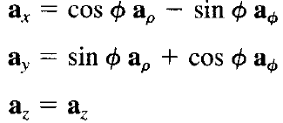
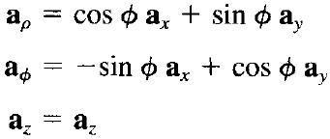
Unit Vector Transformations
In summary, we have:
OR

Slide 13

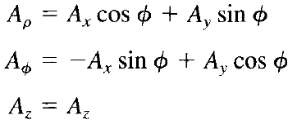
Vector Transformations
Finally, the relationship between (Ax, Ay, Az) and (Aρ, A_{Φ}, Az) are obtained by simply substituting the unit vector transformations into the equation below:
After collecting terms, we get:
OR

Slide 14
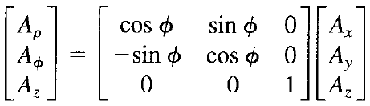
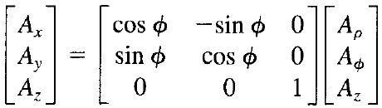
Vector Transformations
The transformations may be written in matrix form as:
AND

Slide 15
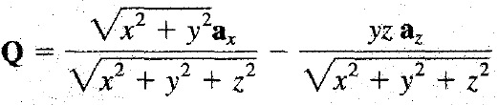
Problem-1
Convert point P(0, - 4 , 3) from Cartesian to cylindrical coordinates
Evaluate Q at P in Cartesian and cylindrical coordinate systems
Notes:
If a point is NOT given, you cannot assign numerical cylindrical components. You can only express the vector symbolically in cylindrical coordinates using $ρ,φ,z$.
When a point is given, you evaluate $φ$numerically and the unit vectors become fixed. When a point is not given, the cylindrical unit vectors are position-dependent.
Cartesian unit vectors: $a_{x}, a_{y}, a_{z}$, are constant everywhere in space. Cylindrical unit vectors: $a_{ρ}, a_{φ}, a_{z},$depend on position, specifically on $φ$. That dependence is the reason a point is required for numerical conversion.

