Slide 1
Introduction to Signals and Systems

Slide 2
Motivation
A common application is the restoration of signals that have been degraded in some way
For example, when a pilot is communicating with an air-traffic control tower, the communication can be degraded by the high level of background noise in the cockpit
In this case, it is possible to design systems that will retain the desired signal (pilot’s voice), and reject (at least approximately) the unwanted signal (noise)
Restoration and enhancement of images that are a degraded version of the scene being photographed (e.g. space images)

Slide 3
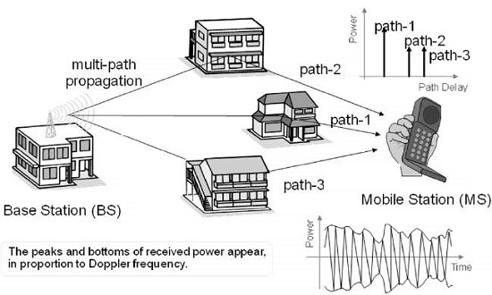
Motivation
https://www.tutorialspoint.com/cdma/cdma_fading.htm

Slide 4
What is a Signal?
A signal is a pattern of variation of some form
Signals are variables that carry information
Examples of signal include:
Electrical signals - Voltages and currents in a circuit
Acoustic signals - Acoustic pressure (sound) over time
Mechanical signals - Velocity of a car over time
Video signals - Intensity level of a pixel (camera, video) over time

Slide 5
Signal Representation
Mathematically, signals are represented as a function of one or more independent variables
For instance, the magnitude of a Radio Frequency signal is dependent on x, y, z coordinates as well as time t, f(x,y,z,t)
In this course, we shall be exclusively concerned with signals that are a function of a single variable: time
f(t)
t

Slide 6
Continuous Time Signals
Most signals in the real world are continuous time as the scale is infinitesimally fine, for example voltage, velocity…
Denoted by x(t), where the time interval may be bounded (finite) or infinite
x(t)
t

Slide 7
Discrete-Time Signals
A signal that is specified only at discrete values of time
Some real world and many digital signals are discrete time as they are sampled, for example pixels, daily stock averages
Denoted by x[n], where n is an integer value that varies discretely
x[n]
n

Slide 8
Analog and Digital Signals
A signal whose amplitude can take on any value in a continuous range is an analog signal
This means that an analog signal amplitude can take on an infinite number of values
A digital signal, on the other hand, is one whose amplitude can take on only a finite number of values
Signals associated with a digital computer are digital because they take on only two values (binary signals)
Sampled continuous signal
x[n] =x(nk), where k is sample time

Slide 9
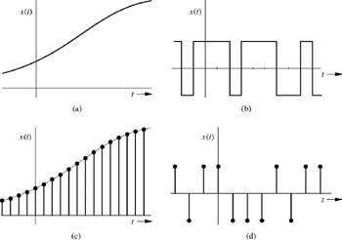
Analog and Digital Signals
(a)-Analog CT, (b)-Digital CT, (c)-Analog DT, (d)-Digital DT

Slide 10
What is a System?
A System processes input signals to produce output signals
Examples:
  A circuit involving a capacitor can be viewed as a system that transforms the source voltage (signal) to the voltage (signal) across the capacitor
  A microphone system converts the sound input to an electrical output signal
  A communication system is generally composed of three sub-systems, the transmitter, the channel and the receiver

Slide 11
How is a System Represented?
A system takes a signal as an input and transforms it into another signal
In a very broad sense, a system can be represented as the ratio of the output signal over the input signal
  That way, when we “multiply” the system by the input signal, we get the output signal
  This concept will be discussed in further detail in the coming weeks
Input signal
x(t)
System
Output signal
y(t)

Slide 12
END

