Slide 1
CONVECTION AND CONDUCTION CURRENTS

Slide 2
Introduction
Until now, we considered electrostatic fields in free space or a space that has no materials in it
Thus what we have developed so far under electrostatics may be regarded as the "vacuum" field theory
Similarly, we shall develop the theory of electric phenomena in material space
Most of the formulas derived for Electrostatic fields in free space are still applicable, though some may require modification

Slide 3

Electric Current
Electric voltage (or potential difference) and current are two fundamental quantities in electrical engineering
Before examining how electric field behaves in a conductor or dielectric, it is appropriate to consider electric current
Electric current is generally caused by the motion of electric charges
The current (in amperes) through a given area is the electric charge passing through the area per unit time

Slide 4


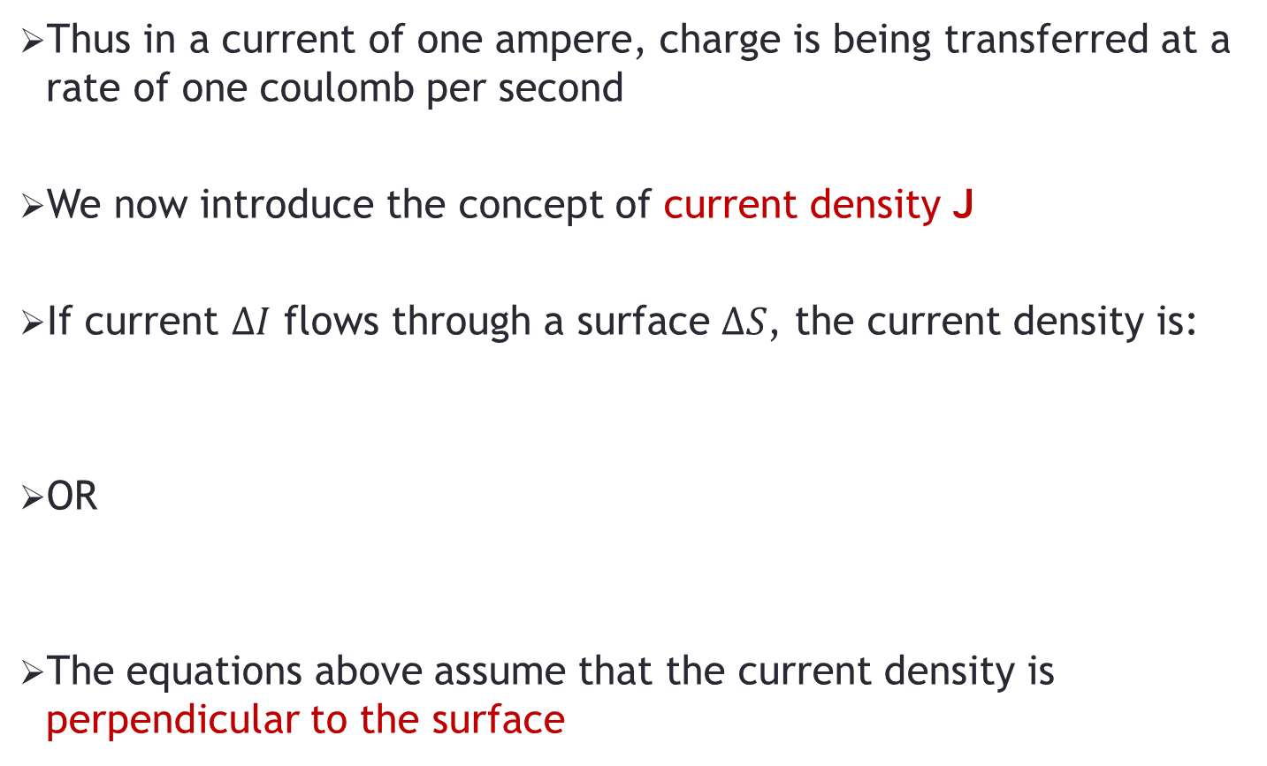
Current Density
Thus in a current of one ampere, charge is being transferred at a rate of one coulomb per second
We now introduce the concept of current density J
If current $∆I$ flows through a surface $∆S$, the current density is:
OR
The equations above assume that the current density is perpendicular to the surface

Slide 5


Current Density
If the current density is not normal to the surface, then:
Thus, the total current flowing through a surface S is:
The current density at a given point is the current through a unit normal area at that point

Slide 6
Convection Current
Convection current, as distinct from conduction current, does not involve conductors and consequently does not satisfy Ohm's law
It occurs when current flows through mediums such as liquid, rarefied gas, or a vacuum (Rarefied gas: A gas whose pressure is much less than atmospheric pressure)
A beam of electrons in a vacuum tube, for example, is a convection current

Slide 7

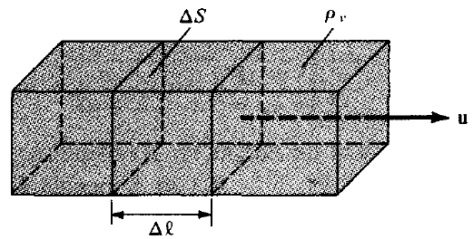
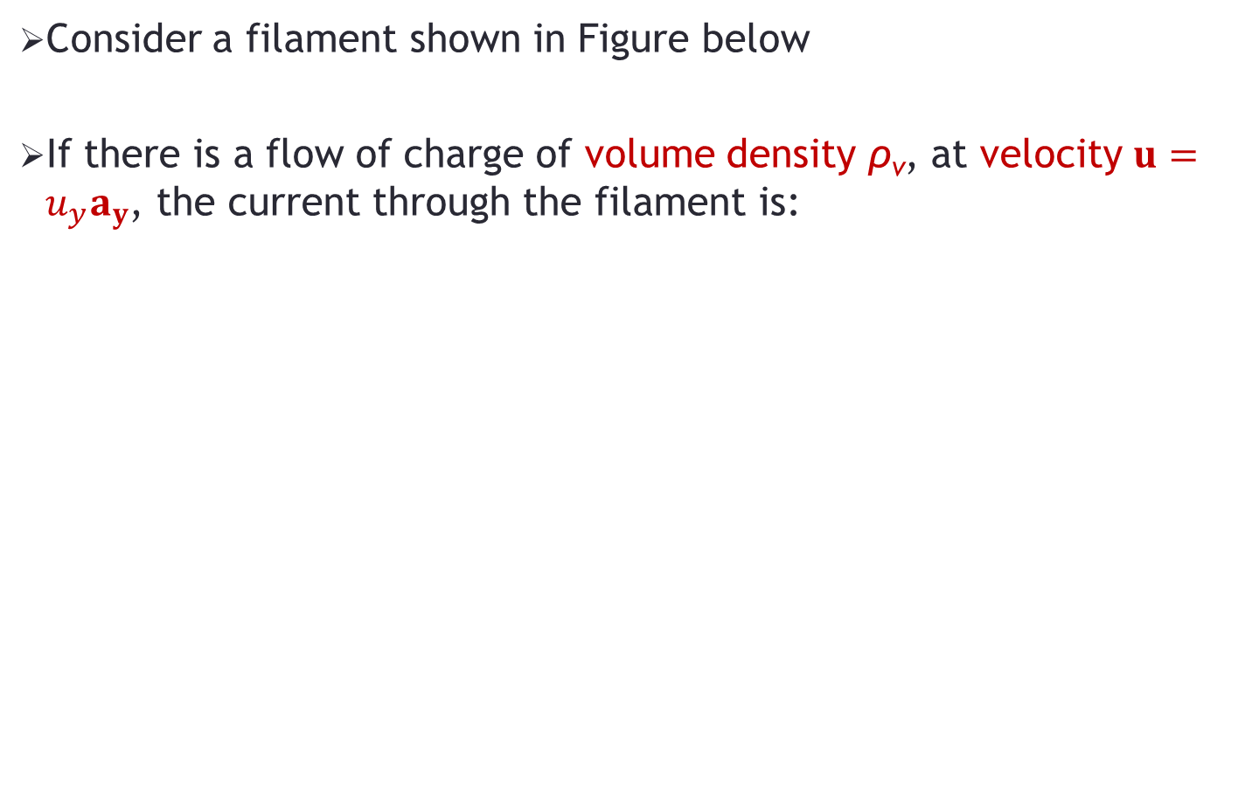
Convection Current
Consider a filament shown in Figure below
If there is a flow of charge of volume density ρ_{v}, at velocity $u=u_{y}a_{y}$, the current through the filament is:

Slide 8


Convection Current
The y-directed current density J_{y} is given by:
Hence in general:
The current I is the convection current and J is the convection current density in amperes/square meter (A/m²)

Slide 9

Conduction Current
Conduction current requires a conductor
A conductor is characterized by a large amount of free electrons that provide conduction current due to an impressed electric field E
When an E is applied, the force on an electron with charge —e is:
Since the electron is not in free space, it will not be accelerated under the influence of the electric field only
Rather, it suffers constant collision with the atomic lattice and drifts from one atom to another

Slide 10


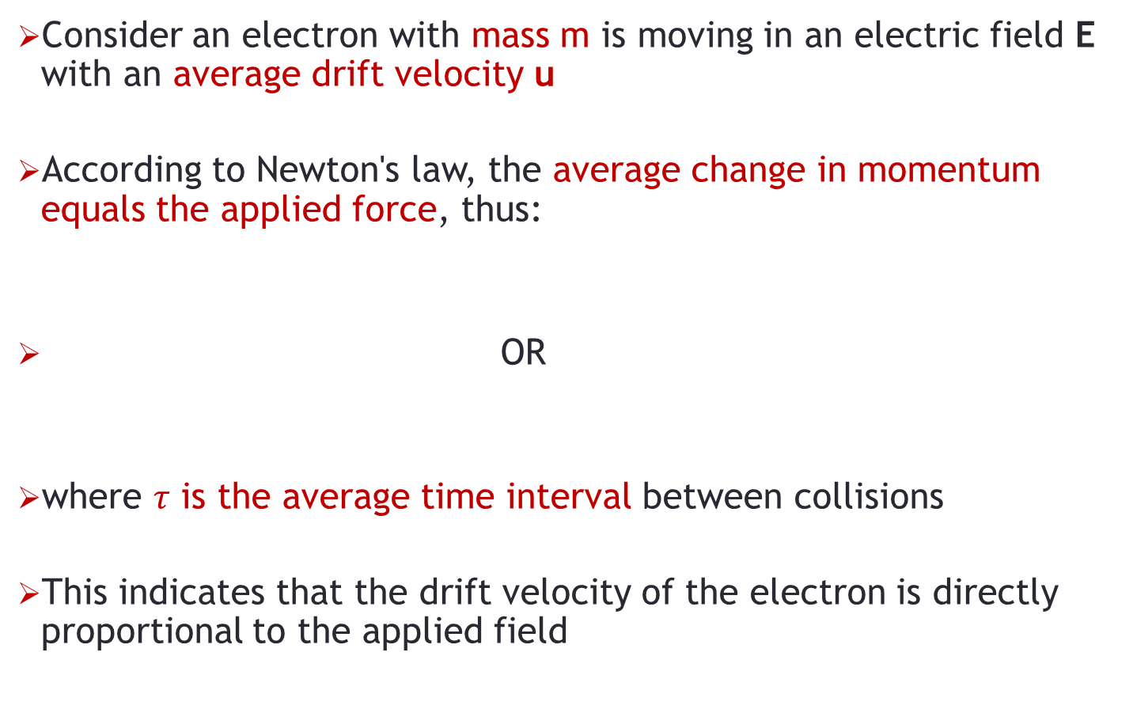
Conduction Current
Consider an electron with mass m is moving in an electric field E with an average drift velocity u
According to Newton's law, the average change in momentum equals the applied force, thus:
OR
where $τ$ is the average time interval between collisions
This indicates that the drift velocity of the electron is directly proportional to the applied field

Slide 11



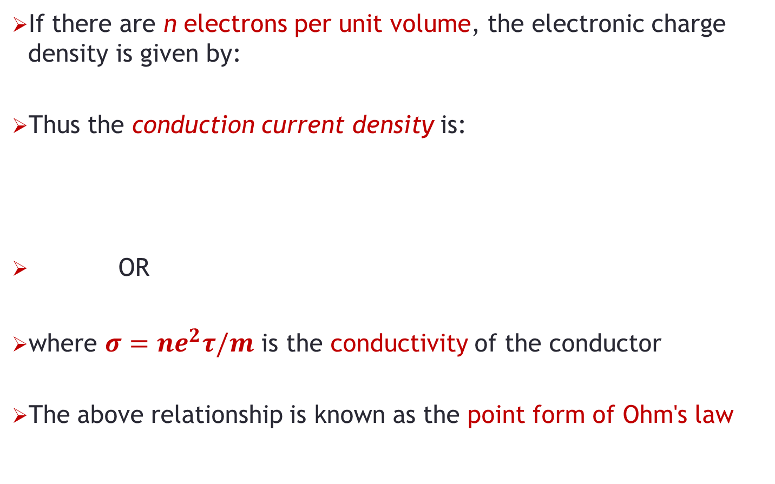
Conduction Current Density
If there are n electrons per unit volume, the electronic charge density is given by:
Thus the conduction current density is:
OR
where $σ=ne^{2}τ/m$ is the conductivity of the conductor
The above relationship is known as the point form of Ohm's law

Slide 12
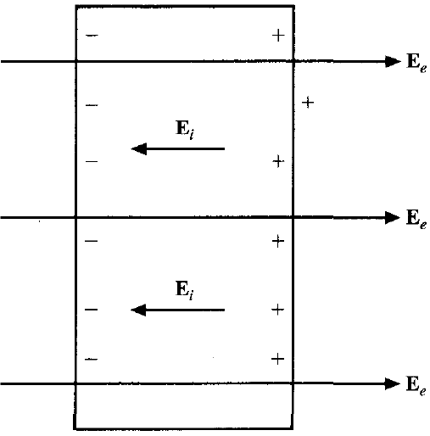
Conductor - Equipotential body
A conductor has abundance of charge that is free to move
Consider an isolated conductor, such as shown in Figure
When an external electric field E_{e} is applied, the positive free charges are pushed along the same direction as the applied field
While the negative free charges move in the opposite direction

Slide 13
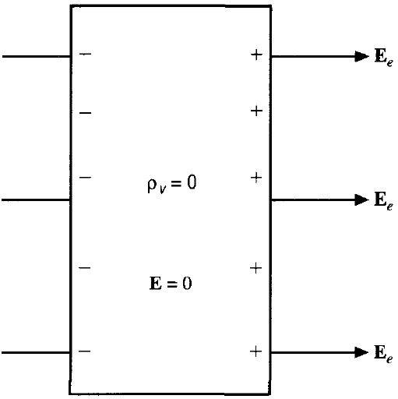
Conductor - Equipotential body
The charge migration takes place very quickly
The free charges do two things
First, they accumulate on the surface of the conductor and form an induced surface charge
Second, the induced charges set up an internal induced field E_{i}, which cancels the externally applied field E_{e}

Slide 14
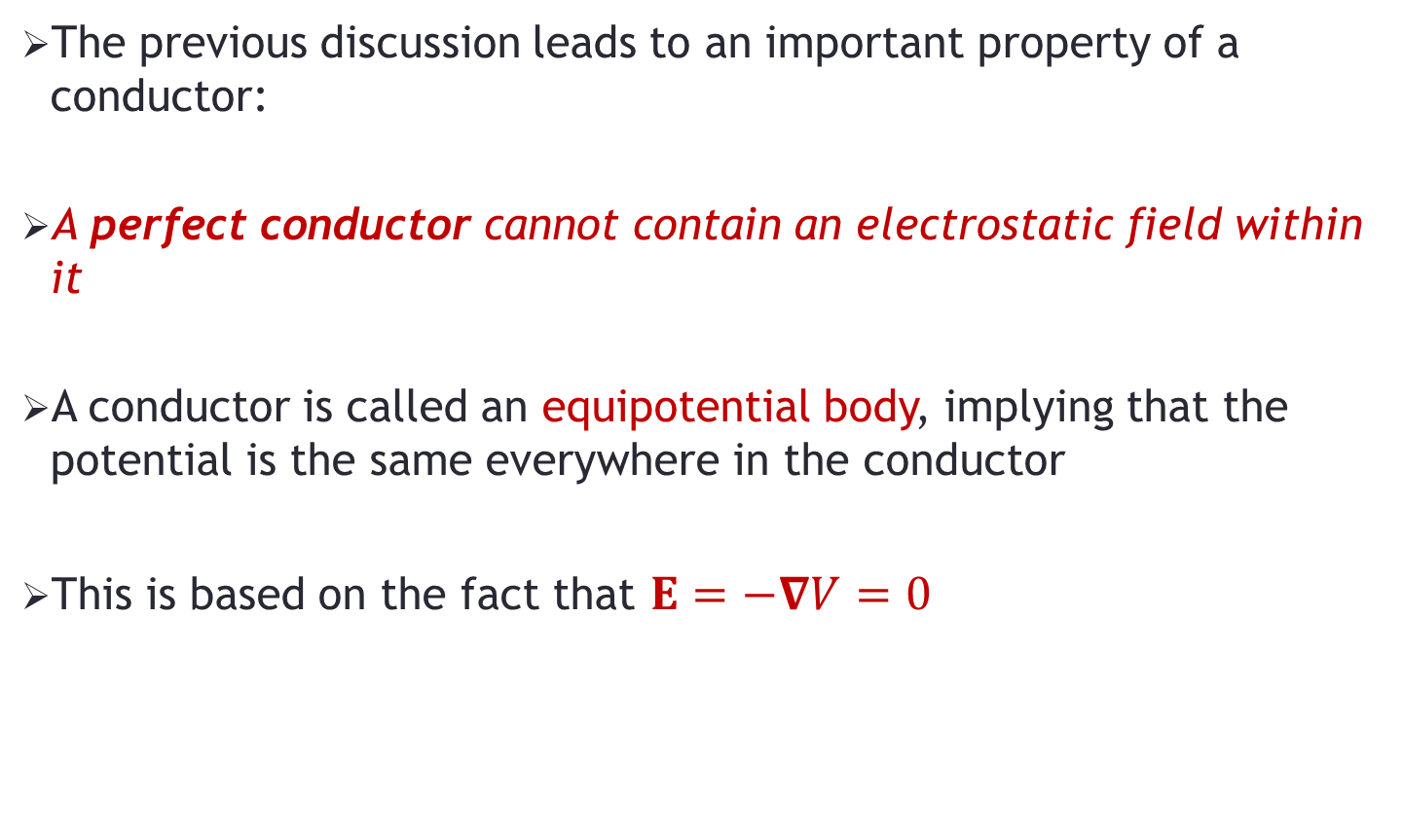
Conductor - Equipotential body
The previous discussion leads to an important property of a conductor:
A perfect conductor cannot contain an electrostatic field within it
A conductor is called an equipotential body, implying that the potential is the same everywhere in the conductor
This is based on the fact that $E=−∇V=0$

Slide 15
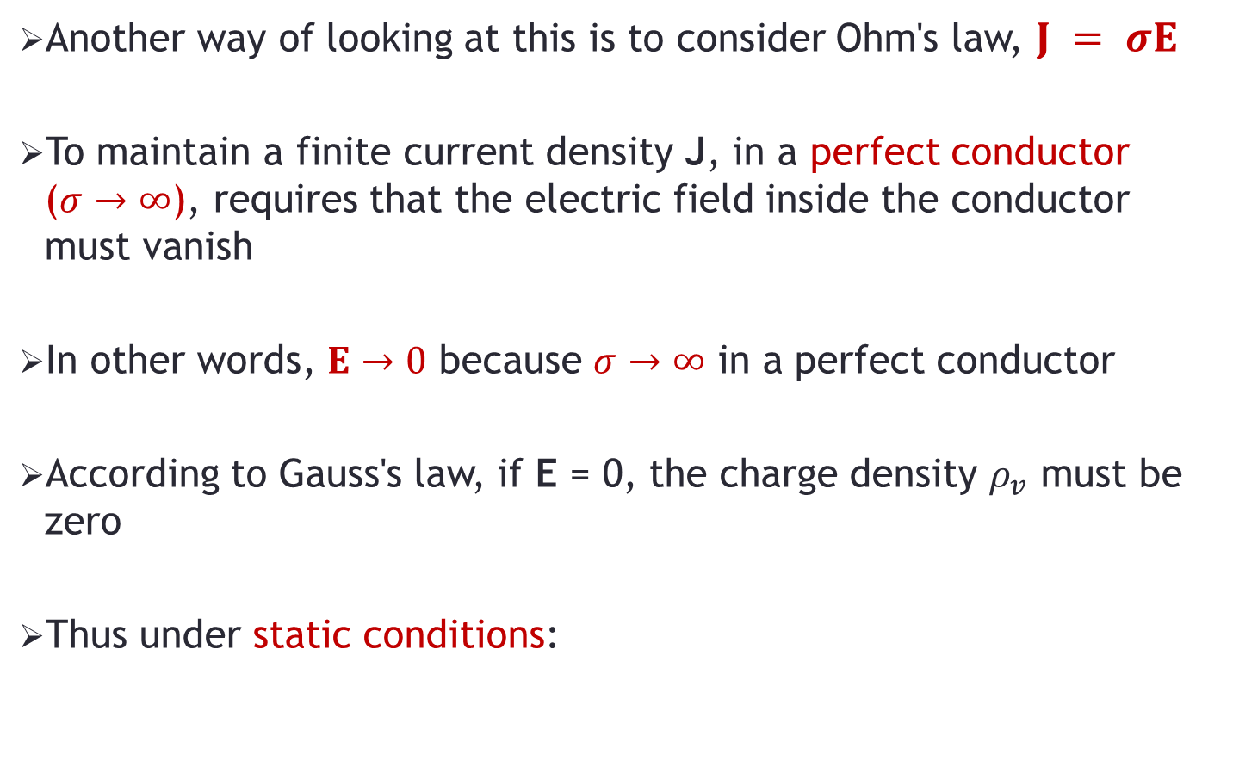
Conductor - Equipotential body
Another way of looking at this is to consider Ohm's law, $J = σE$
To maintain a finite current density J, in a perfect conductor ($σ→∞$), requires that the electric field inside the conductor must vanish
In other words, $E→0$ because $σ→∞$ in a perfect conductor
According to Gauss's law, if E = 0, the charge density $ρ_{v}$ must be zero
Thus under static conditions:

Slide 16
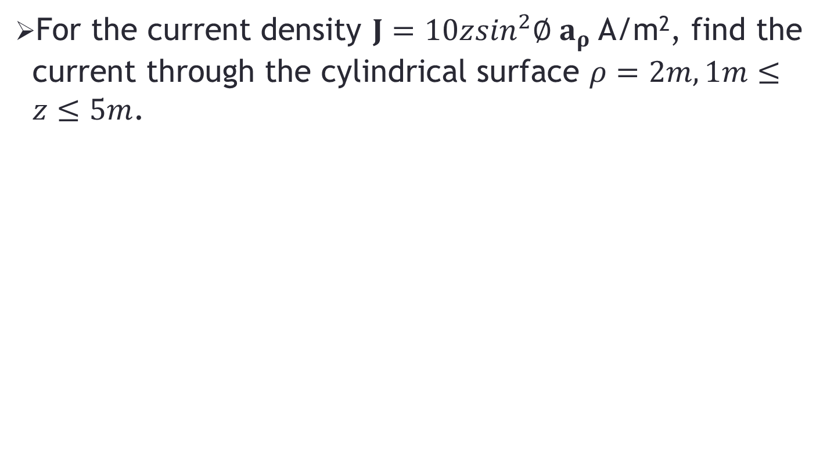
Problem-1
For the current density $J=10z\sin^{2}∅ a_{ρ}$A/m², find the current through the cylindrical surface $ρ=2m, 1m≤z≤5m$.

