Slide 1
ELECTRIC DIPOLE AND ENERGY DENSITY

Slide 2
Electric Dipole
An electric dipole is formed when two point charges of equal magnitude but opposite sign are separated by a small distance
Example is the formation of dipoles in dielectric materials in the presence of an electric field
Dipole moment is a measure of system’s overall polarity
The distance between the point charges is small compared to the distance to the point P at which we want to know the electric potential and potential fields

Slide 3
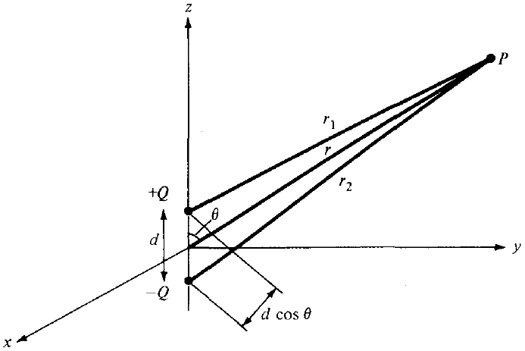
Electric Dipole
Figure shows an electric
dipole

Slide 4


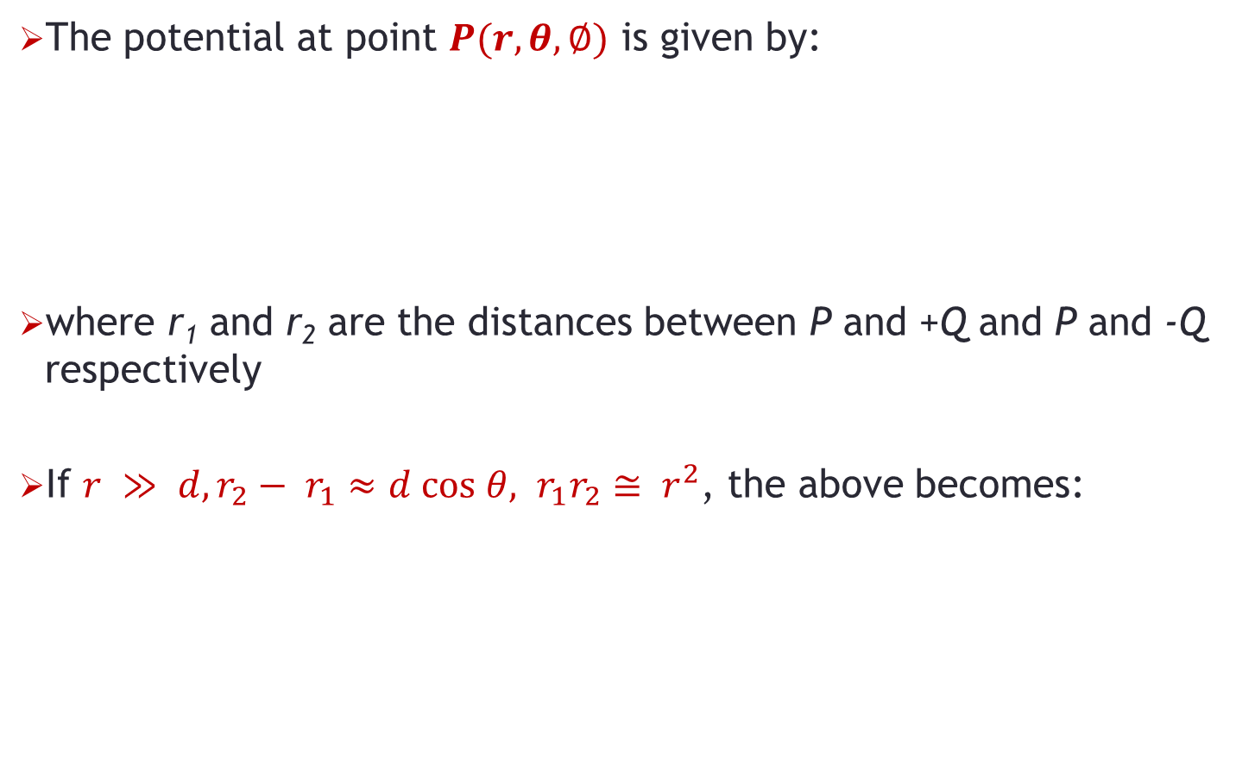
Potential due to Electric Dipole
The potential at point $P(r,θ,∅)$ is given by:
where r₁ and r₂ are the distances between P and +Q and P and -Q respectively
If $r ≫ d,r_{2}− r_{1}≈d cos θ, r_{1}r_{2}≅ r^{2}$, the above becomes:

Slide 5



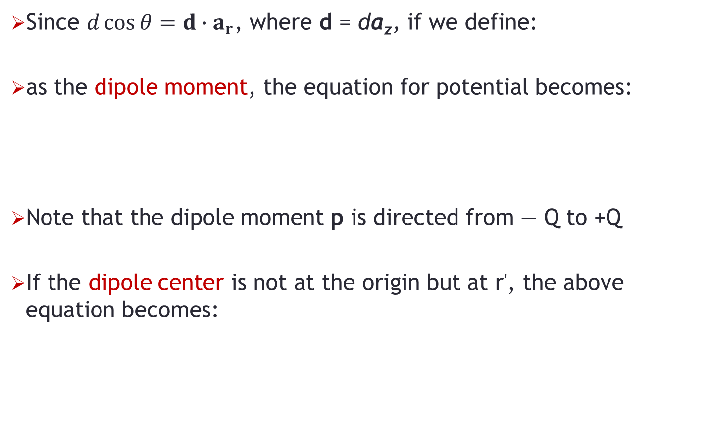
Potential due to Electric Dipole
Since $d\cos{θ=d∙a_{r}}$, where d = da_{z}, if we define:
as the dipole moment, the equation for potential becomes:
Note that the dipole moment p is directed from — Q to +Q
If the dipole center is not at the origin but at r', the above equation becomes:

Slide 6




Electric Field due to Electric Dipole
The electric field due to the dipole with center at the origin, can be obtained readily as:
OR

Slide 7
Electric Dipole
Notice that a point charge is a monopole and its electric field varies inversely as r² while its potential field varies inversely as r
From the equations for electric dipole, we notice that the electric field due to a dipole varies inversely as r³ while its potential varies inversely as r²
The electric fields due to successive higher-order multi-poles (such as a quadrupole consisting of two dipoles or an octupole consisting of two quadrupoles) vary inversely as r⁴, r⁵, r⁶,…. while their corresponding potentials vary inversely as r³, r⁴, r⁵,….

Slide 8
Electric Flux Lines
The idea of electric flux lines (or electric lines of force as they are sometimes called) was introduced by Michael Faraday in his experimental investigation as a way of visualizing the electric field
An electric flux line is an imaginary path or line drawn in such a way that its direction at any point is the direction of the electric field at that point

Slide 9

Equipotential Surfaces
Any surface on which the potential is the same throughout is known as an equipotential surface
The intersection of an equipotential surface and a plane results in a path or line known as an equipotential line (surface would be like a sphere)
No work is done in moving a charge from one point to another along an equipotential line or surface (V_{A} - V_{B} = 0) and hence:
From the above equation, we may conclude that the lines of force or flux lines (or the direction of E) are always normal to equipotential surfaces

Slide 10
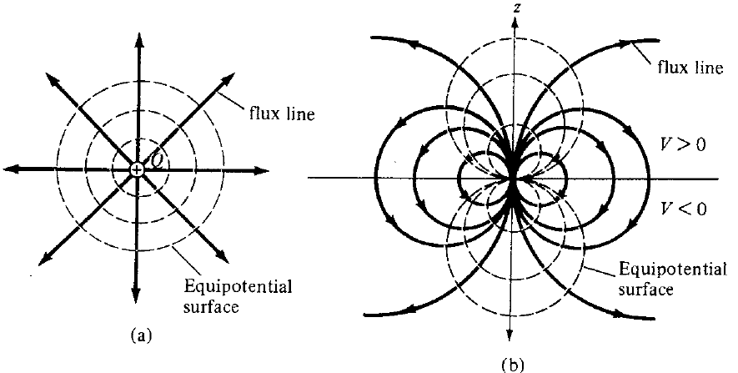
Equipotential Surfaces
Examples of equipotential surfaces for point charge and a dipole are shown in figure (a) and (b), respectively

Slide 11
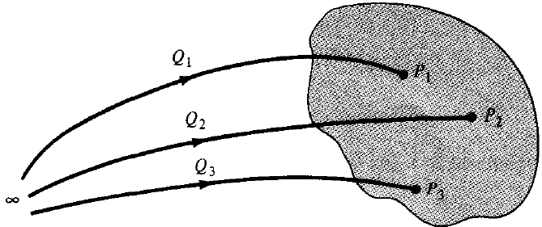
Energy Density in Electrostatic Fields
To determine the energy present in an assembly of charges, we must first determine the amount of work necessary to assemble them
Suppose we wish to position three point charges Q₁, Q₂, and Q₃ in an initially empty space shown shaded in figure below

Slide 12

Energy Density in Electrostatic Fields
No work is required to transfer Q₁ from infinity to P₁ because the space is initially charge free and there is no electric field
The work done in transferring Q₂ from infinity to P₂ is equal to the product of Q₂ and the potential V₂₁ at P₂ due to Q₁
Work done in positioning Q₃ at P₃ is equal to Q₃(V₃₂ + V₃₁), where V₃₂ and V₃₁ are the potentials at P₃ due to Q₂ and Q₁, respectively
Total work done:

Slide 13


Energy Density in Electrostatic Fields
If the charges were positioned in reverse order, we get:
where V₂₃ is the potential at P₂ due to Q₃, V₁₂ and V₁₃ are, respectively, the potentials at P₁ due to Q₂ and Q₃
Adding the two equations above, we get:

Slide 14


Energy Density in Electrostatic Fields
Or
where V₁, V₂, and V₃ are total potentials at P₁, P₂, and P₃, respectively
In general, if there are n point charges, we have:

Slide 15
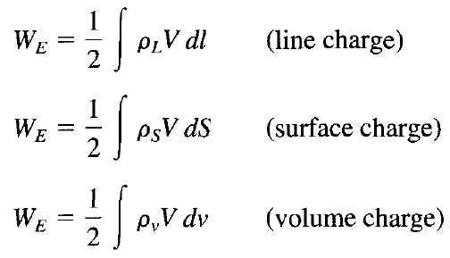
Energy Density in Electrostatic Fields
If, instead of point charges, the region has a continuous charge distribution, the summation in previous equation becomes integration; that is:

Slide 16



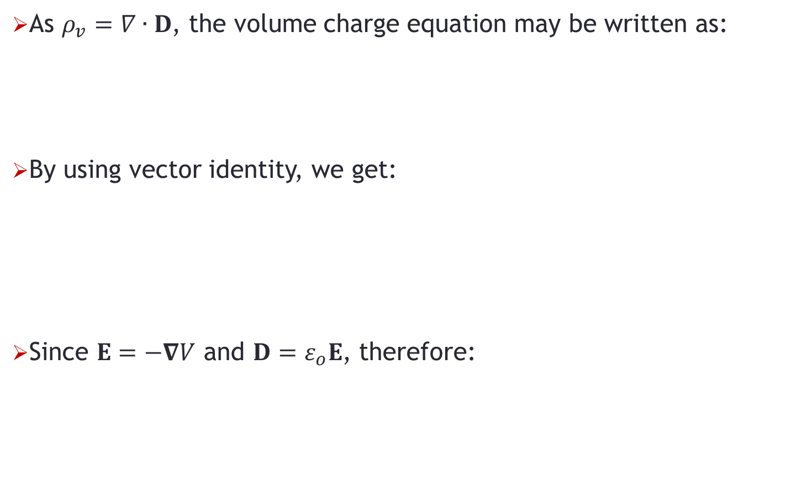
Energy Density in Electrostatic Fields
As $ρ_{v}=∇∙D$, the volume charge equation may be written as:
By using vector identity, we get:
Since $E=−∇V$ and $D=ε_{o}E$, therefore:

Slide 17
Problem-1
Point charges Q₁ = 1 nC, Q₂ = - 2 nC, Q₃ = 3 nC, and Q₄ = - 4 nC are positioned one at a time and in that order at (0,0,0), (1,0,0), (0,0,-1), and (0,0,1), respectively. Calculate the energy in the system after each charge is positioned

