Slide 1
ELECTRIC POTENTIAL AND POTENTIAL ENERGY

Slide 2
Introduction
The electric field intensity E due to a charge distribution can be obtained from Coulomb's law in general or from Gauss's law when the charge distribution is symmetric
It would be desirable if we could find some as yet undefined scalar function and then determine the electric field from this scalar by some simple straightforward procedure, such as differentiation
This scalar function does exist and is known as the potential or scalar potential field
The method of obtaining E from the electric scalar potential V is discussed in this lecture

Slide 3
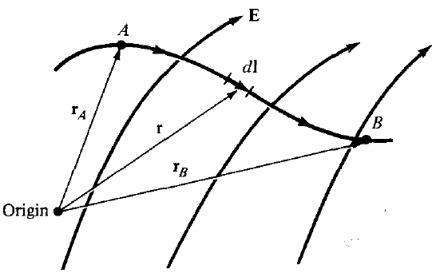

Electric Potential
Suppose we wish to move a point charge Q from point A to point B in an electric field E
From Coulomb's law, the force on Q is F = QE so that the work done in displacing the charge by dl is:

Slide 4


Electric Potential
The negative sign indicates that the work is being done by an external agent
Thus, the total work done, or the potential energy required, in moving Q from A to B is:
Dividing W by Q in the above equation gives the potential energy per unit charge:
This quantity, denoted by V_{AB}, is known as the potential difference between points A and B
Notes:
When external agent performs work, the direction of E and dl is opposite

Slide 5
Electric Potential – Important Points
In determining V_{AB}, A is the initial point while B is the final point
If V_{AB} is negative, there is a loss in potential energy in moving Q from A to B; this implies that the work is being done by the field
If V_{AB} is positive, there is a gain in potential energy in the movement; an external agent performs the work
V_{AB} is independent of the path taken (to be proved later)
V_{AB} is measured in joules per coulomb, commonly referred to as volts (V)
Notes:
Point-3. External agent performs work this implies starting point is at a lower potential than the end point.

Slide 6

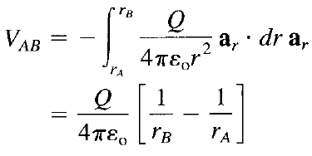

Electric Potential - Point Charge
As an example, if the E field in the figure is due to a point charge Q located at the origin, then:
Then the equation for potential difference between point A and B becomes:
Or:
Here V_{A} and V_{B} are potentials or absolute potentials at A and B
Notes:
dl=dr is the distance vector = difference of two position vectors

Slide 7


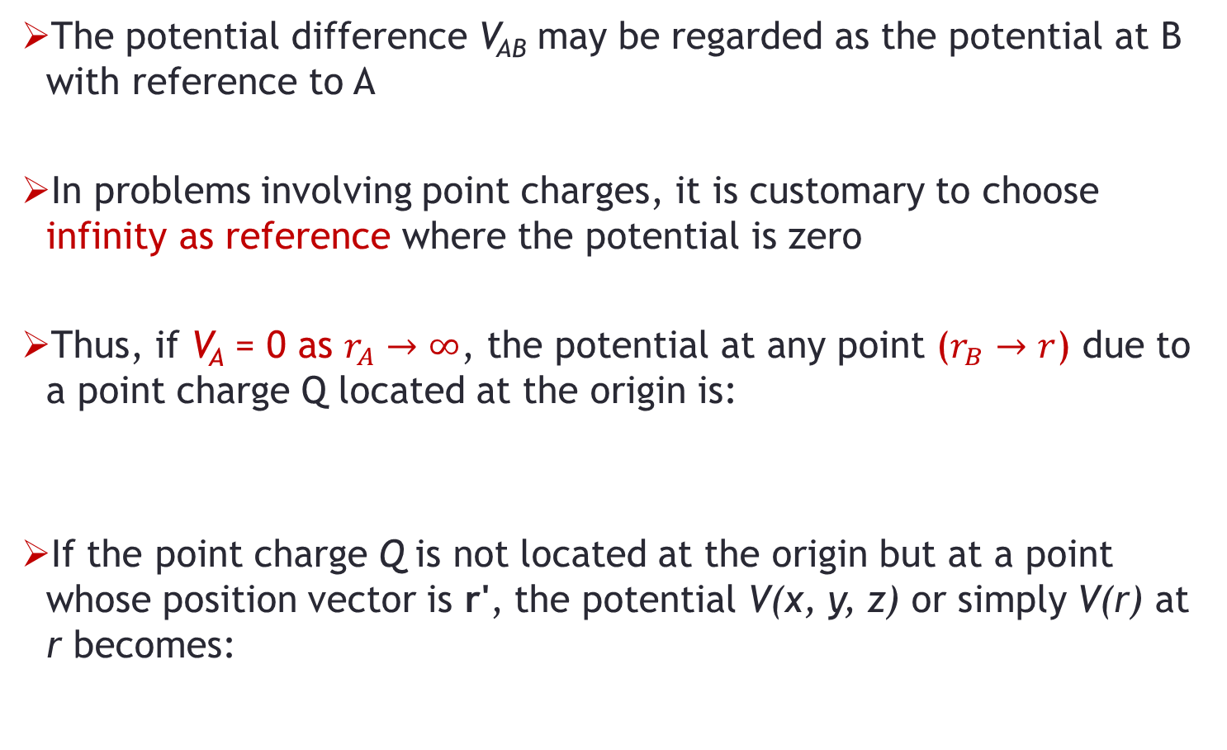
Electric Potential - Point Charge
The potential difference V_{AB} may be regarded as the potential at B with reference to A
In problems involving point charges, it is customary to choose infinity as reference where the potential is zero
Thus, if V_{A} = 0 as $r_{A}→∞$, the potential at any point ($r_{B}→r$) due to a point charge Q located at the origin is:
If the point charge Q is not located at the origin but at a point whose position vector is r', the potential V(x, y, z) or simply V(r) at r becomes:

Slide 8
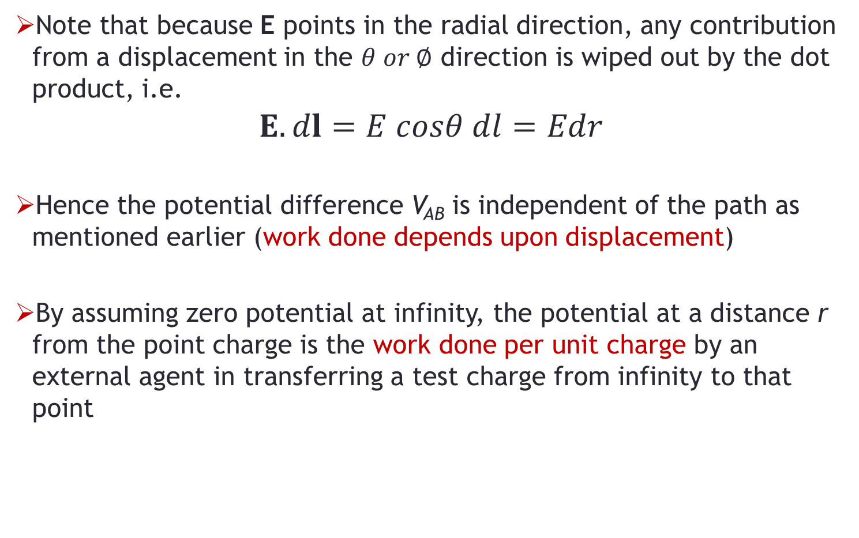
Electric Potential - Point Charge
Note that because E points in the radial direction, any contribution from a displacement in the $θ or ∅$ direction is wiped out by the dot product, i.e.
$$E.dl=E cosθ dl=Edr$$
Hence the potential difference V_{AB} is independent of the path as mentioned earlier (work done depends upon displacement)
By assuming zero potential at infinity, the potential at a distance r from the point charge is the work done per unit charge by an external agent in transferring a test charge from infinity to that point

Slide 9


Electric Potential - Multiple Charges
The superposition principle, which we applied to electric fields, applies to potentials
For n point charges Q₁, Q₂,….,Q_{n} located at points with position vectors r₁, r₂,…., r_{n}, the potential at r is:
Or:

Slide 10
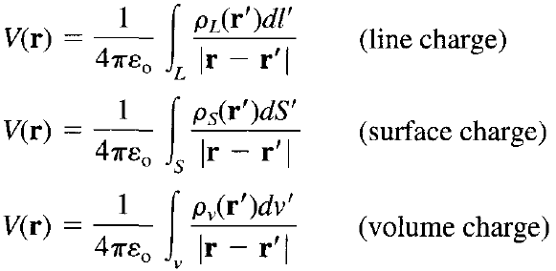
Electric Potential - Charge Distributions
For continuous charge distributions, we replace Q_{k} with charge element ρ_{L} dl, ρ_{s} dS, or ρ_{v} dv and the summation becomes an integration, so the potential at r becomes:
Primed coordinates denote source point location, unprimed coordinates refer to field point

Slide 11



Relationship Between E and V
As discussed, the potential difference between points A and B is independent of the path taken, hence:
Therefore:
Or:
The line integral of E along a closed path must be zero
Physically, this implies that no net work is done in moving a charge along a closed path in an electrostatic field

Slide 12


Relationship Between E and V
Applying Stokes's theorem, we get:
Or:
Any vector field that satisfies the above equations is said to be conservative => electrostatic field is a conservative field
The above equation is referred to as Maxwell's second equation for static electric fields

Slide 13



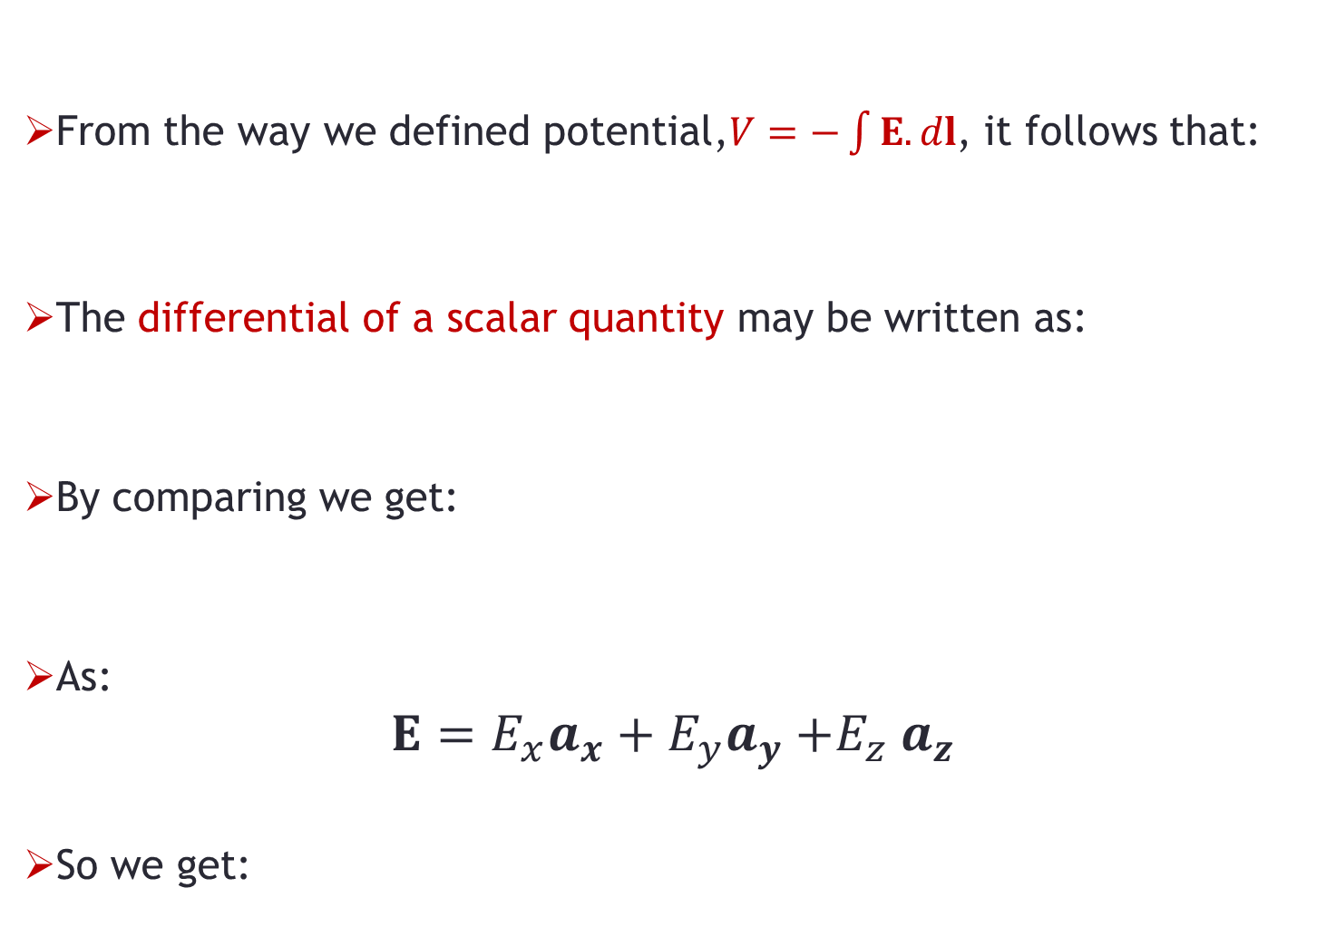
Relationship Between E and V
From the way we defined potential,$V=−\int{E.dl}$, it follows that:
The differential of a scalar quantity may be written as:
By comparing we get:
As:
$$E=E_{x}a_{x}+E_{y}a_{y}{+E}_{z}a_{z}$$
So we get:

Slide 14
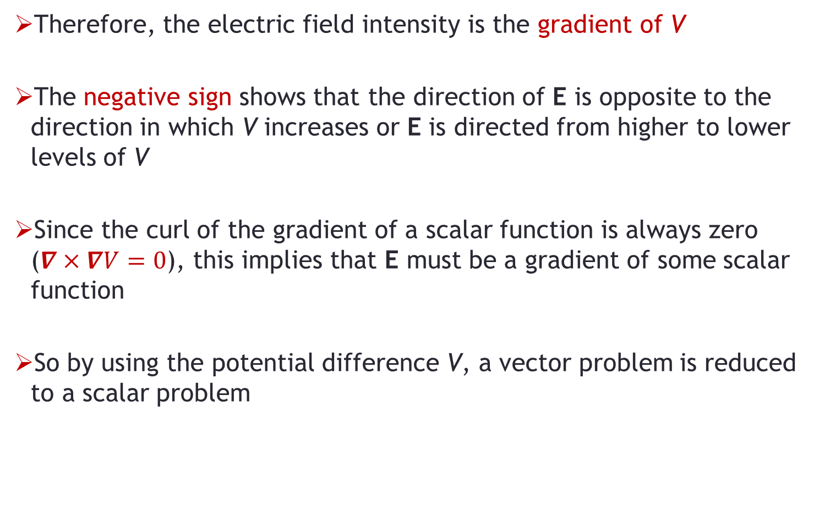
Relationship Between E and V
Therefore, the electric field intensity is the gradient of V
The negative sign shows that the direction of E is opposite to the direction in which V increases or E is directed from higher to lower levels of V
Since the curl of the gradient of a scalar function is always zero ($∇×∇V=0$), this implies that E must be a gradient of some scalar function
So by using the potential difference V, a vector problem is reduced to a scalar problem

Slide 15
Problem-1
An infinite line charge having charge density ρ_{L} C/m² is placed along the z-axis. Find the work done in moving a point charge Q:
From point b to a on the y-axis, where a is closer to the line charge compared to b.
In a circle around the line charge.

