Slide 1
APPLICATION OF
GAUSS LAW – PROBLEM session

Slide 2
Problem-1
Consider a coaxial cable where radius of the inner conductor is a and that of outer conductor is b. The length of the conductor is L and line charge density of the inner conductor is ρ_{L}. Determine the electric field E in terms of ρ_{L} at the region:
Between the two conductors of the coaxial cable
Outside the coaxial cable

Slide 3
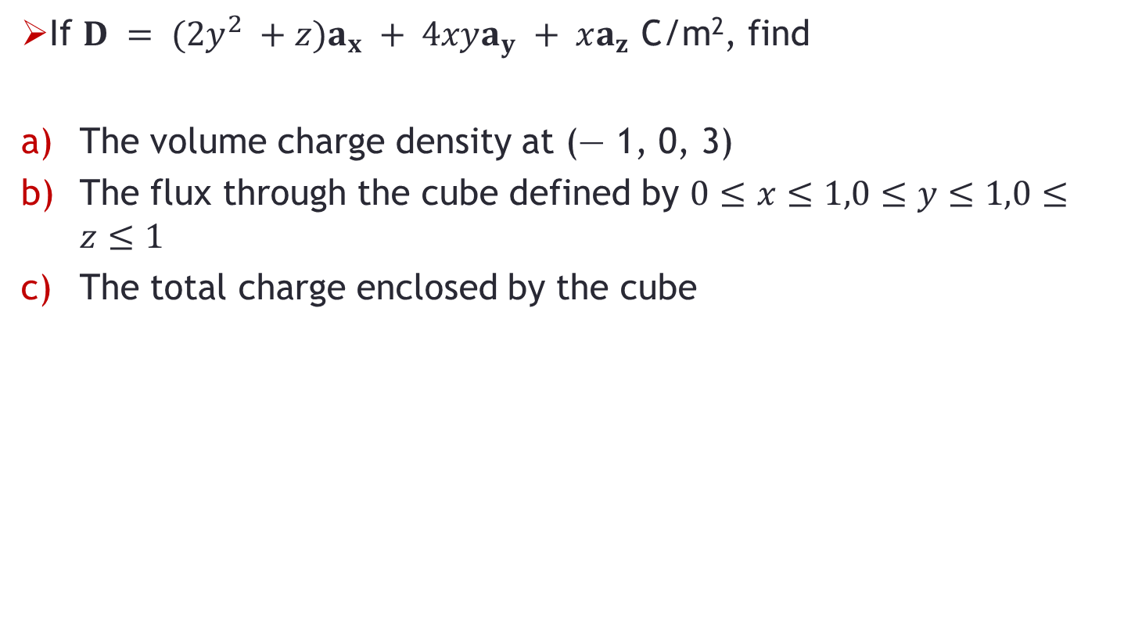
Problem-2
If $D = (2y^{2} +z)a_{x} + 4xya_{y} + xa_{z}$ C/m², find
The volume charge density at (— 1, 0, 3)
The flux through the cube defined by $0≤x≤1,0≤y≤1,0≤z≤1$
The total charge enclosed by the cube

Slide 4
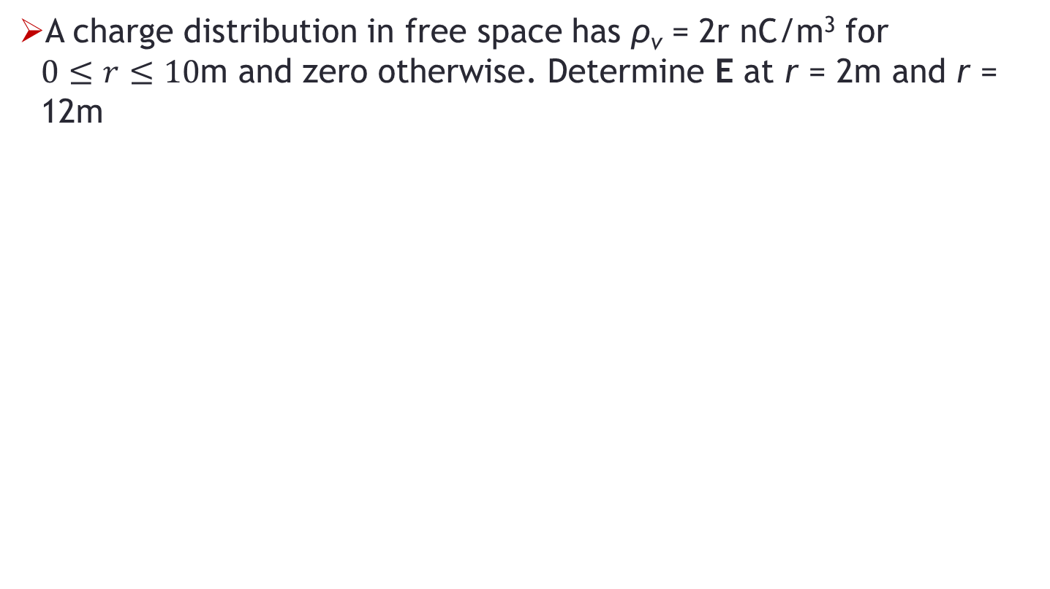
Problem-3
A charge distribution in free space has ρ_{v} = 2r nC/m³ for $0≤r≤10$m and zero otherwise. Determine E at r = 2m and r = 12m

