Slide 1
APPLICATIONs OF
GAUSS LAW

Slide 2
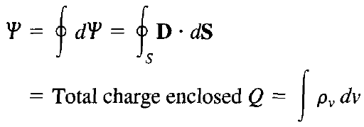
Gauss’s Law
We will now consider how we may use the Gauss’s law below:
The procedure for applying Gauss's law to calculate the electric field involves first knowing whether symmetry exists
Once symmetric charge distribution exists, we construct a mathematical closed surface (known as a Gaussian surface) around the source of electric field

Slide 3
Gauss’s Law
The solution to the Gauss’s law equation is easy if we are able to choose a closed surface which satisfies two conditions:
Ds is everywhere either normal or tangential to the closed surface, so that D_{s}.dS becomes either D_{s}dS or zero, respectively
On that portion of the closed surface for which D_{s}.dS is not zero, Ds = constant
We will now apply Gauss’s law to the four types of charged sources, namely point, line, surface and volume charge

Slide 4
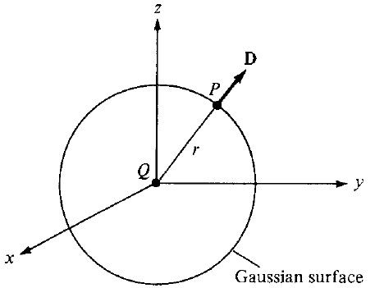
A Point Charge
Suppose a point charge Q is located at the origin
To determine D at a point P, it is easy to see that choosing a spherical surface containing P will satisfy symmetry conditions
Thus, a spherical surface centered at the origin is the Gaussian surface in this case as shown in figure

Slide 5


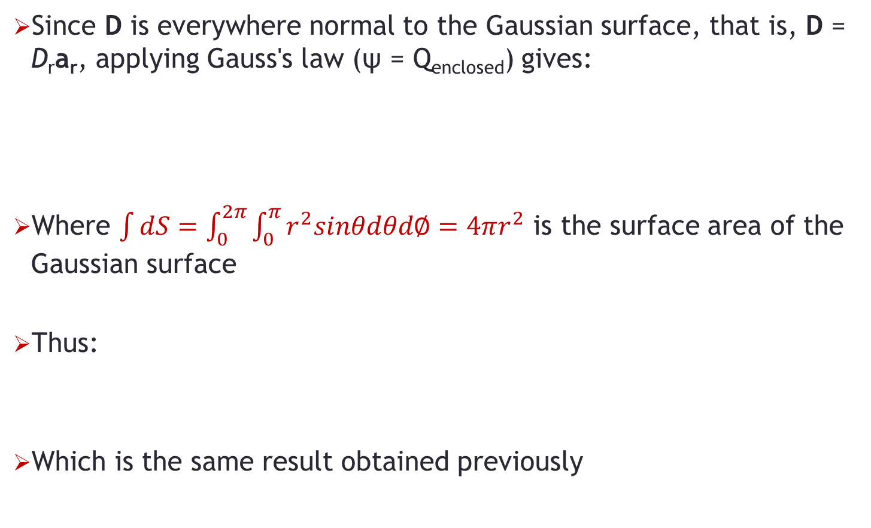
A Point Charge
Since D is everywhere normal to the Gaussian surface, that is, D = D_{r}a_{r}, applying Gauss's law (ψ = Q_{enclosed}) gives:
Where $\int{dS=\int_{0}^{2π}{\int_{0}^{π}{r^{2}sinθdθd∅}}=4πr^{2}}$ is the surface area of the Gaussian surface
Thus:
Which is the same result obtained previously

Slide 6
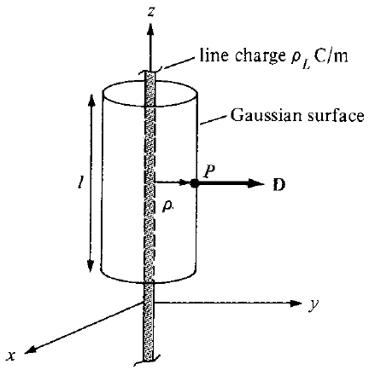
Infinite Line Charge
Suppose the infinite line of uniform charge ρ_{L} C/m lies along the z-axis as shown in figure
To determine D at a point P, we choose a cylindrical surface containing P to satisfy symmetry condition
D is constant on and normal to the cylindrical Gaussian surface; that is: D = D_{ρ}a_{ρ}

Slide 7


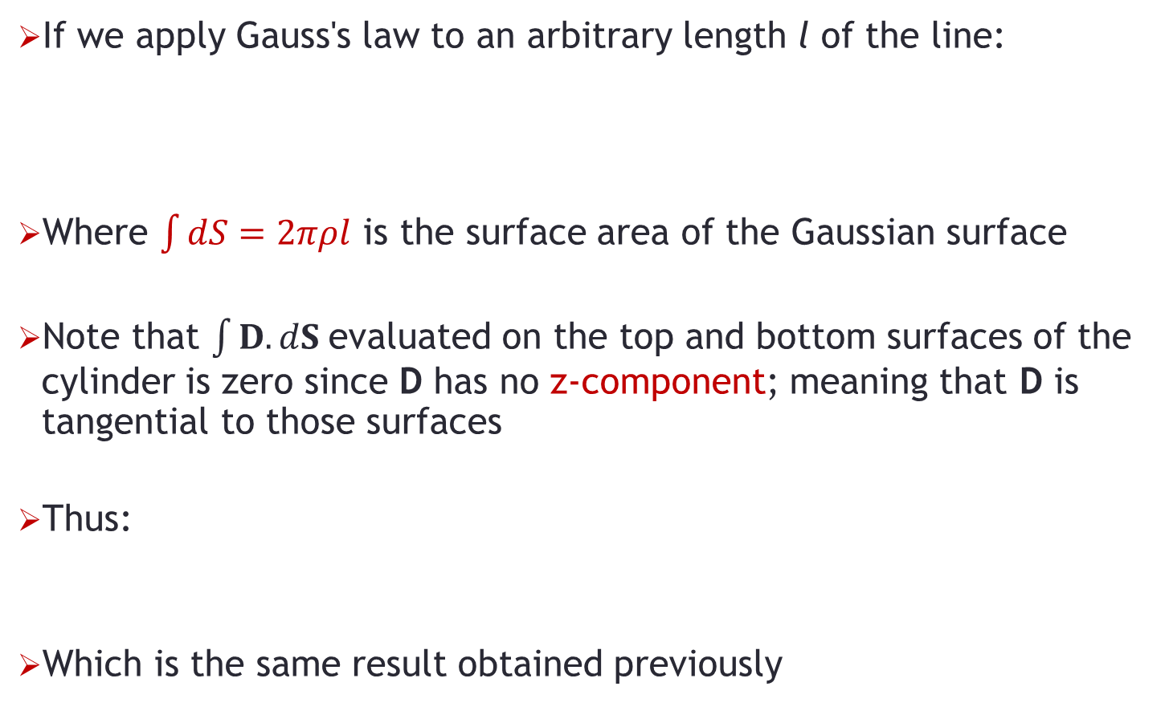
Infinite Line Charge
If we apply Gauss's law to an arbitrary length l of the line:
Where $\int{dS}=2πρl$ is the surface area of the Gaussian surface
Note that $\int{D. dS}$evaluated on the top and bottom surfaces of the cylinder is zero since D has no z-component; meaning that D is tangential to those surfaces
Thus:
Which is the same result obtained previously

Slide 8
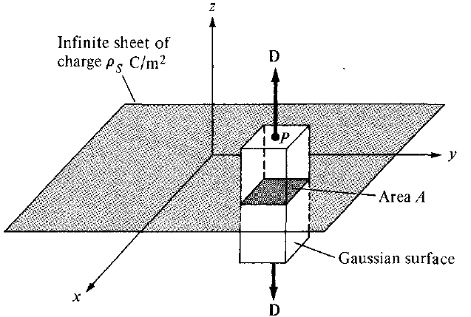
Infinite Sheet of Charge
Consider the infinite sheet of uniform charge ρ_{s} C/m² lying on the z = 0 plane
To determine D at point P, we choose a rectangular box that is cut symmetrically by the sheet of charge and has two of its faces parallel to the sheet

Slide 9




Infinite Sheet of Charge
As D is normal to the sheet, D = D_{z}a_{z}, and applying Gauss's law gives:
Note that D.dS evaluated on the sides of the box is zero because D has no components along a_{x} and a_{y}
If the top and bottom area of the box each has area A, the above equation becomes:
And thus:
Or:

Slide 10
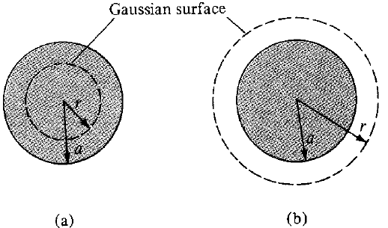
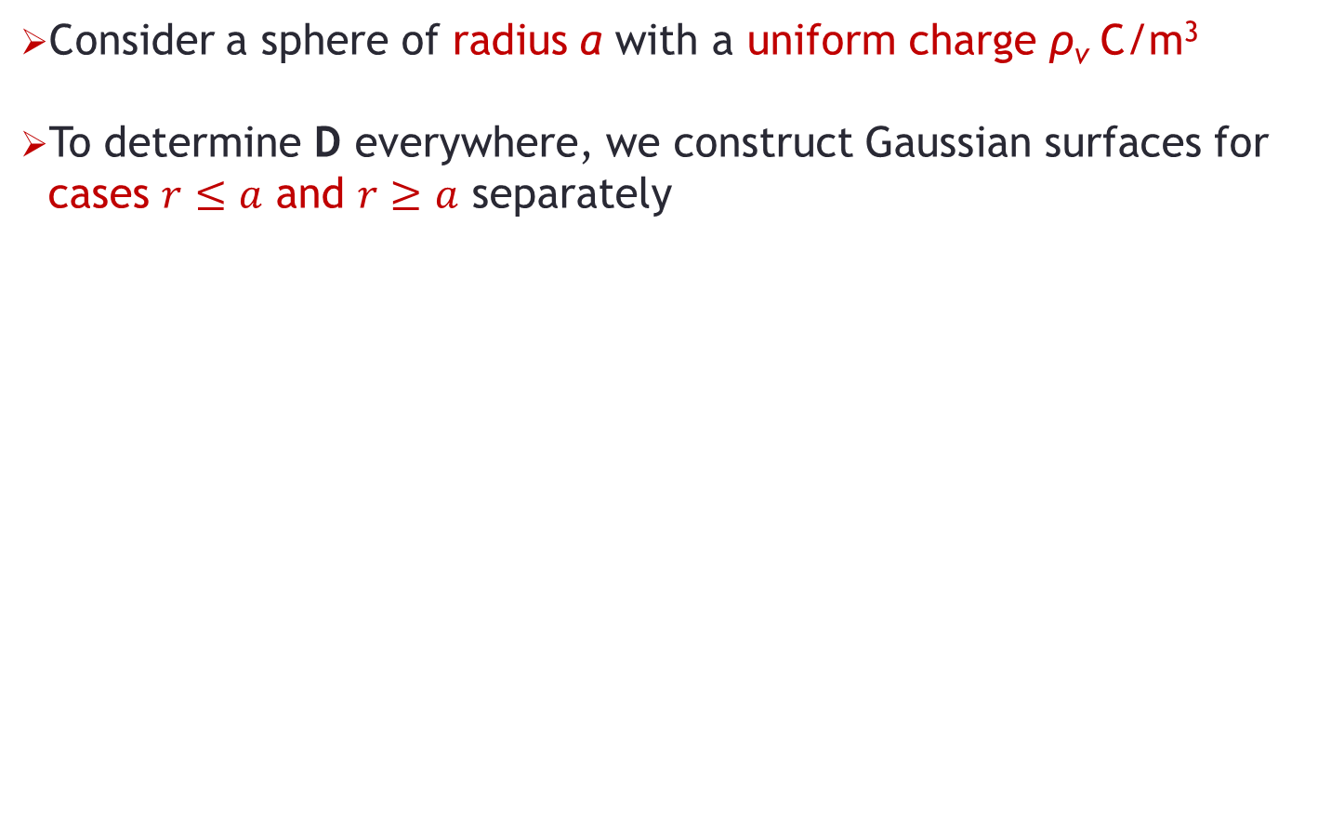
Uniformly Charged Sphere
Consider a sphere of radius a with a uniform charge ρ_{v} C/m³
To determine D everywhere, we construct Gaussian surfaces for cases $r≤a$ and $r≥a$ separately
Since the charge has spherical symmetry, it is obvious that a spherical surface is an appropriate Gaussian surface

Slide 11
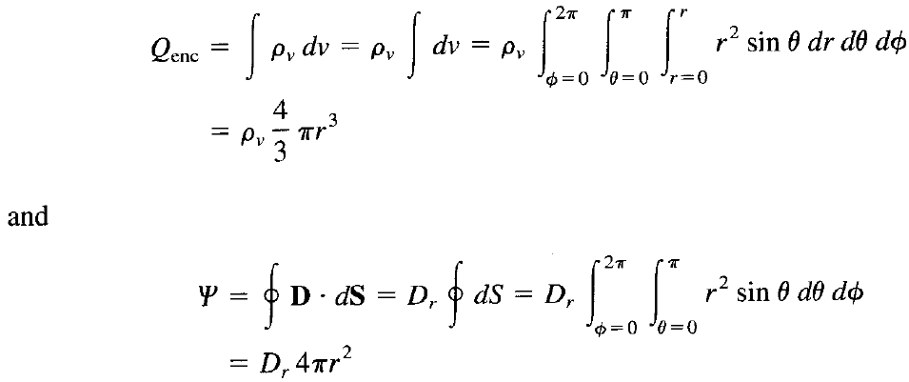
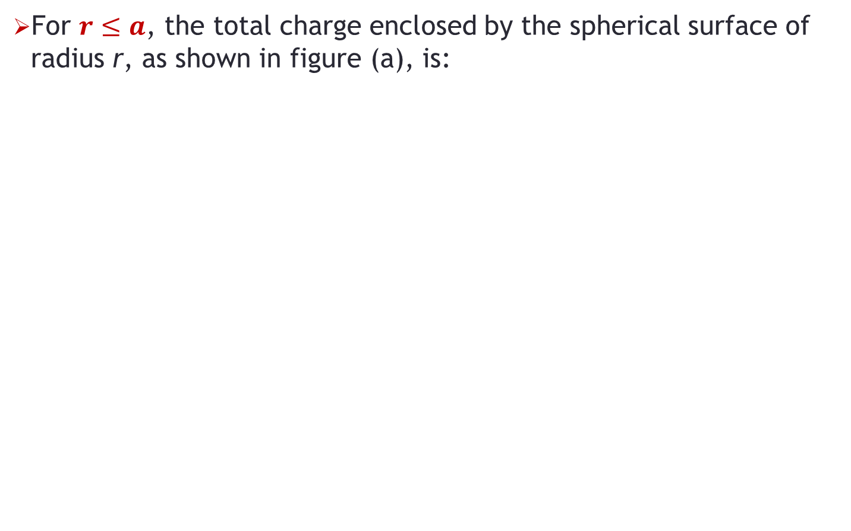
Uniformly Charged Sphere
For $r≤a$, the total charge enclosed by the spherical surface of radius r, as shown in figure (a), is:

Slide 12


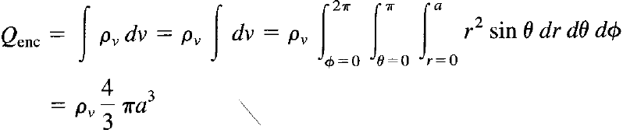
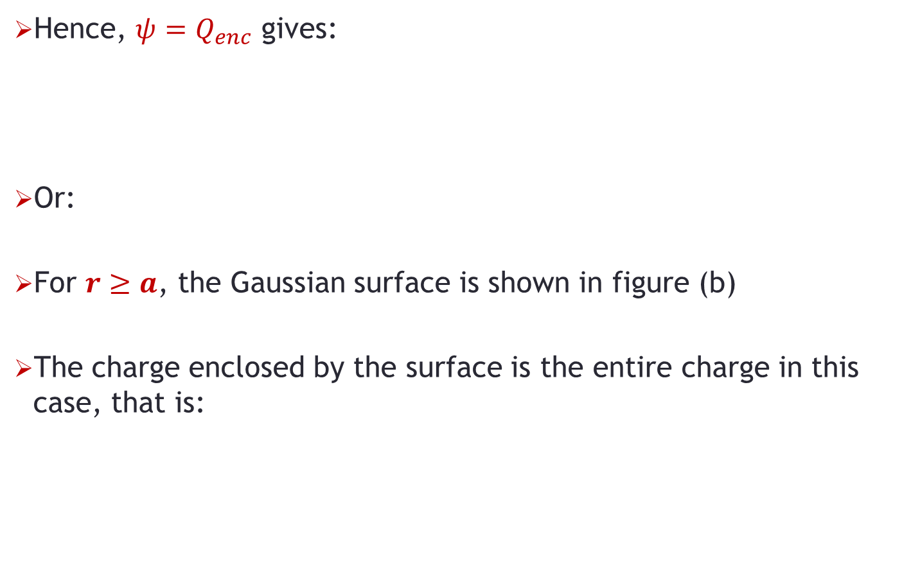
Uniformly Charged Sphere
Hence, $ψ=Q_{enc}$ gives:
Or:
For $r≥a$, the Gaussian surface is shown in figure (b)
The charge enclosed by the surface is the entire charge in this case, that is:

Slide 13



Uniformly Charged Sphere
We have the total flux as:
Hence from the previous two equations, we have:
Or:

Slide 14
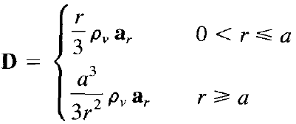
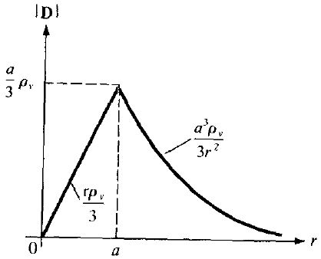
Uniformly Charged Sphere
Thus D everywhere is given as:
The sketch of |D| versus distance from the center of the sphere is shown:

Slide 15
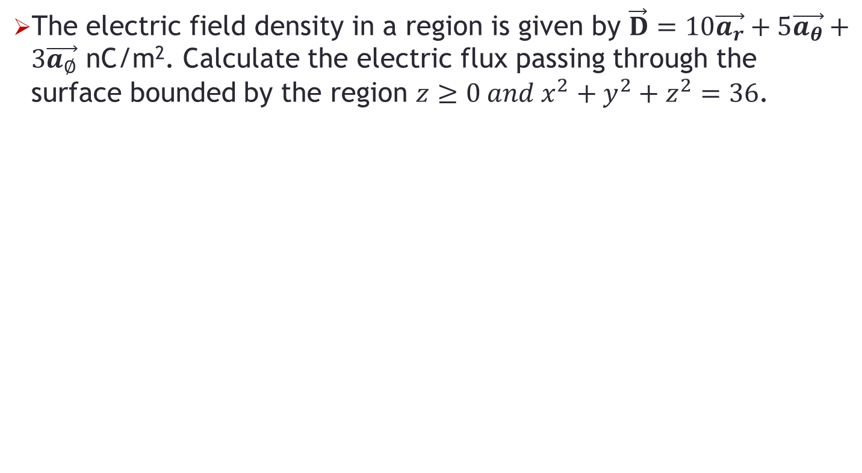
Problem-1
The electric field density in a region is given by $\vec{D}=10\vec{a_{r}}+5\vec{a_{θ}}+3\vec{a_{∅}}$ nC/m². Calculate the electric flux passing through the surface bounded by the region $z≥0 and x^{2}+y^{2}+z^{2}=36$.

Slide 16
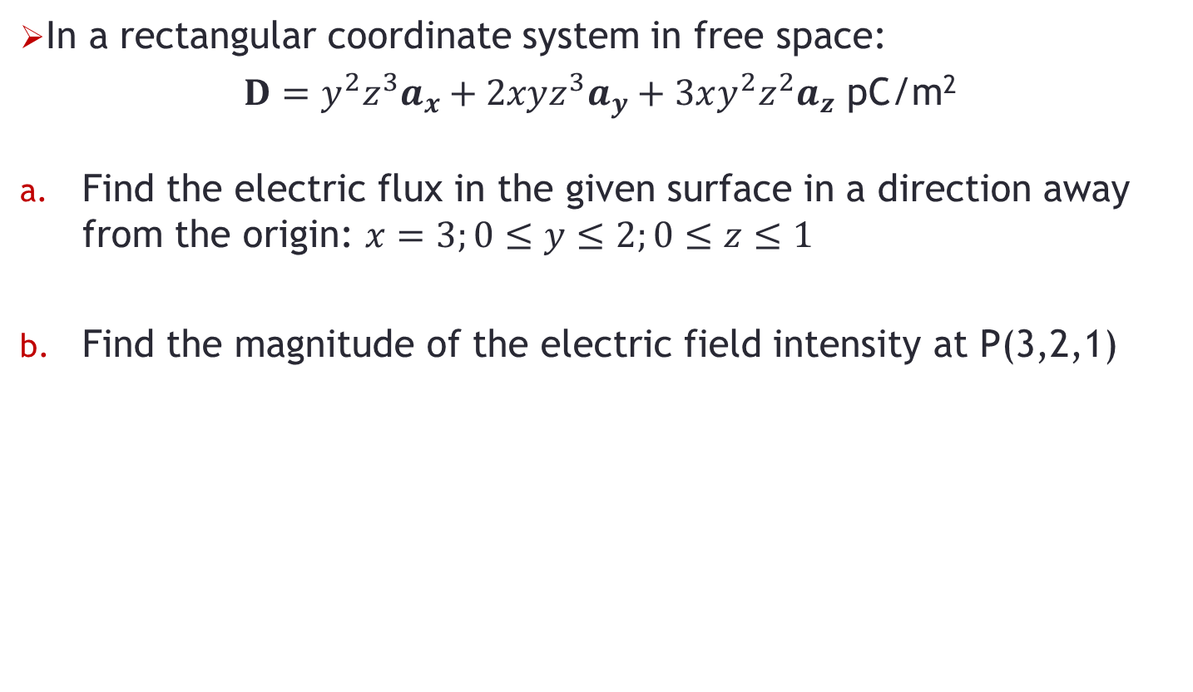
Problem-2
In a rectangular coordinate system in free space:
$D=y^{2}z^{3}a_{x}+2xyz^{3}a_{y}+3xy^{2}z^{2}a_{z}$ pC/m²
Find the electric flux in the given surface in a direction away from the origin: $x=3;0≤y≤2;0≤z≤1$
Find the magnitude of the electric field intensity at P(3,2,1)

