Slide 1
ELECTRIC FLUX DENSITY AND
GAUSS LAW

Slide 2
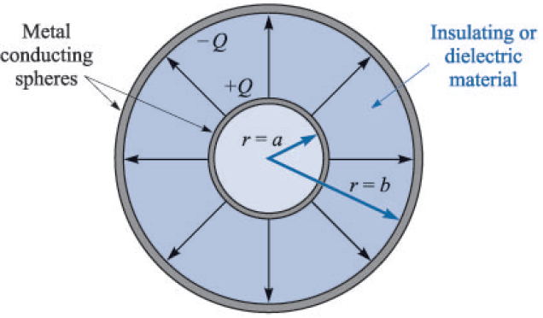
Electric Flux Density
Faraday used the equipment shown in figure below to study static electric fields
The inner sphere was given a positive charge and the outer sphere was discharged by connecting it momentarily to ground

Slide 3
Electric Flux Density
It was found that the total charge on the outer sphere was equal in magnitude to the original charge placed on the inner sphere
This was true regardless of the dielectric material separating the two spheres
It was concluded that there was some sort of displacement from the inner sphere to the outer sphere which was independent of the medium
We now refer this flux as displacement flux or simply electric flux

Slide 4

Electric Flux Density
Faraday’s experiments also showed that a larger positive charge on the inner sphere induced a correspondingly larger negative charge on the outer sphere
Hence, there exists a direct proportionality between the electric flux and the charge on the inner sphere
The constant of proportionality is dependent on the system of units involved, and for SI units, it is 1
If the electric flux is denoted by ψ and the total charge on the inner sphere by Q, then from the Faraday experiment:

Slide 5


Electric Flux Density
We can obtain more quantitative information by considering an inner sphere of radius a and outer sphere of radius b, with charges of Q and -Q
So at the surface of the inner sphere, ψ coulombs of electric flux are produced by the charge Q (= ψ) distributed uniformly over a surface having an area of:
The density of the flux at this surface is called electric flux density and is denoted by D, mathematically:

Slide 6




Electric Flux Density
The direction of D at a point is the direction of the flux lines at that point and the magnitude is given by the number of flux lines crossing a surface normal to the lines divided by the surface area
At a radial distance r, where
If we now let the inner sphere become smaller and smaller, while still retaining a charge of Q, it becomes a point charge, but the electric flux density is still given by the above equation
The electric field intensity is given as:
Therefore, we have in free space:

Slide 7



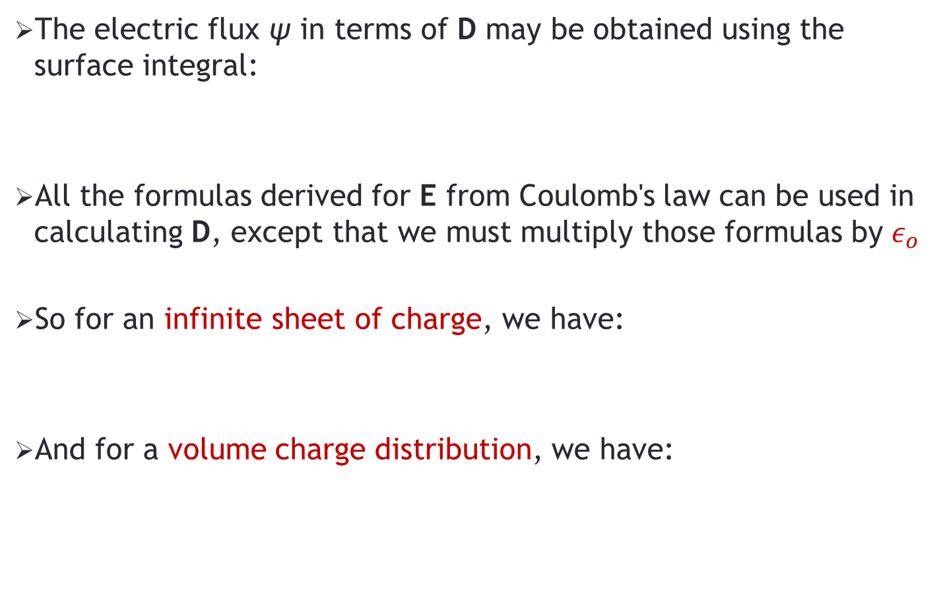
Electric Flux Density
The electric flux ψ in terms of D may be obtained using the surface integral:
All the formulas derived for E from Coulomb's law can be used in calculating D, except that we must multiply those formulas by $ε_{o}$
So for an infinite sheet of charge, we have:
And for a volume charge distribution, we have:

Slide 8

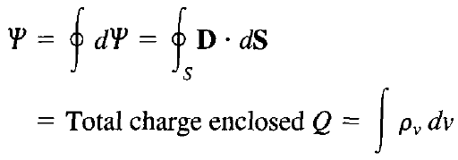

Gauss Law
Gauss's law states that the total electric flux ψ through any closed surface is equal to the total charge enclosed by that surface:
That is:
Or:

Slide 9
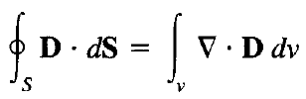

Gauss Law
By applying divergence theorem:
Comparing the two volume integrals above:
This is the first of the four Maxwell's equations
The equation states that the volume charge density is the same as the divergence of the electric flux density

Slide 10


Gauss Law – Important Points
Integral form of Gauss law:
Differential or point form of Gauss law:
Gauss's law provides an easy means of finding E or D for symmetrical charge distributions
Examples of symmetrical charge distributions are a point charge, an infinite line charge, an infinite cylindrical surface charge, and a spherical distribution of charge

Slide 11
Problem-1
A uniform volume charge density of 80 μC/m³ is present throughout the region 8mm< r <10mm. Let ρ_{v} = 0 for 0< r <8mm.
a) Find the total charge inside the spherical surface r = 10 mm:
b) Find D_{r} at r = 10 mm:
c) If there is no charge for r > 10 mm, find Dr at r = 20 mm:

Slide 12
Problem-2
Volume charge density is located as follows: ρ_{v} = 0 for ρ < 1 mm and ρ > 2 mm and for 1 < ρ < 2 mm, ρ_{v} = 4ρ μC/m³.
a) Calculate the total charge in the region 0 < ρ < ρ1, 0 < z < L, where 1 < ρ1 < 2 mm:
b) Determine D_{ρ} at ρ = ρ1:

