Slide 1
ELECTRIC FIELDS DUE TO CONTINUOUS CHARGE DISTRIBUTIONS –
VOLUME CHARGE

Slide 2
Volume Charge
A volume charge may be visualized by a region of space with a large number of charges separated by very small distances
We can replace this distribution of very small particles with a smooth continuous distribution described by a volume charge density
We denote the volume charge density by ρ_{v}, having the units of coulombs per cubic meter (C/m³)

Slide 3
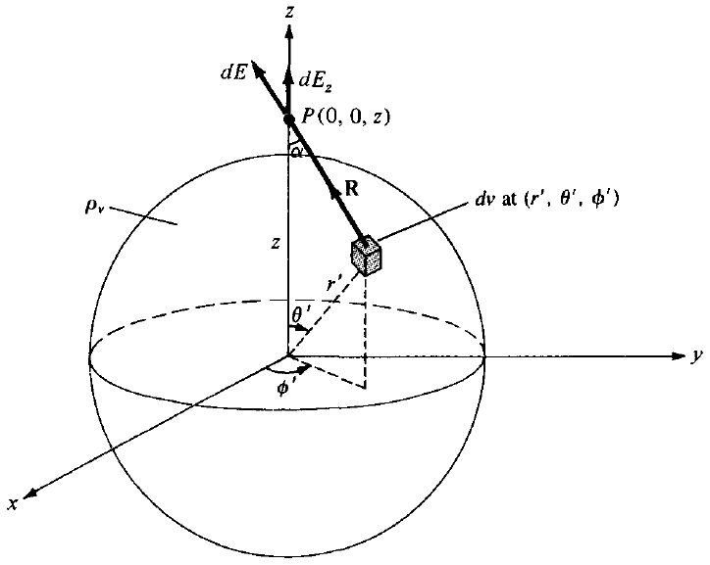
Volume Charge
A volume charge distribution with uniform charge density ρ_{v} is shown in figure
We choose a volume of the shape of a cube

Slide 4


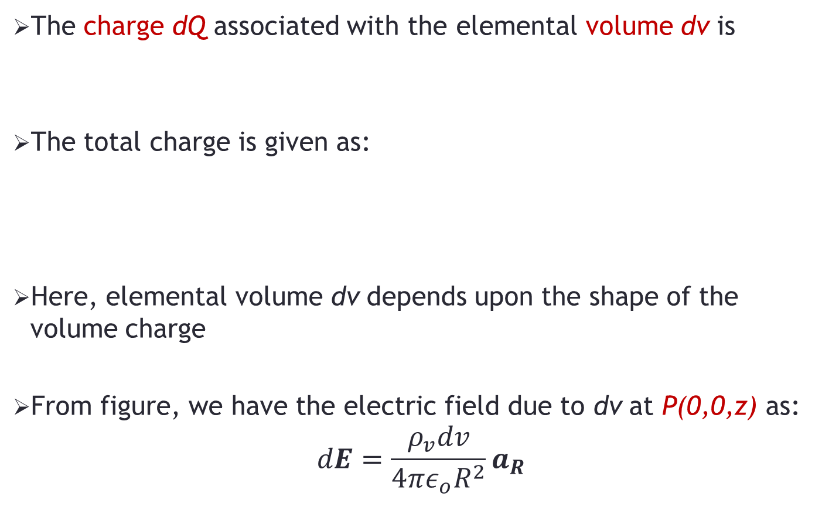
Volume Charge
The charge dQ associated with the elemental volume dv is
The total charge is given as:
Here, elemental volume dv depends upon the shape of the volume charge
From figure, we have the electric field due to dv at P(0,0,z) as:
$$dE=\frac{ρ_{v}dv}{4πε_{o}R^{2}}a_{R}$$

Slide 5



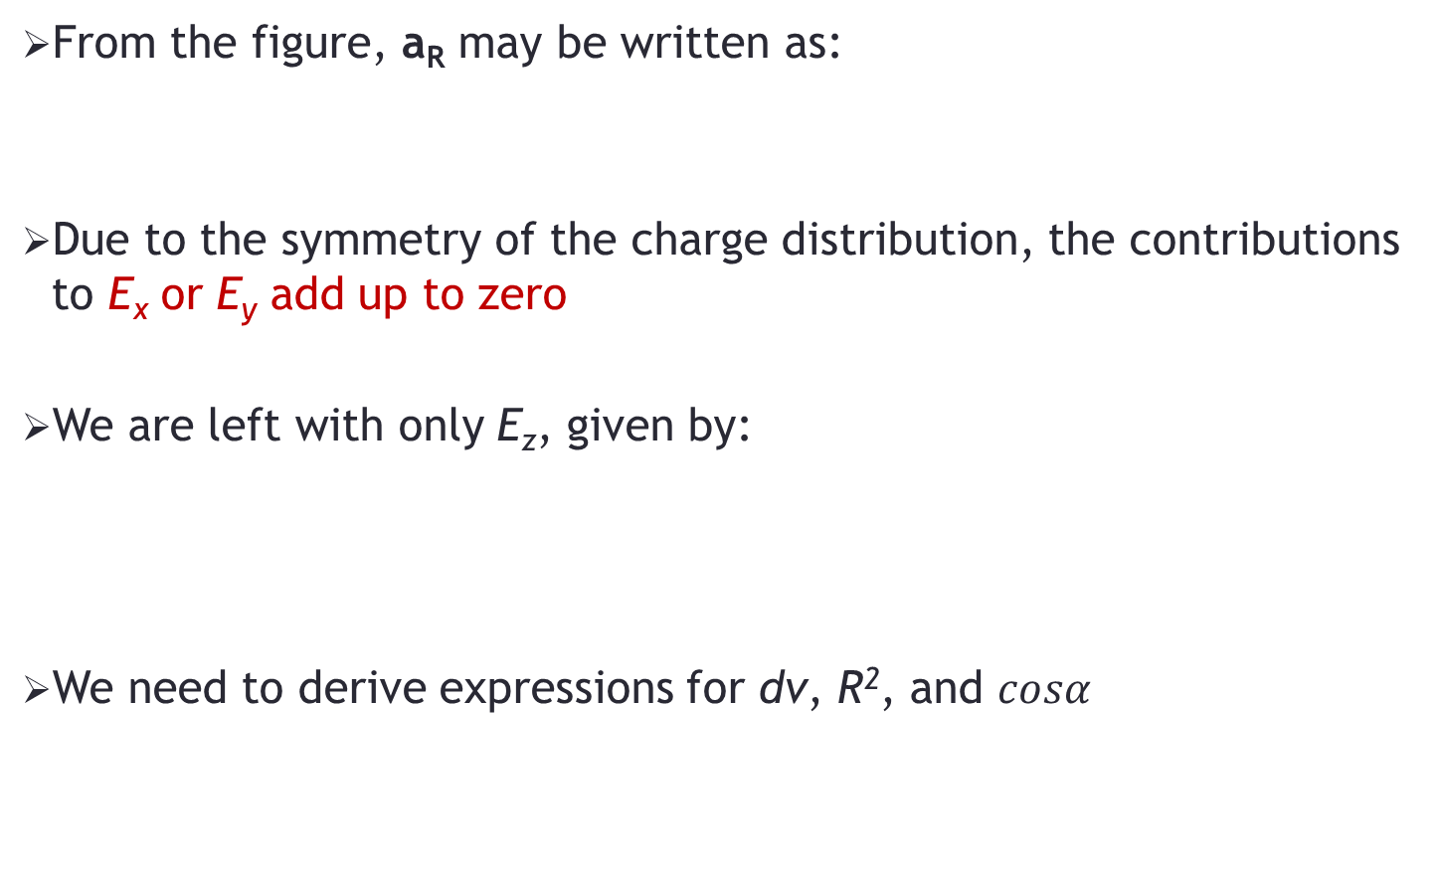
Volume Charge
From the figure, a_{R} may be written as:
Due to the symmetry of the charge distribution, the contributions to E_{x} or E_{y} add up to zero
We are left with only E_{z}, given by:
We need to derive expressions for dv, R², and $cosα$

Slide 6

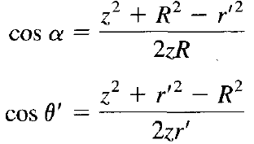
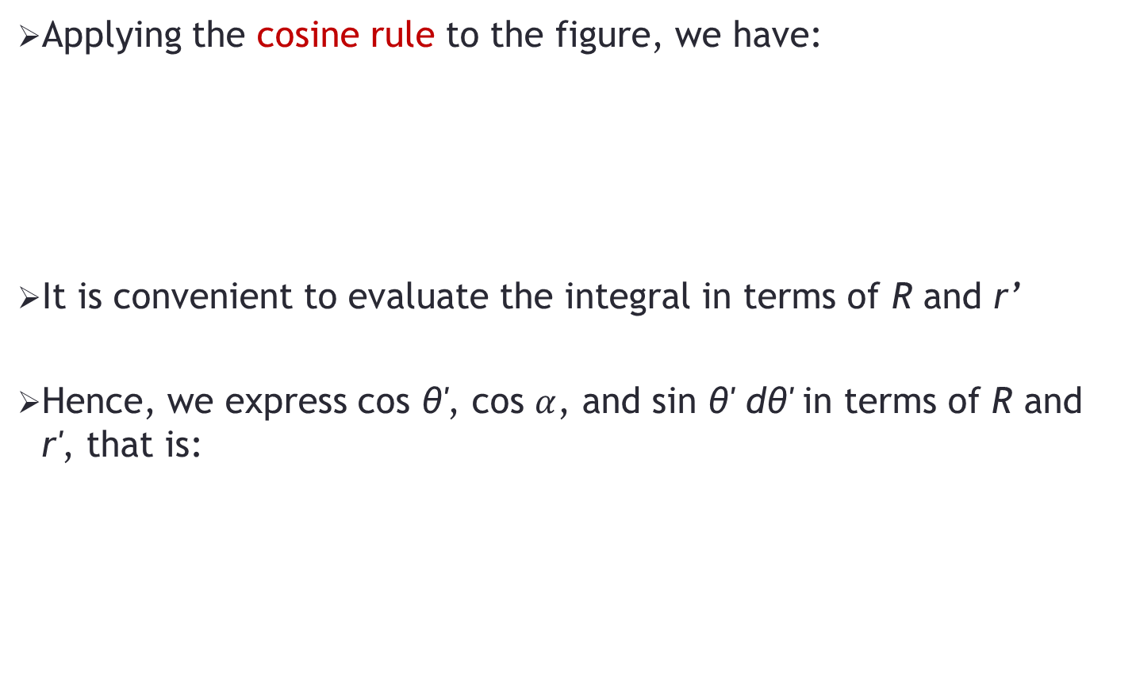
Volume Charge
Applying the cosine rule to the figure, we have:
It is convenient to evaluate the integral in terms of R and r’
Hence, we express cos θ', cos $α$, and sin θ' dθ' in terms of R and r', that is:

Slide 7

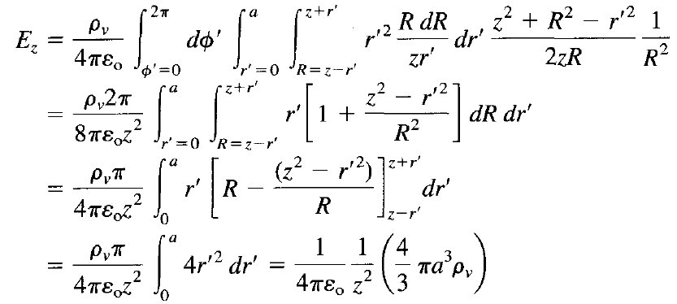
Volume Charge
Differentiating the above equation with respect to θ' keeping z and r' fixed, we obtain:
Substituting values in the integral, we get:
Notes:
Max value = z+r’, Min value = z-r’. The max and min both will exist along the diameter.

Slide 8




Volume Charge
Earlier, the total charge was given as:
If we assume that the whole volume charge has a spherical volume with radius a, then:
Using this value in the equation for electric field, we get:

Slide 9

Volume Charge
Due to the symmetry of the charge distribution, the electric field at P(r,θ,Φ) is readily obtained as:
It may be observed that the above equation is identical to the electric field at the same point due to a point charge Q located at the origin or the center of the spherical charge distribution

Slide 10
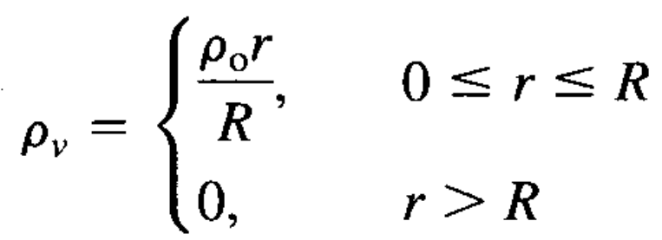
Problem-1
A charge distribution is given by the following density:
Determine electric field E at distance r > R and plot the magnitude of the electric field versus distance r.

Slide 11
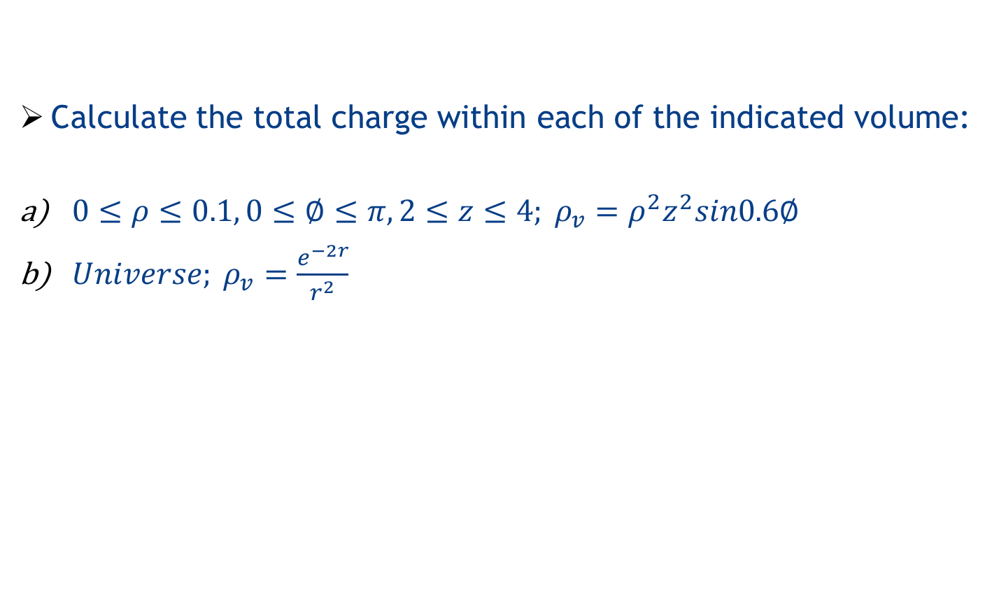
Problem-2
Calculate the total charge within each of the indicated volume:
$0≤ρ≤0.1, 0≤∅≤π, 2≤z≤4; ρ_{v}=ρ^{2}z^{2}sin0.6∅$
$Universe; ρ_{v}=\frac{e^{−2r}}{r^{2}}$

