Slide 1
CT Convolution

Slide 2
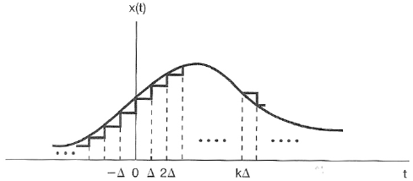
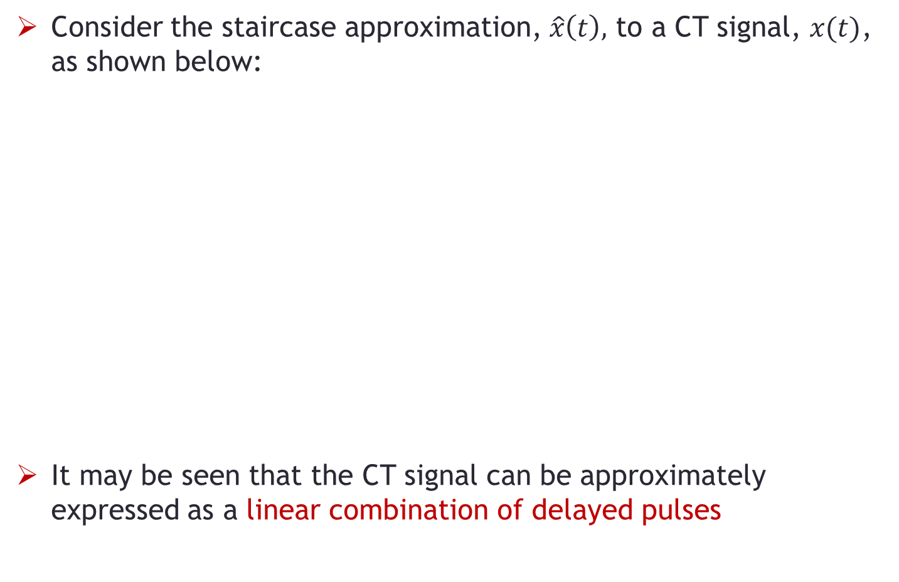
CT Signals as Sum of Impulses
Consider the staircase approximation, $\hat{x}\left(t\right),$ to a CT signal, $x(t)$, as shown below:
It may be seen that the CT signal can be approximately expressed as a linear combination of delayed pulses

Slide 3
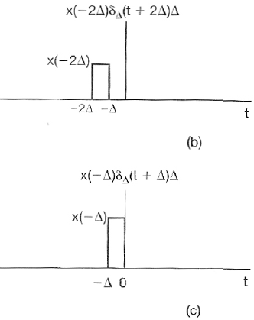
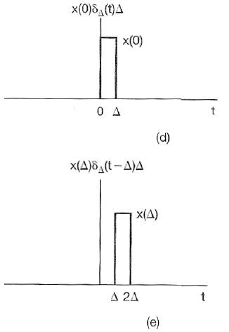
CT Signals as Sum of Impulses
The approximation expressed as a linear combination of delayed pulses is shown in parts: (b)-(e)

Slide 4
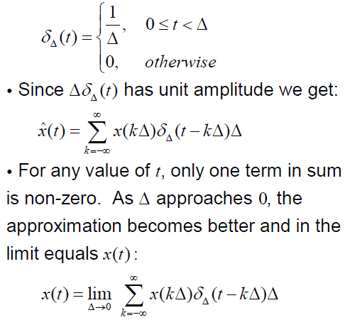
CT Signals as Sum of Impulses
The unit impulse can be written as:

Slide 5
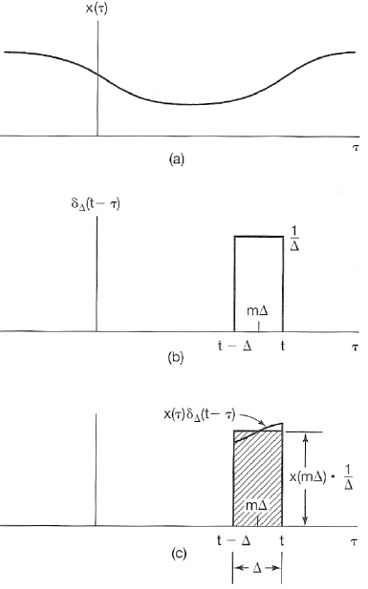
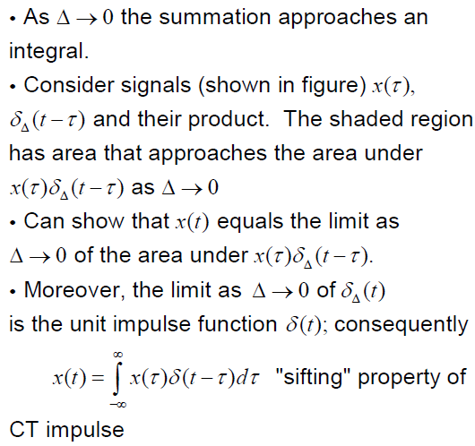
CT Signals as Sum of Impulses

Slide 6
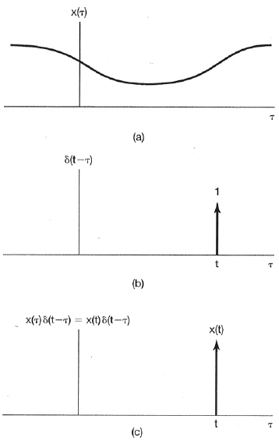

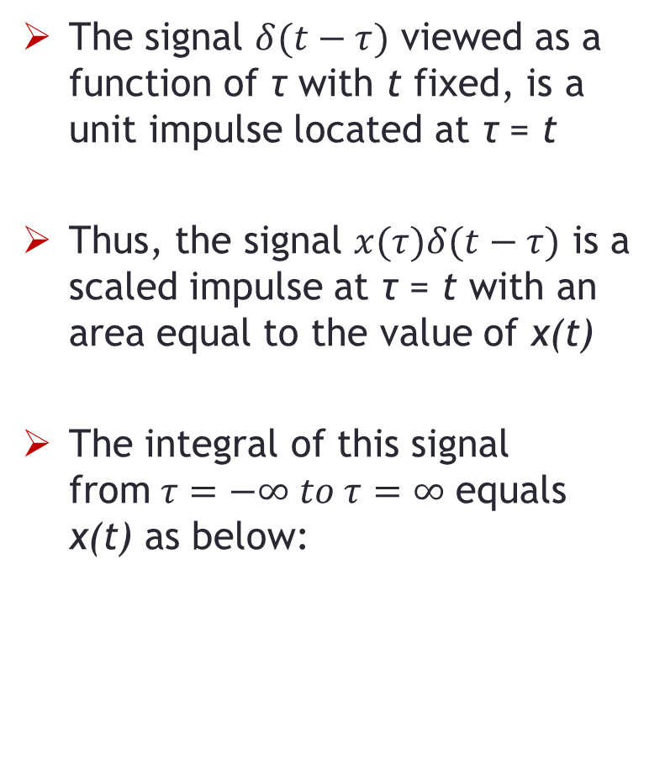
CT Signals as Sum of Impulses
The signal $δ(t−τ)$ viewed as a function of τ with t fixed, is a unit impulse located at τ = t
Thus, the signal $x(τ)δ(t−τ)$ is a scaled impulse at τ = t with an area equal to the value of x(t)
The integral of this signal from$τ=−∞ to τ=∞$ equals x(t) as below:

Slide 7
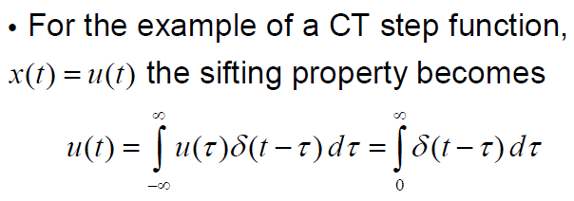
CT Step Signal - Example

Slide 8
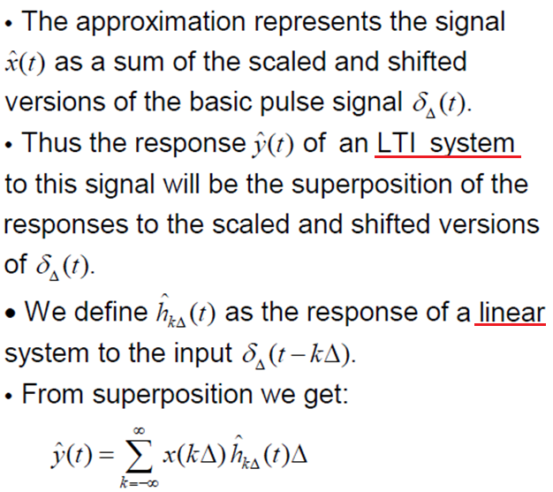
CT Convolution Integral

Slide 9
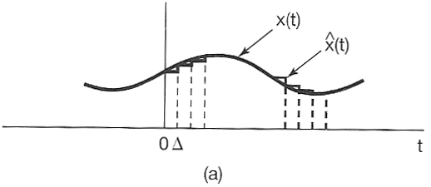
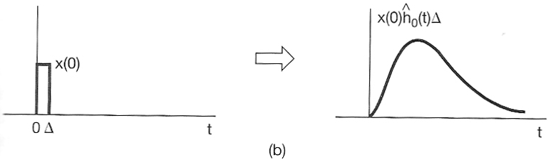
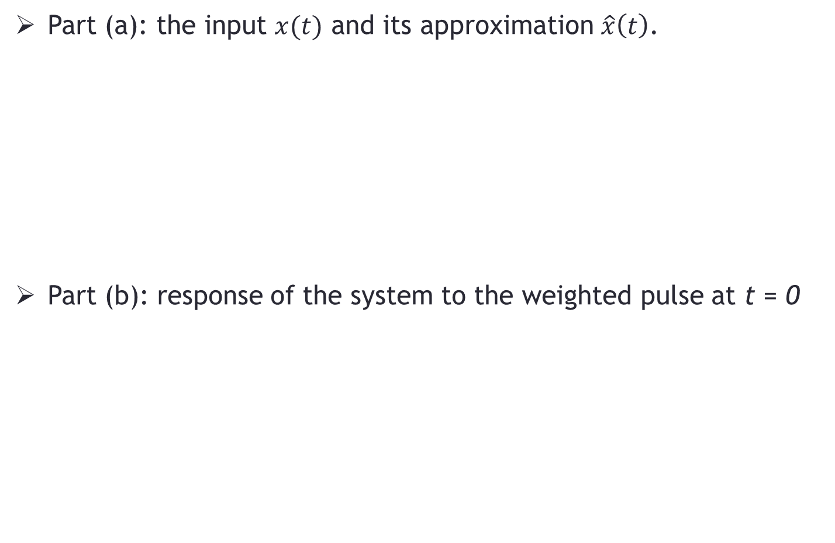
CT Convolution
Part (a): the input $x(t)$ and its approximation $\hat{x}\left(t\right)$.
Part (b): response of the system to the weighted pulse at t = 0

Slide 10
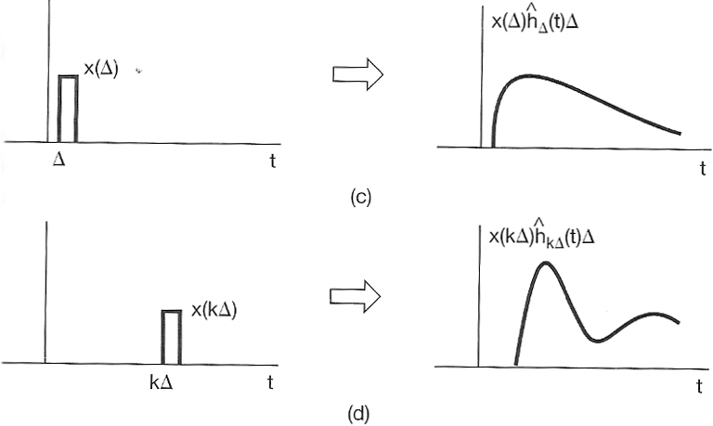
CT Convolution
Part (c)-(d): response of the system to the weighted pulses at t = kΔ

Slide 11
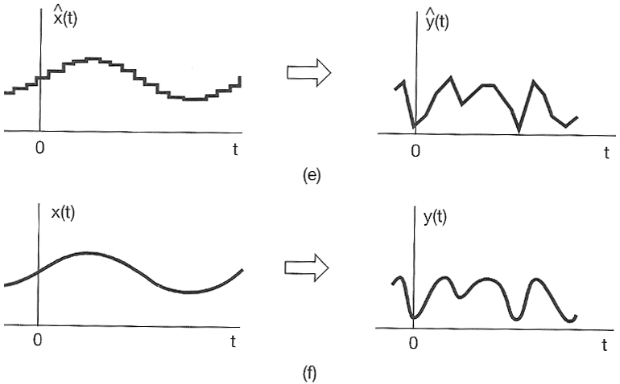
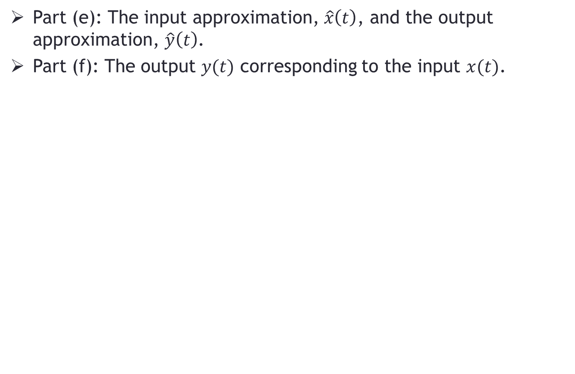
CT Convolution
Part (e): The input approximation, $\hat{x}\left(t\right)$, and the output approximation, $\hat{y}\left(t\right)$.
Part (f): The output $y(t)$ corresponding to the input $x(t)$.

Slide 12
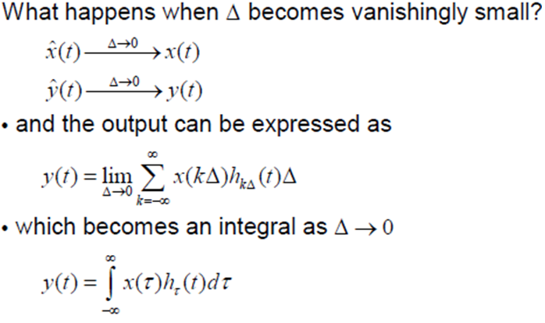
CT Convolution

Slide 13
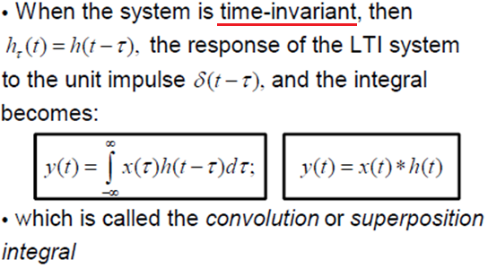
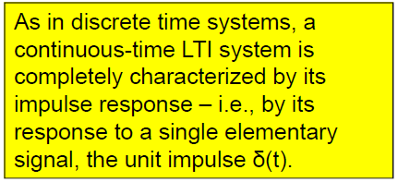
CT Convolution

Slide 14
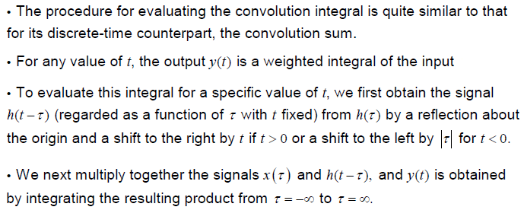
CT Convolution - Procedure

Slide 15

CT Convolution – Problem-1
Notes:
First-order RC low-pass circuit, the impulse response is: h(t)=1/RC x ​e^{−t/RC}u(t). This corresponds to an RC circuit with time constant τ=RC=12\tau = RC = \tfrac{1}{2}τ=RC.
Interpretation for students:
x(t)x(t)x(t) (rectangular pulse) → could be a sensor sending a 1-second test signal.
The RC circuit (with RC=0.5RC=0.5RC=0.5) processes it → output y(t)y(t)y(t) rises smoothly (not instantly like the input) and then decays exponentially after the pulse ends.
This shows them how convolution directly models real circuit behavior

Slide 16
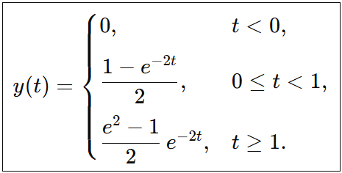
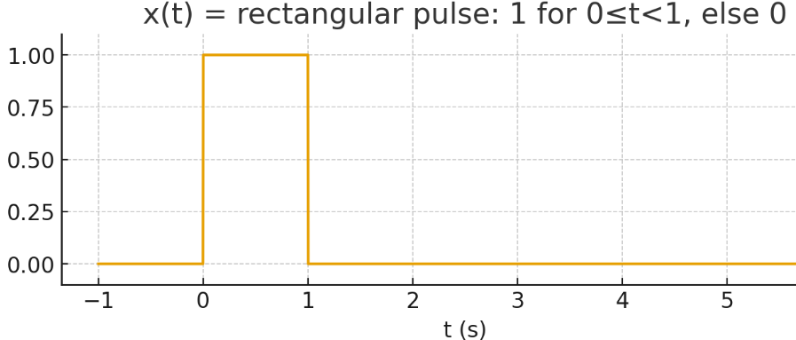
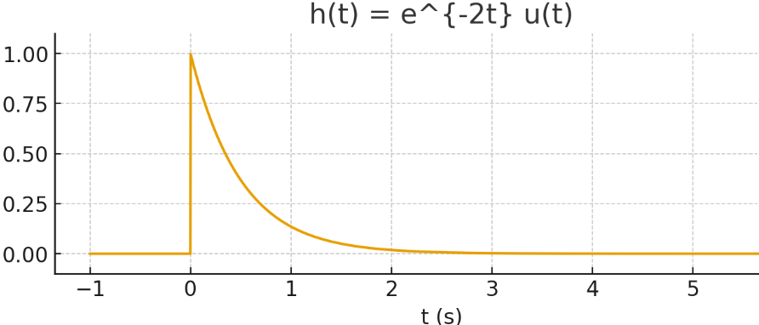
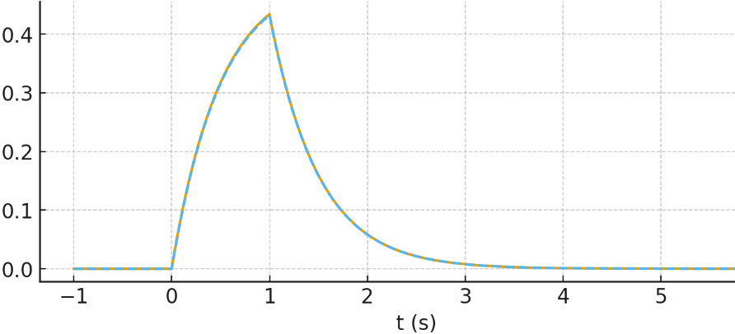
CT Convolution – Problem-1

Slide 17
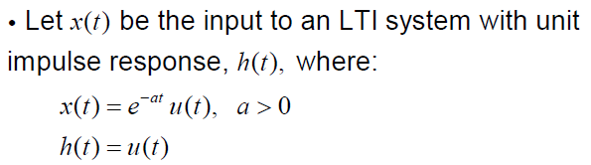


CT Convolution – Problem-2
Find

Slide 18
END

