Slide 1
COURSE INTRODUCTION and
VECTOR ALGEBRA

Slide 2
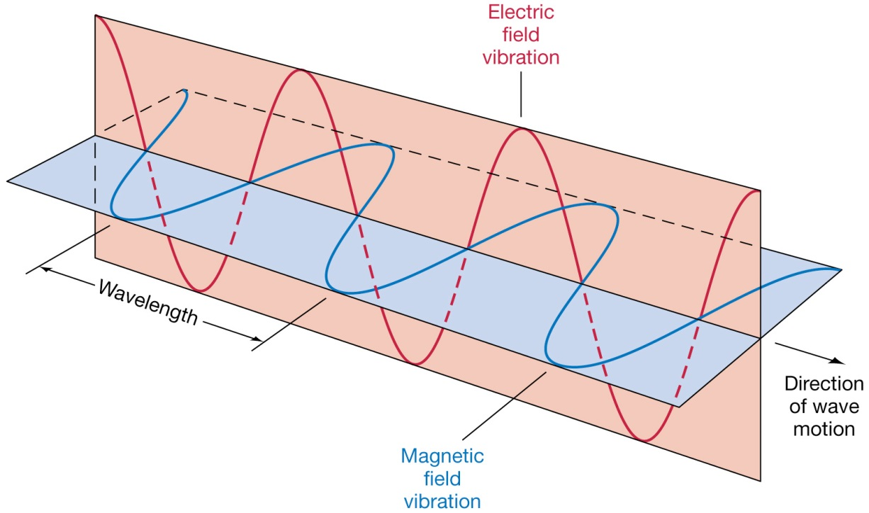
Electromagnetics
Electromagnetics (EM) is a branch of physics or electrical engineering in which electric and magnetic phenomena are studied
(EM) may be regarded as the study of the interactions between electric charges at rest and in motion
EM principles find applications in various disciplines such as microwaves, antennas, electric machines, satellite communications, fibre optics, electromagnetic interference and compatibility ….

Slide 3
Scalars and Vectors
Vector analysis is a mathematical tool with which EM concepts are most conveniently expressed and comprehended
A scalar is a quantity that has only magnitude (time, mass, distance ....)
A vector is a quantity that has both magnitude and direction (velocity, force, electric field intensity …)
EM theory is essentially a study of some particular fields
A field can be scalar or vector and is a function that specifies a particular quantity everywhere in a region
Examples of scalar fields are temperature distribution in a building, electric potential in a region …
The gravitational force on a body in space is an example of vector field

Slide 4

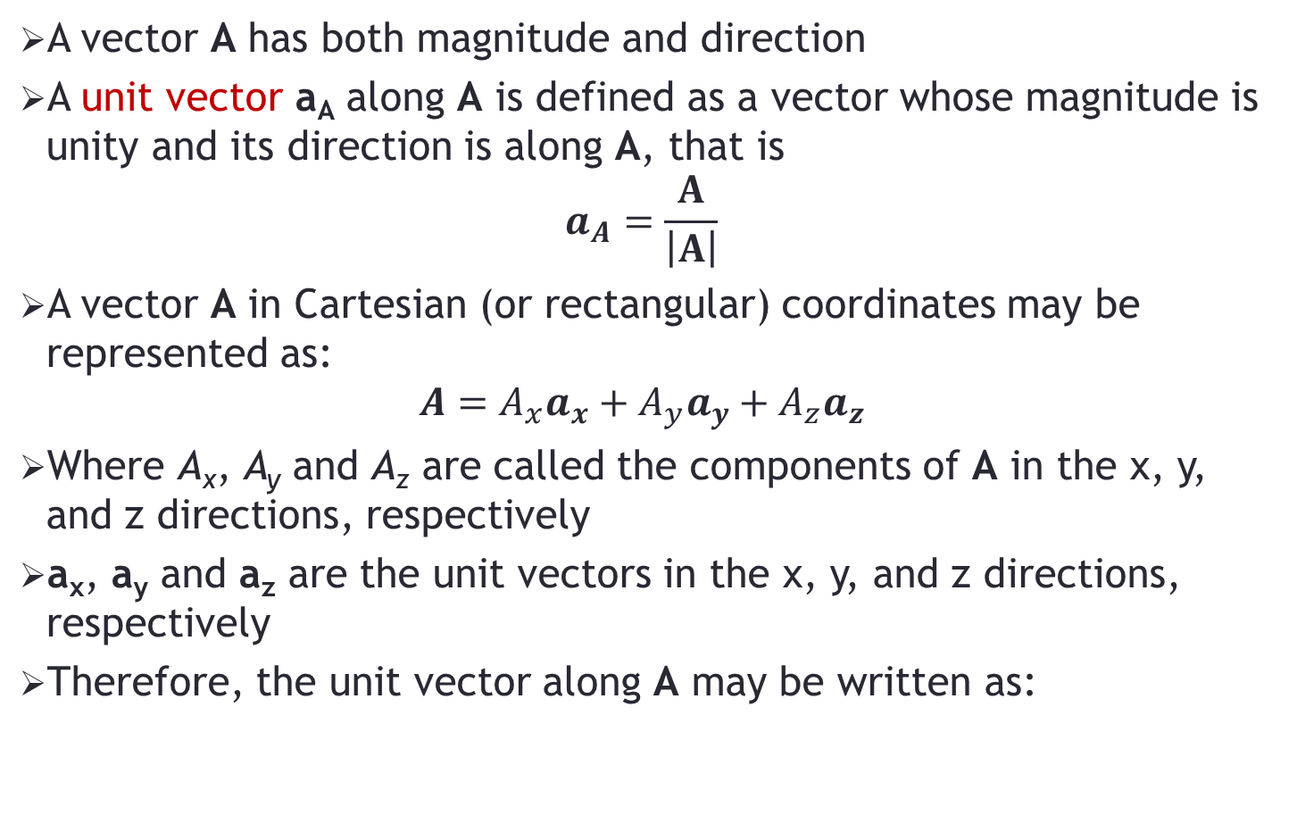
Scalars and Vectors
A vector A has both magnitude and direction
A unit vector a_{A} along A is defined as a vector whose magnitude is unity and its direction is along A, that is
$$a_{A}=\frac{A}{\left|A\right|}$$
A vector A in Cartesian (or rectangular) coordinates may be represented as:
$$A=A_{x}a_{x}+A_{y}a_{y}+A_{z}a_{z}$$
Where A_{x}, A_{y} and A_{z} are called the components of A in the x, y, and z directions, respectively
a_{x}, a_{y} and a_{z} are the unit vectors in the x, y, and z directions, respectively
Therefore, the unit vector along A may be written as:

Slide 5

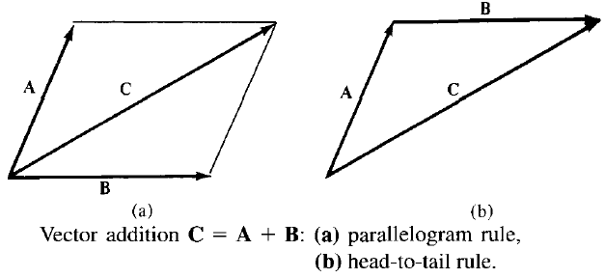
Vector Addition and Subtraction
Two vectors A and B can be added together to give another vector C, that is:
The vector addition is carried out component by component
Thus, if A = (A_{x}, A_{y}, A_{z}) and B = (B_{x}, B_{y}, B_{z}), then
Vector subtraction is similarly carried out as:

Slide 6
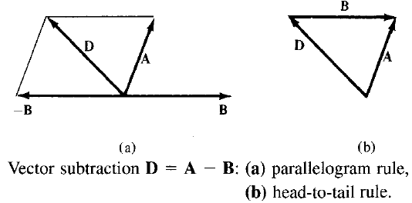
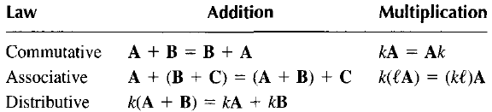
Vector Addition and Subtraction
The three basic laws of algebra obeyed by any given vectors A, B, and C, are summarized as follows:

Slide 7
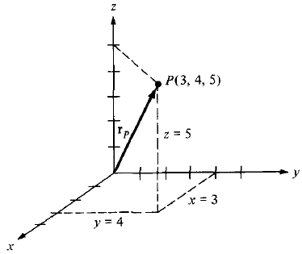
Position Vector
Point P in Cartesian coordinates may be represented by (x, y, z)
The position vector r_{p} (or radius vector) of point P is defined as the directed distance from the origin O to P, i.e.
For point (3, 4, 5), the position vector is shown in the figure

Slide 8

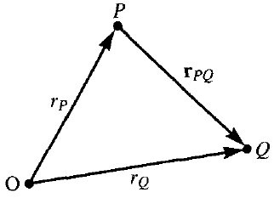
Distance Vector
The distance vector is the displacement from one point to another
For two points P and Q given by (x_{P}, y_{P}, z_{p}) and (x_{Q}, y_{Q}, z_{Q}), the distance vector (or separation vector) is the displacement from P to Q, that is:

Slide 9
Distance Vector
A vector field is said to be constant or uniform if it does not depend on space variables x, y, and z
For example, vector B = 3a_{x} — 2a_{y} + 10a_{z} is a uniform vector while vector A = 2xya_{x} + y²a_{y} — xz²a_{z} is not uniform
Both P and A may be represented in the same manner as (x, y, z) and (A_{x}, A_{y}, A_{z}), respectively
However, the point P is not a vector; only its position vector r_{P} is a vector

Slide 10


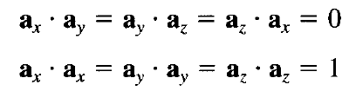
Vector Multiplication – Dot Product
The dot product of two vectors A and B, written as A • B, is defined geometrically as the product of the magnitudes of A and B and the cosine of the angle between them
Also called scalar product
If A = (Ax, Ay, Az) and B = (Bx, By, Bz), then
Note that:

Slide 11

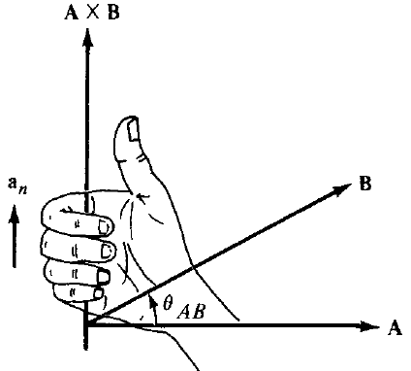
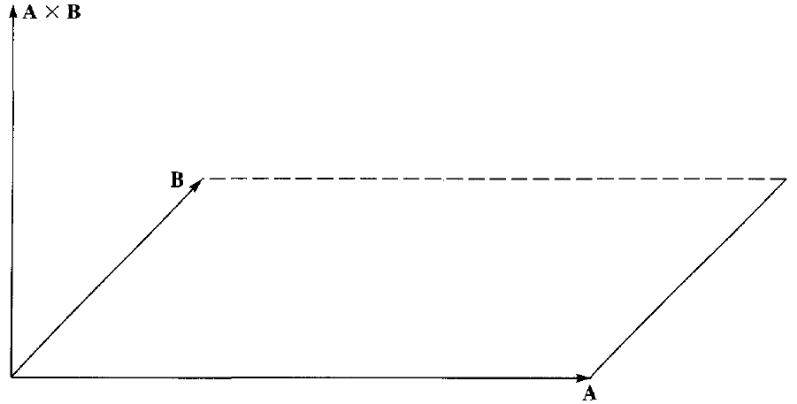
Vector Multiplication – Cross Product
The cross product of two vectors A and B, written as A x B, is a vector quantity whose magnitude is the area of the parallelopiped formed by A and B and is in the direction of the right thumb when the fingers of the right hand rotate from A to B

Slide 12
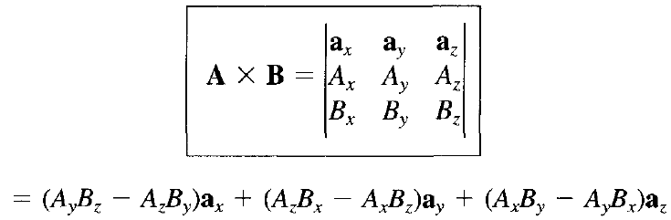
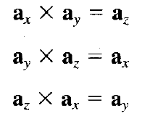
Vector Multiplication – Cross Product
If A = (Ax, Ay, Az) and B = (Bx, By, Bz), then
Note that:

Slide 13
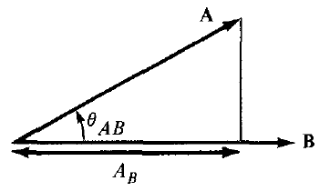

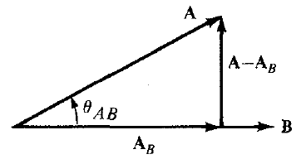

Components of a Vector
Scalar Component:
Vector Component:

Slide 14
Problem- 1
Let E = 3a_{y} + 4a_{z}, and F = 4a_{x} - 10a_{y} + 5a_{z}
(a) Find the vector component of E along F
(b) Determine a unit vector perpendicular to both E and F

